Slide 1

Decision Support System of Construction Tendering Using Analytical Hierarchal Process (ahp).
AHMAD NUZUL ASRAR BIN ABD RAHIM
2016317747

Slide 2



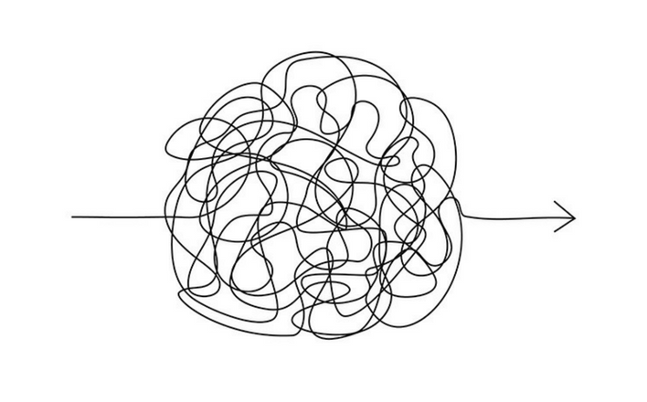


Problem Statement
ISSUES
WHY ADDRESS THE ISSUES?
Too complicated to compare criteria using values using an algorithm manually without a system.
Shorten evaluation time.
Make less mistakes.
More accurate results and values.
Compare tenderers per criterion.
Long amount of time to evaluate all the criteria from multiple tenderers.

Slide 3

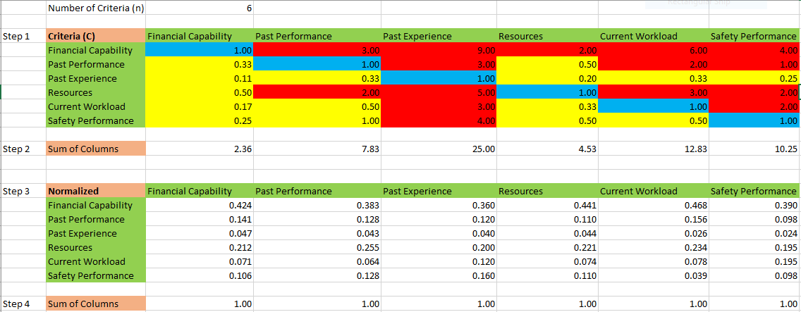
Objectives
1- To identify requirements in evaluating and analyzing the tender.
2- To develop a prototype system with complete rules, criteria and algorithm.
3- To evaluate the functions of the system by expert accuracy test and user testing.

Slide 4
Project Scope
This project will grant a construction contract to the best tenderer company that applied for it based on six criteria; financial capability, past performance, past experience, resources, current workload and safety performance of the company. The user will decide which criteria is more important using AHP when using the Decision Support System.
This eliminate the decision maker’s confusion if the tenderers score high in certain criteria, but low in other criteria.

Slide 5
Related and Similar Works
AUTHOR | TITLE | SCOPE | TECHNIQUE
Mohammed Balubaid, Rami Alamoudi (2015) | Application of the Analytical Hierarchy Process (AHP) to Multi-Criteria Analysis for Contractor Selection. | Contractor Selection | Analytical Hierarchy Process (AHP)
Ana Nieto-Morote, Francisco Ruz-Vila (2012) | A fuzzy multi-criteria decision making model for construction contractor prequalification | Contractor Prequalification | Fuzzy Set
N. J Smith, Martin Skitmore, S. T. Ng (1995) | Case-Based Reasoning for Contractor Prequalification - A Feasibility Study | Contractor Prequalification | Case-Based Reasoning
Michael Almeida (2017) | A Selection Method In Construction Project Management Using Analytic Network Process (ANP) As A Tool In Decision | Construction Project Management | Analytic Network Process (ANP)
Brenda McCabe, Viet Tran, and Joseph Ramani (2005) | Construction prequalification using data envelopment analysis | Contractor Prequalification | Data Envelopment Analysis (DEA)

Slide 6



Conceptual framework
AHP
MAKE
DECISION
Pair-Wise Comparison of Criteria
Criteria Weight
Pair-Wise Comparison of Alternatives for each Criterion
USES SYSTEM
INTERFACE
Multiply Criteria Weight with combined Alternative Priorities from every criterion
GAINED RESULT
Goal
Alternative Priorities for each Criterion
OUTPUT

Slide 7
Methodology framework
PHASE 1
PHASE 2
PHASE 3
PHASE 4
Preliminary Study
Data Analysis
Data
Collection
Prototype
Testing & Evaluation
Literature Review
Research
Report
Document
Secondary data
Criteria
Methods
Java GUI
AHP
Data Comparison
Consistency Test

Slide 8
data Collection
primary data Collection
SECONDARY data Collection
Interview Experts from Construction Company
  Engineers from JKR.
  Discuss Criteria.
  Get opinions from engineers to get the input values of AHP.
  Get agreement from experts on the importance of criteria.
Database from internet
  Video of AHP
  Construction Tendering Process Research
  Analytical Hierarchy Process Documents
  Application of AHP on Construction Tendering Projects
Report from Organization
  Pretender Process from Jabatan Kerja Raya (JKR)

Slide 9
Analytical hierarchy process
Value | Meaning
9 | Criteria A has been demonstrated to be more important than B.
8 | Between 7 and 9.
7 | Criteria A is thought to be, or demonstrated to be more important than B.
6 | Between 5 and 7.
5 | Criteria A is strongly more important than B.
4 | Between 3 and 5.
3 | Criteria A is moderately more important than B.
2 | Between 1 and 3.
1 | Criteria A and B is equally important.

Slide 10
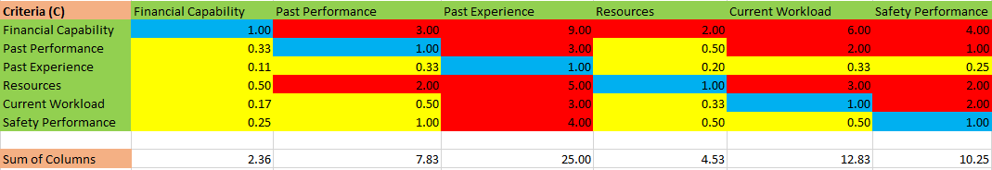
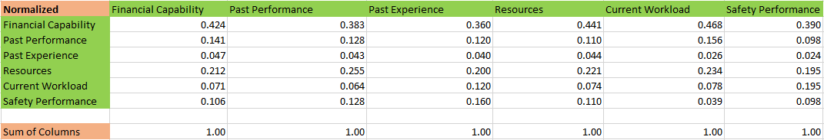
Data representation
1- Pair-Wise Comparison of 6 Criteria
2- Normalized Pair-Wise Comparison of Criteria

Slide 11
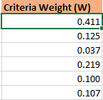
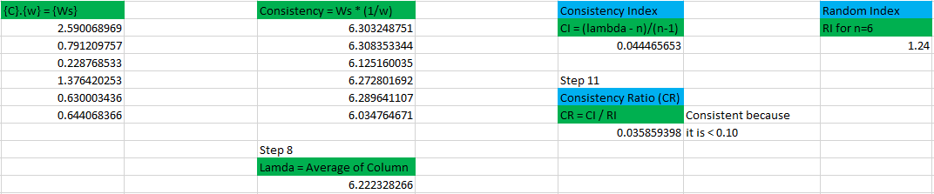
Data representation
3- Criteria Weight
4- Calculate consistency, to make sure our Pair-Wise Comparison is balanced.

Slide 12
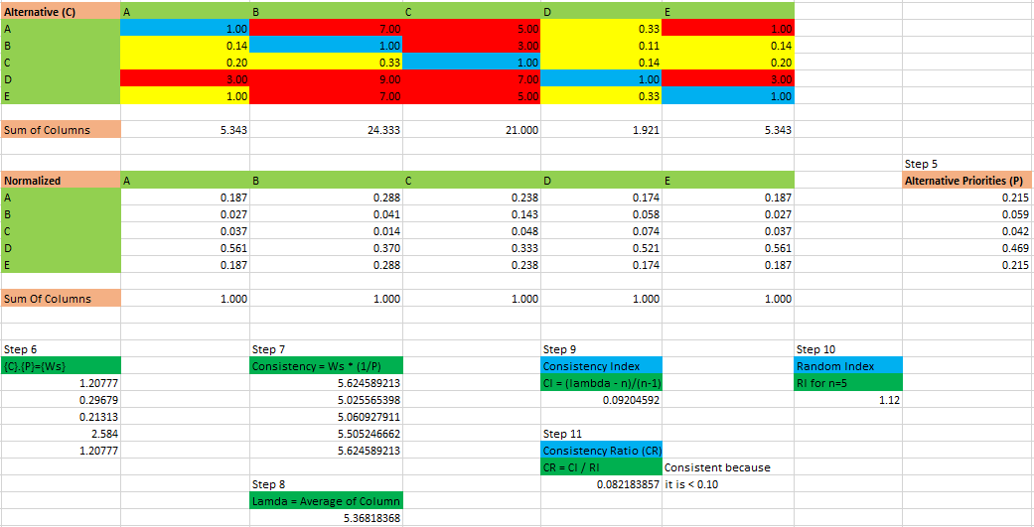
Data representation
5- Repeat Step 1 to 4 for each criterion
Alternative
Priorities

Slide 13
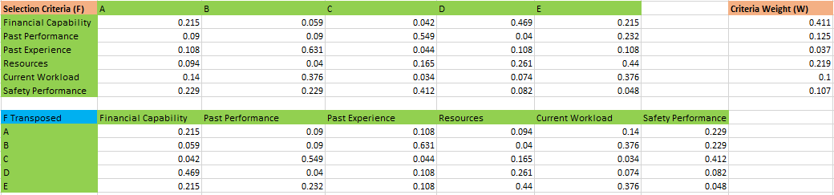
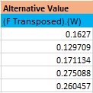
Data representation
6- Calculate result, Multiply Alternative Priorities X Criteria Weight
7- Get final result

Slide 14
Ahp hierarchy model
Logical design
goal
Step 1 – Develop a model to clarify our goal, and how to achieve it
Best Tenderer
criteria
Financial Capability
Current
Workload
Safety
Performance
Performance
Experience
Resources
alternatives
Tenderer 1
Tenderer 2
Tenderer 3
Tenderer 4
Tenderer 5

Slide 15
Pair-Wise comparison of criteria
PAST
PERFORMANCE
CURRENT
WORKLOAD
Decision Maker has to know the rank of all criteria from the most important to least important by comparing each criterion to one another.
The output (ranking)of this process is called Criteria Weight in AHP.
PAST
EXPERIENCE
SAFETY PERFORMANCE
RESOURCES
FINANCIAL
CAPABILITY

Slide 16
Criteria Weight
Criteria Weight is the ranking of the criteria from most important to least important based on the comparison made by the user (decision maker).
If the user is not satisfied with the ranking, the user can redo the Pair-Wise Comparison of the criteria again
1-
FINANCIAL CAPABILITY
2-
RESOURCES
3-
PAST PERFORMANCE
4-
SAFETY PERFORMANCE
5-
CURRENT WORKLOAD
6-
PAST EXPERIENCE

Slide 17
Pair-Wise comparison of alternatives per criterion
FINANCIAL CAPABILITY
This process is important to rank every alternative (tenderer) for every criteria.
RESOURCES
Tenderer 1
Tenderer 2
Tenderer 3
Tenderer 1
SAFETY PERFORMANCE
CURRENT WORKLOAD
Tenderer 2
Tenderer 1
Tenderer 2
Tenderer 3
Tenderer 3
Tenderer 1
Tenderer 2
Tenderer 3
PAST EXPERIENCE
PAST PERFORMANCE
Tenderer 1
Tenderer 2
Tenderer 3
Tenderer 1
Tenderer 2
Tenderer 3

Slide 18
Alternative Priorities
FINANCIAL CAPABILITY
RESOURCES
Alternative Priorities is the ranking of the tenderers for every criteria.
1-
1-
Tenderer 1
Tenderer 2
2-
Tenderer 1
2-
Tenderer 2
CURRENT WORKLOAD
3-
Tenderer 3
3-
Tenderer 3
1-
Tenderer 2
SAFETY PERFORMANCE
PAST EXPERIENCE
2-
Tenderer 3
1-
Tenderer 3
… …. …
3-
Tenderer 1
2-
Tenderer 2
PAST PERFORMANCE
3-
Tenderer 1
… …. …

Slide 19
CALCULATE RESULTS
FINANCIAL
CAPABILITY
RESOURCES
PAST
PERFORMANCE
Multiply (Combined Alternative Priorities from all criteria) with (Criteria Weight) to get the best tenderer according to AHP algorithm
Tenderer 2
Tenderer 1
Tenderer 2
Tenderer 1
Tenderer 2
Tenderer 3
Tenderer 3
Tenderer 3
Tenderer 1
FINANCIAL
CAPABILITY
SAFETY
PERFORMANCE
SAFETY
PERFORMANCE
PAST
EXPERIENCE
X
CURRENT
WORKLOAD
PAST
EXPERIENCE
CURRENT
WORKLOAD
Tenderer 3
Tenderer 2
Tenderer 2
Tenderer 2
Tenderer 3
Tenderer 3
PAST
PERFORMANCE
RESOURCES
Tenderer 1
Tenderer 1
Tenderer 1

Slide 20
Best tenderer (goal)
Final Result is obtained by ranking the best tenderer according to AHP
1-
Tenderer 3
2-
Tenderer 1
3-
Tenderer 2

Slide 21
Experiment setup
AHP Values Table
Data set of tenders to be evaluated
Computer
System software with complete algorithm
System Developer
Engineer Expertise

Slide 22
Result analysis
(data by expert – JKR Engineer)

Slide 23
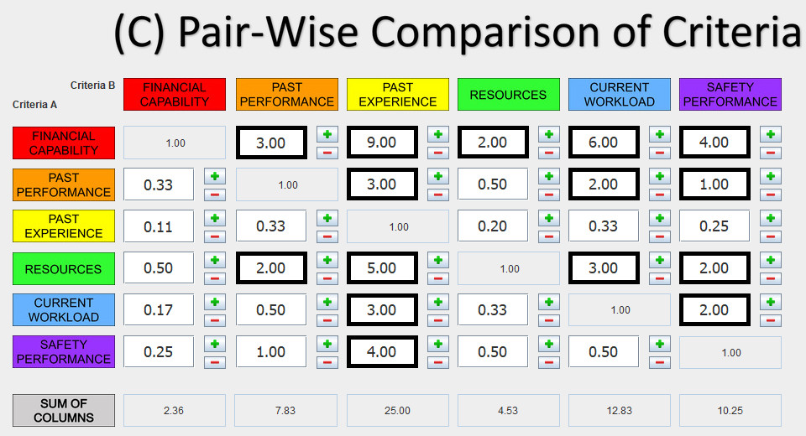
Pair-Wise Comparison of criteria (C)

Slide 24
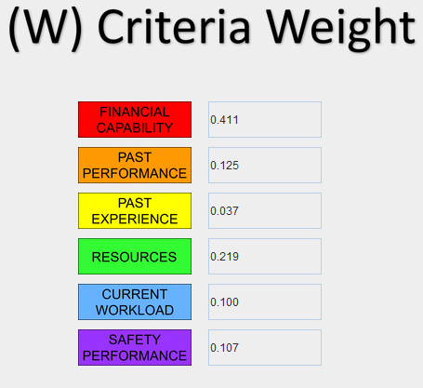
Criteria weight (w)

Slide 25
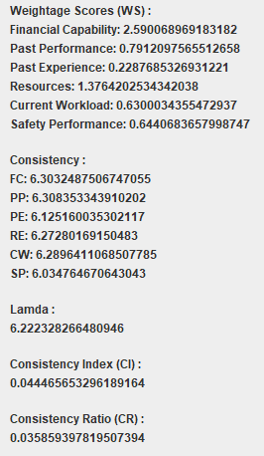
Consistency test of table c
Consistency ratio (cr) for table c is below 0.1 which means that the comparison of criteria in table c is consistent.
consistency test window interface are plain and simple as shown on the picture at the right since this test is a display of outputs and involved no inputs from the user.

Slide 26
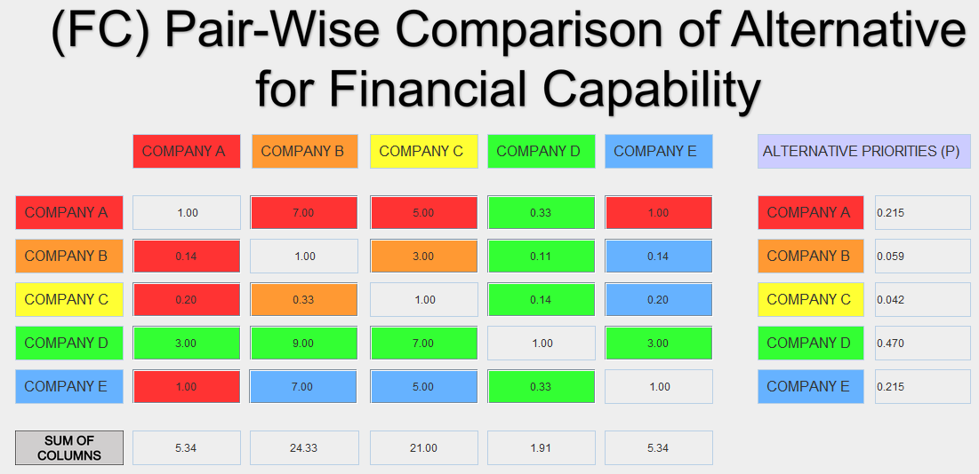
Pair-Wise Comparison of alternative for financial capability (fC)

Slide 27
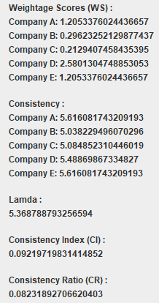
Consistency test of table fc
consistency ratio (cr) is < 0.1
Consistent!

Slide 28
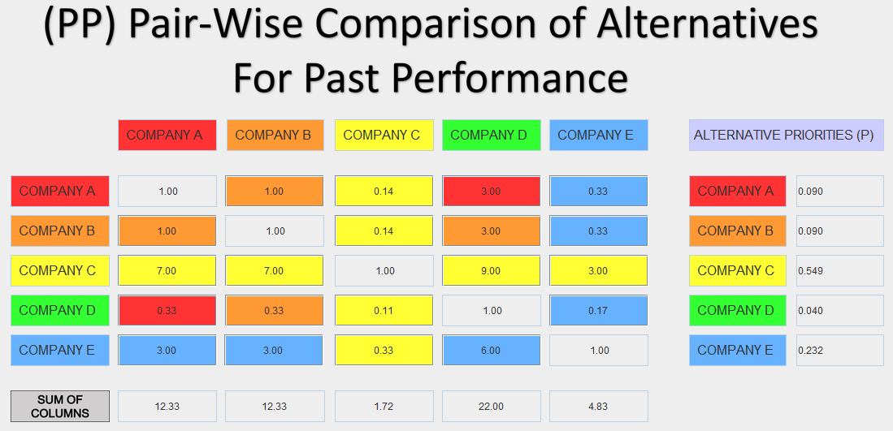
Pair-Wise Comparison of alternative for past performance (pp)

Slide 29
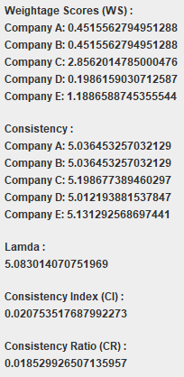
Consistency test of table pp
consistency ratio (cr) is < 0.1
Consistent!

Slide 30
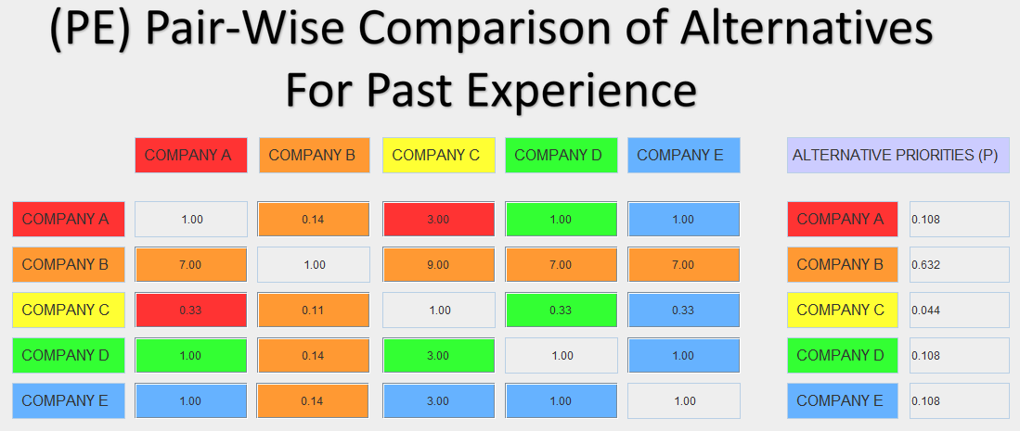
Pair-Wise Comparison of alternative for past experience (pe)

Slide 31
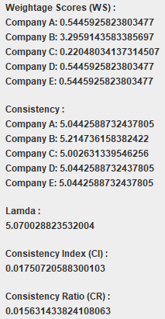
Consistency test of table pe
consistency ratio (cr) is < 0.1
Consistent!

Slide 32
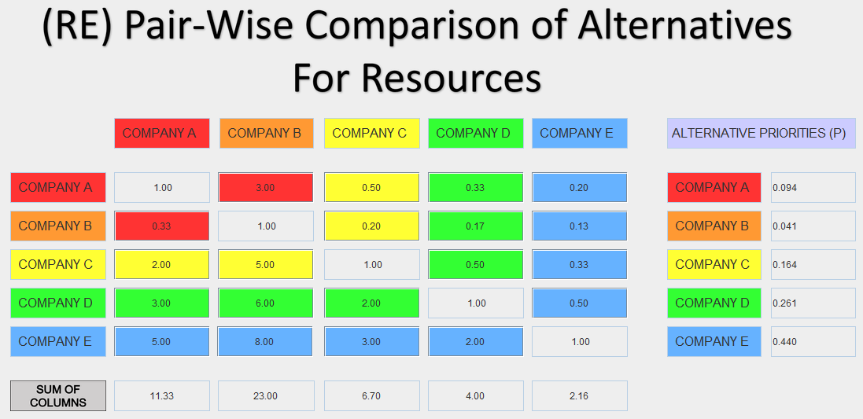
Pair-Wise Comparison of alternative for resources (re)

Slide 33
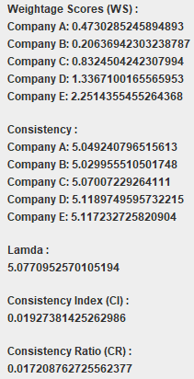
Consistency test of table re
consistency ratio (cr) is < 0.1
Consistent!

Slide 34
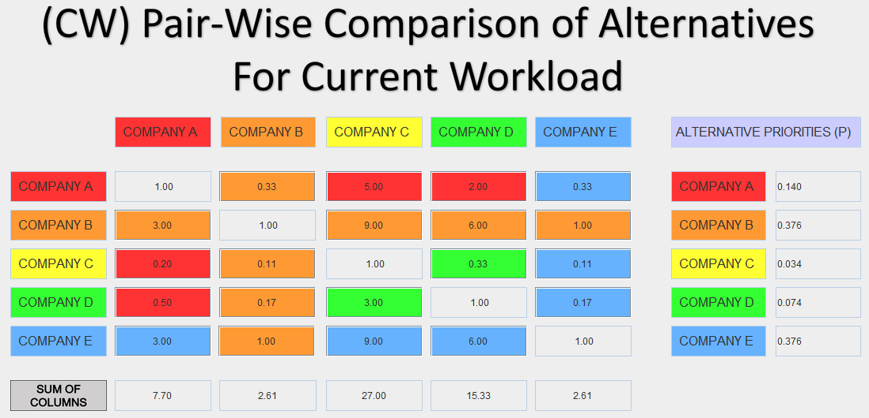
Pair-Wise Comparison of alternative for current workload (cw)

Slide 35
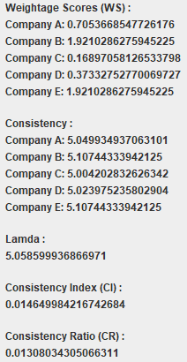
Consistency test of table cw
consistency ratio (cr) is < 0.1
Consistent!

Slide 36
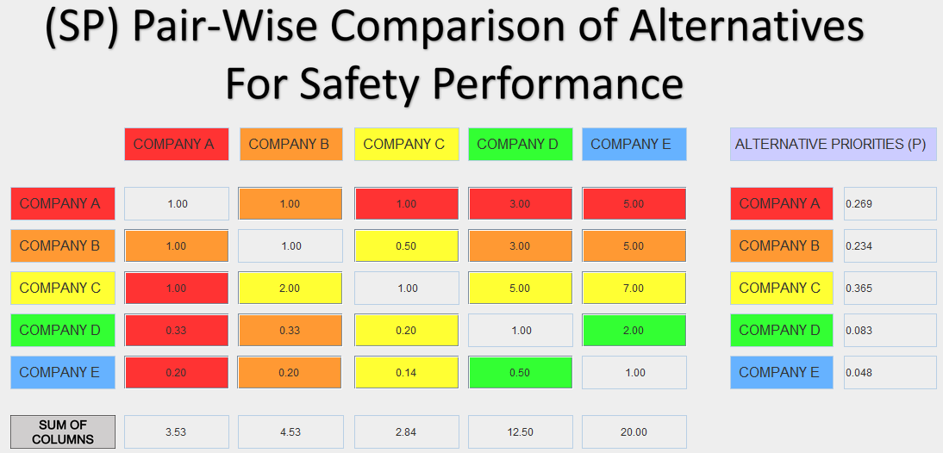
Pair-Wise Comparison of alternative for safety performance (sp)

Slide 37
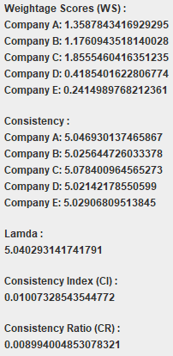
Consistency test of table sp
consistency ratio (cr) is < 0.1
Consistent!

Slide 38
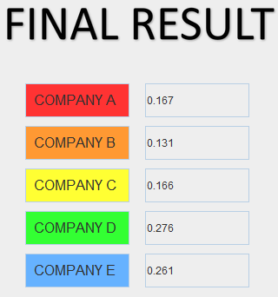
Final result

Slide 39
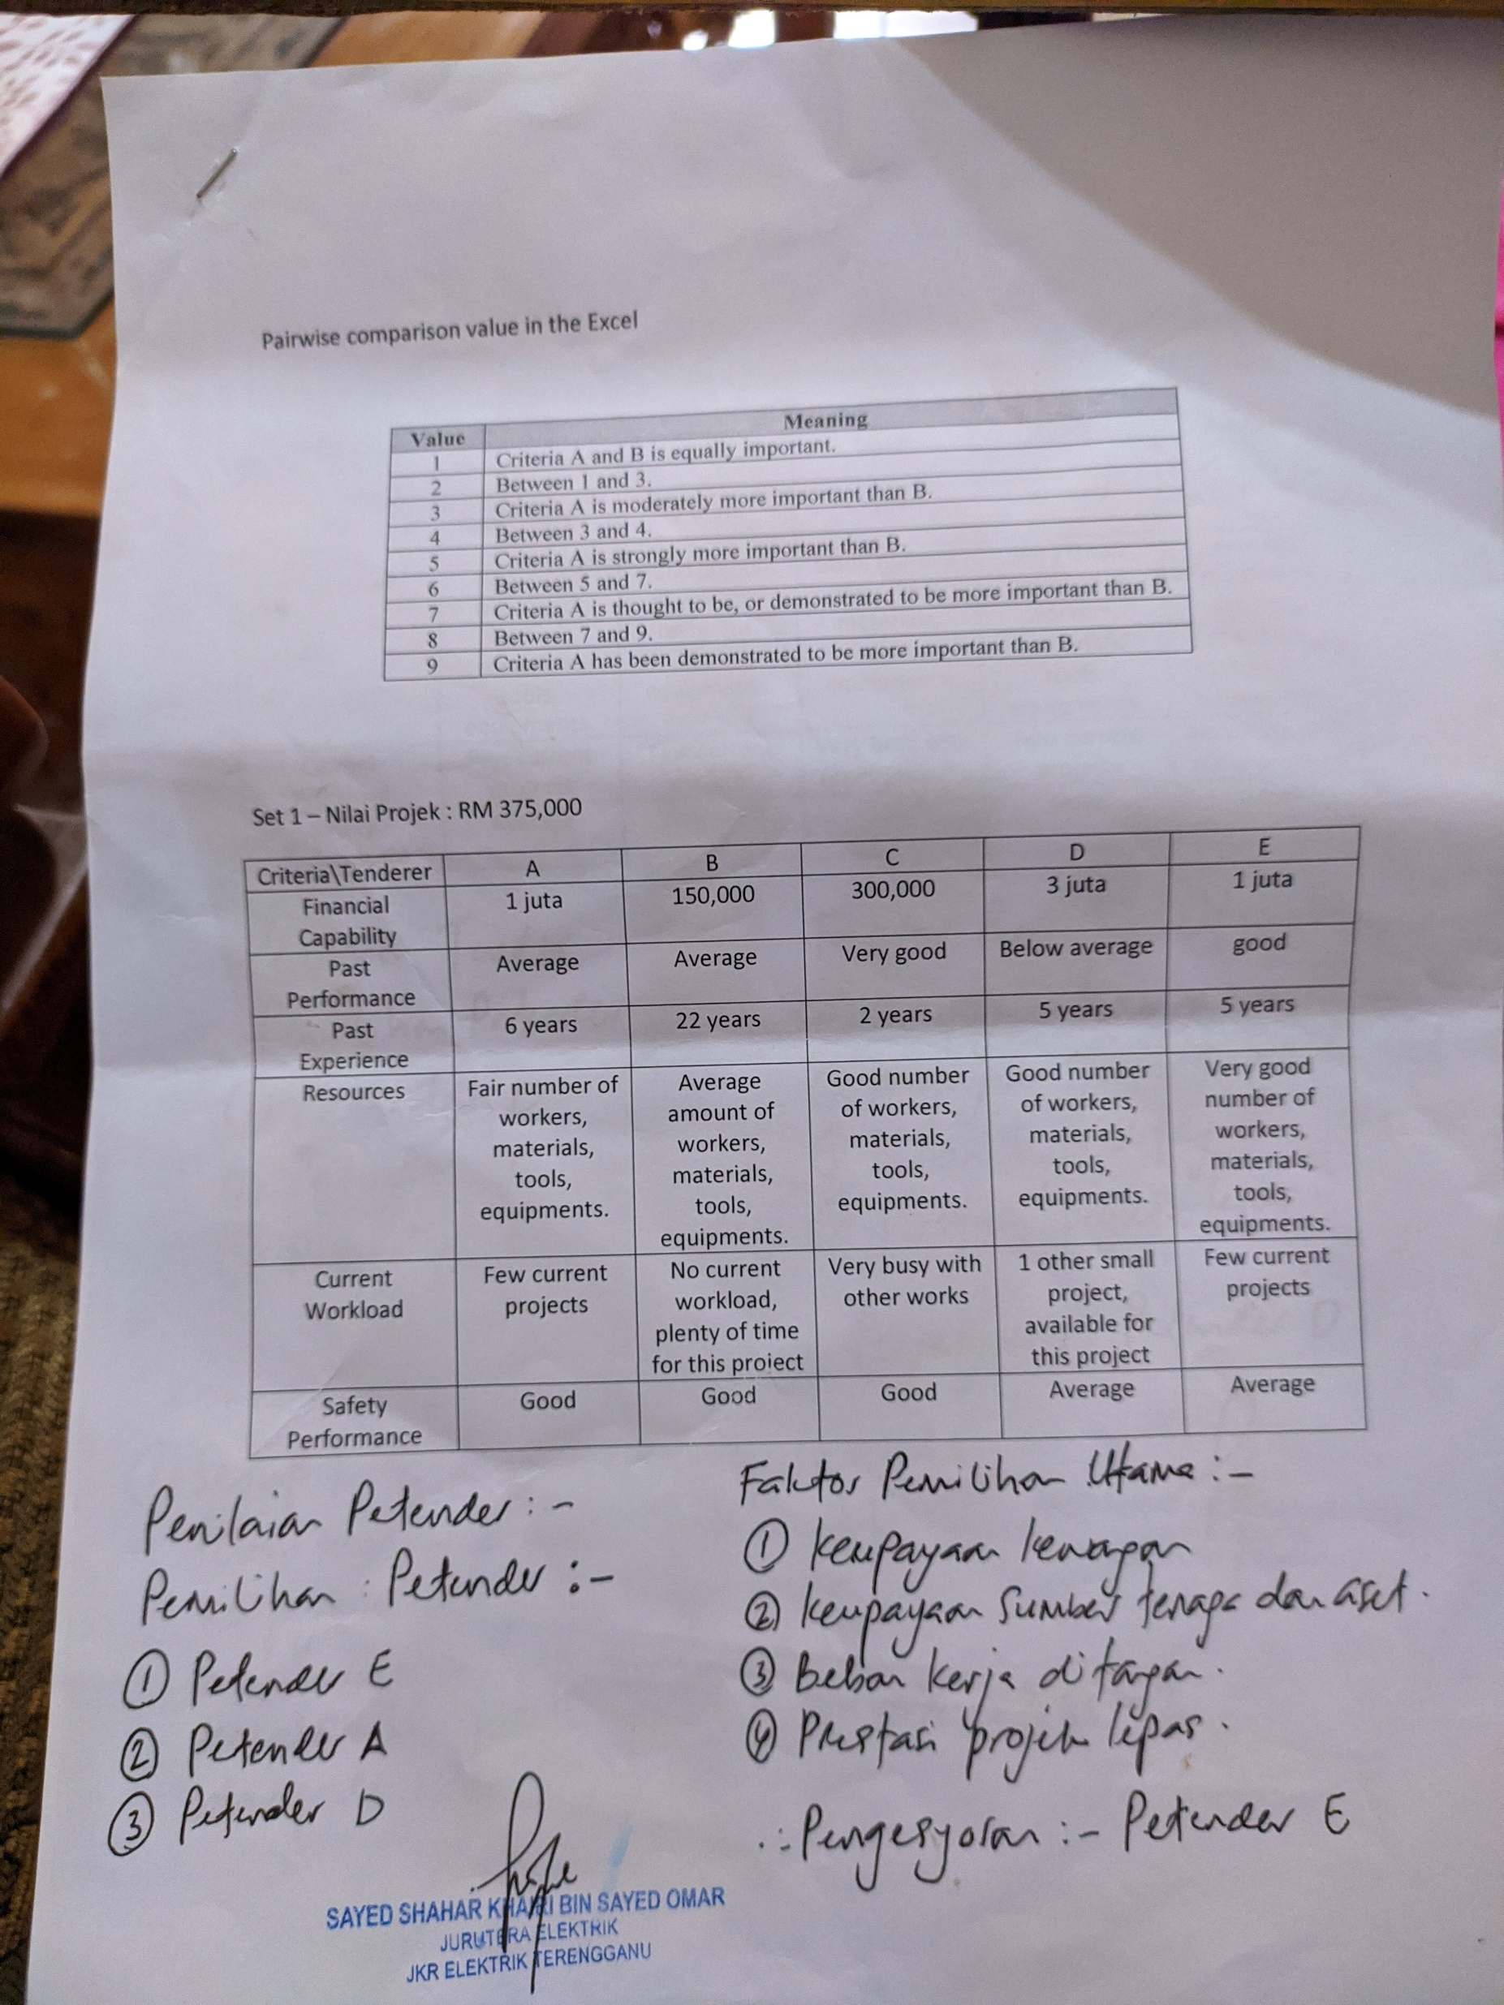
Expert’s manual comparison without using system and ahp algorithm

Slide 40
Experts’ criteria analysis
Ranking | Expert 1 Choice | Expert 2 Choice | Criteria Choice Ranking from Literature Review and Researches | Experts’ Choice Similarity with The Project Proposal
1- | Financial Capability | Financial Capability | Financial Capability | 2/2
2- | Resources | Resources | Resources | 2/2
3- | Current Workload | Current Workload | Past Performance | 0/2
4- | Past Performance | Past Performance | Current Workload | 0/2
5- | Safety Performance / Past Experience | Safety Performance / Past Experience | Safety Performance | 2/2
6 | Safety Performance / Past Experience | Safety Performance / Past Experience | Past Experience | 2/2

Slide 41
Experts’ TENDERER CHOICE analysis
Expert 1 Choice | Expert 2 Choice | AHP Ranking No. | AHP Suggestion | AHP Score
Tenderer E | Tenderer E | 1- | Tenderer D | 0.276
 |  | 2- | Tenderer E | 0.261
 |  | 3- | Tenderer A | 0.167
 |  | 4- | Tenderer C | 0.166
 |  | 5- | Tenderer B | 0.131
 |  | TOTAL |  | 1.00

Slide 42
Only for 1 level of criteria, no sub criteria
Cannot inmport input and export output for now

Slide 43
Conclusion
Type | Advantage | Disadvantage
Human | Ability to know the information of tenderer when applied into real life based on knowledge and experience that only humans are capable of. | Humans may have uncertainty and prone to make even the slightest mistake when dealing with large number of alternatives (eg: 12 tenderers to be evaluated) and have a tendency to make decisions based on feelings that might be slightly unfair.
AHP Algorithm | Rank the selection of alternatives based on human input without bias throughout the steps of comparing the alternatives. | An algorithm only shows the actual data and fact that sometimes only human would know how to interpret on what is best or not for a particular construction project.

Slide 44
Thank YOU ☺

