Slide 1
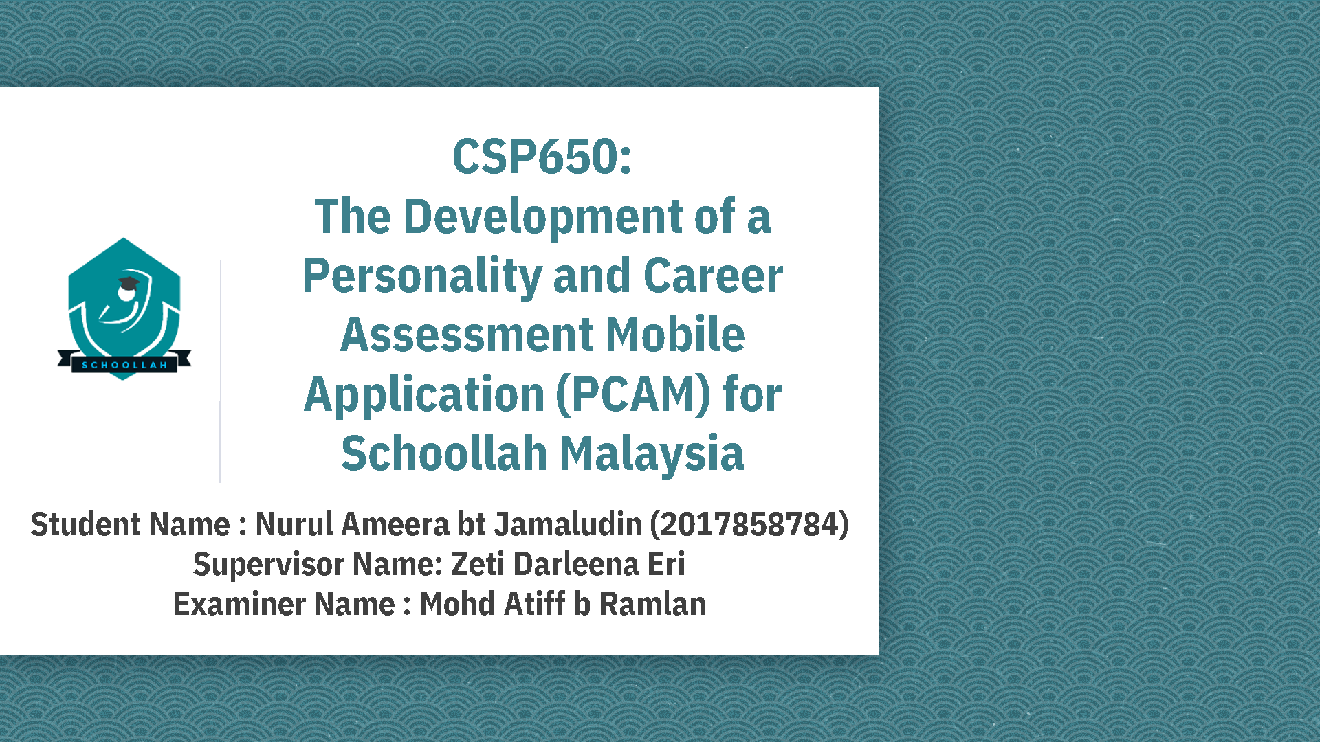

Slide 2
Background of Study
Case Study: Schoollah Malaysia
Domain: Higher Education in Malaysia
AoI: Mobile Application (M-Learning)
Theory: RIASEC Theory Model
Proposed Solution
Problem | Proposed Solution
1. Unorganised structure of former platform (ie WhatsApp, social media) | Mobile application for the organisation
2. Mismanagement issue faced by the organisation | Storing the data in a database for easy access by the organisation
3. Time consuming between the organization and audience | RIASEC Test, and structured feature of mobile application
Problem Statement
1. Unorganised structure of former platform
2. Mismanagement issue faced by the organisation
3. Time consuming between the organisation and audience
Objectives
To identify the requirements of PCAM for Schoollah Malaysia
To design and develop PCAM for Schoollah Malaysia.
To evaluate the functionality of PCAM for Schoollah Malaysia.

Slide 3
Case Study
Schoollah Malaysia was started from WhatsApp in 2014. The founder started to set up a WhatsApp group aimed at current SPM-leavers to raise awareness and exposure of students interested in higher-level education. WhatsApp Group of Schoollah Malaysia has been continuously created for SPM-leavers on a year-by-year basis. He started on his own but continued to appoint committees to assist him.
After a few years, Schoollah Malaysia was registered for branding purposes. Social media accounts such as Facebook, Twitter and Instagram were created for Schoollah Malaysia. The social media approach was chosen because social media was proved to be more effected. This is because majority students spend most of their free time on social media. His statement can be proven by Malaysian Communications and Multimedia Commission (MCMC), (2018); around 24.6 million social networking Malaysian users in 2018, out of the total users, 97.3 percent of total users owned a Facebook account, followed by 57 percent users owned an Instagram account and 48.3 percent of users watched YouTube.

Slide 4
Theory
RIASEC Theory Model | How it is implemented
Characteristics | Implementation in the system
1. Personality and Career Assessment based on RIASEC Theory Model | Implementation of RIASEC Test
2. Combination of six personality types of RIASEC Theory Model | The users’ receival of RIASEC Code, and recommended courses based on their RIASEC Code

Slide 5
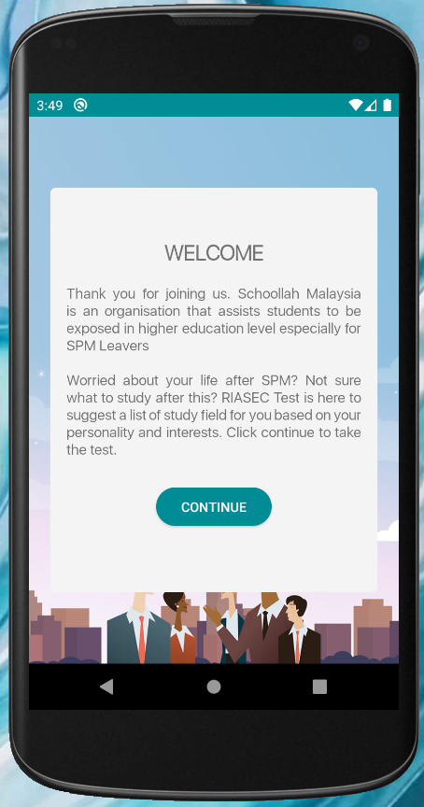
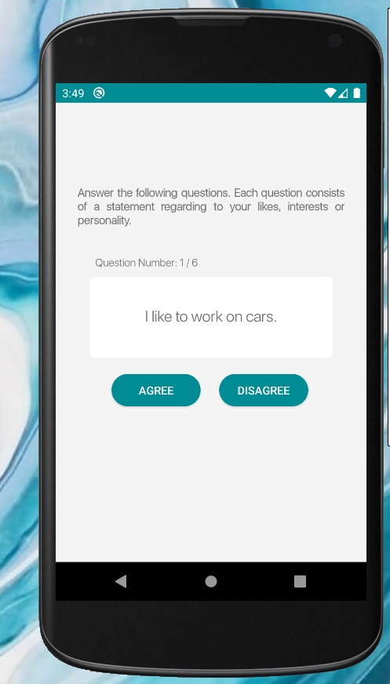
Characteristic 1: Personality and Career Assessment based on RIASEC Theory Model
Implementation : the implementation of RIASEC Test is based on the RIASEC Theory Model proposed by Holland in 1973. The RIASEC Test is an assessment to determine the person’s career based on their personality and skills.

Slide 6
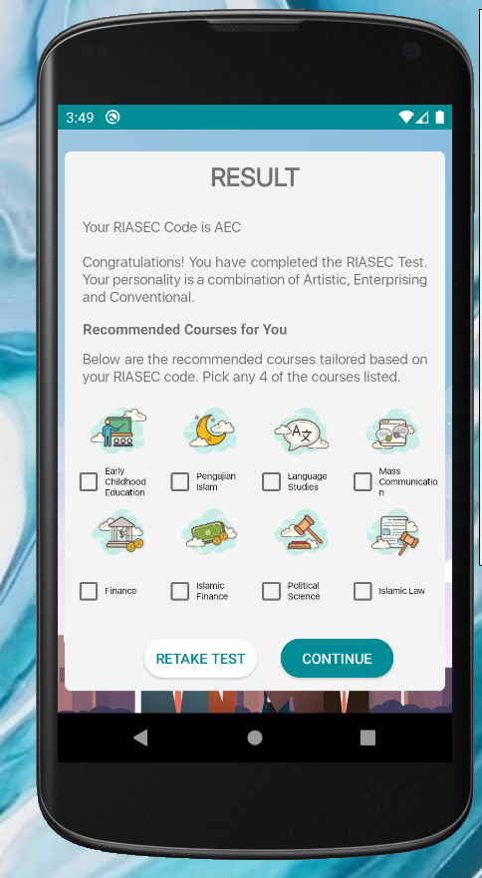
Characteristic 2:
Combination of six personality types of RIASEC Theory Model
Implementation :
  The users’ receival of RIASEC Code – the user receives RIASEC Code which consists of a combination of 6 personality type based on the RIASEC Theory Model
  recommended courses based on their RIASEC Code – upon receiving the RIASEC Code, the user received a list of courses recommended for them.

