Slide 1

V-Lab Online Inventory
System (VOIS)
By:
MUHAMMAD KHAIRUL ZAMIR BIN MOHAMAD RAFI
SUPERVISOR’S NAME:
MADAM UMMU FATIHAH BINTI MOHD BAHRIN

Slide 2
Problem Statement
The staff did not know how many stocks are left and what items should they buy
  difficult in control the quantity of product
  to make sure that product not less than minimum level
The staff needs more books for data stocks
  difficult finding the file of supplier (product)
  need check one by one before order
The staff did not know how many supplier’s queues order
Background of Study
Case Study: V-Lab Printing and Service
Area of Interest: Inventory Management System
Domain: Business
Theory: User Interface Design

Slide 3
Objectives
To identify the current business process and problems requirement an inventory for V-Lab.
To design and develop an inventory system for V-Lab Online Inventory System (VOIS).
To evaluate functionality and usability of the system for the proposed system.

Slide 4
Current Business Process
Inventory management system is a real-time inventory database capable of connecting multiple stores. This can be used to track the inventory of a single store, or to manage the distribution of stock between several branches of a larger franchise.
Staff need check the materials of the product which available or not, or in good condition or not and know how many stocks are left when checking the materials.
The staff need the approval from the manager to proceed the order processing. The stock in will input after getting the approval from manager..
The stock has arrived after a few days waiting. The staffs need to update the stock order using the manual system by writing on the notebook or paper.

Slide 5
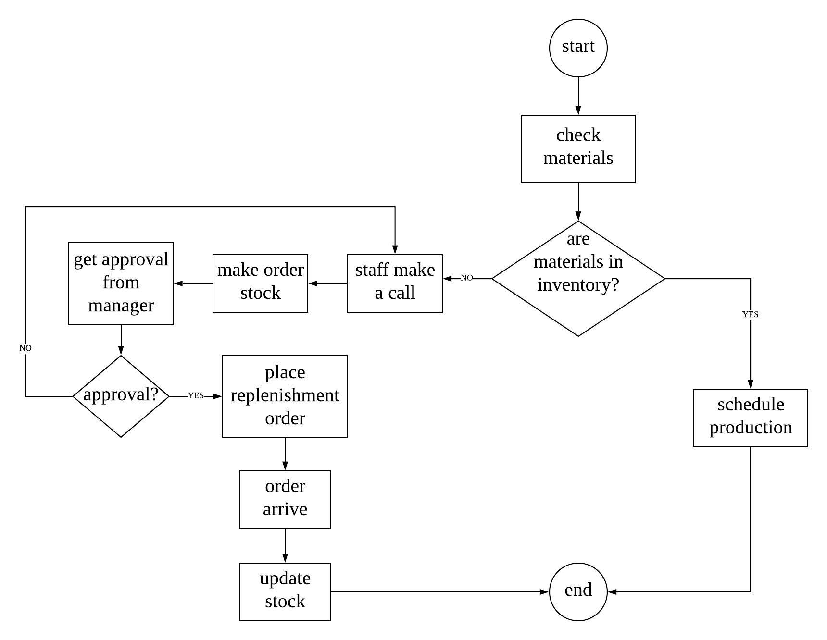
2
1
Flow of Current Business Process
3

Slide 6
Proposed Solution
Problem | Proposed Solution
The staff did not know how many stocks are left and what items should he/his buy | Using this system, the staff can view the list of product with the amount of quantity An alert notification will appeared on the dashboard page for the product that has been out of stock.

Slide 7
Problem | Proposed Solution
2. The staff needs more books for data stocks | By develop the system, the staff easy to store data of the quantity taken and input the amount of quantity that need to restock The staff easy to manage the order product that have minimum level.
3. The staff did not know how many supplier’s queues order | By develop the system, the staff, supplier and manager can view the list of order that has been made by staff. The manager and supplier can change the status order. .

Slide 8
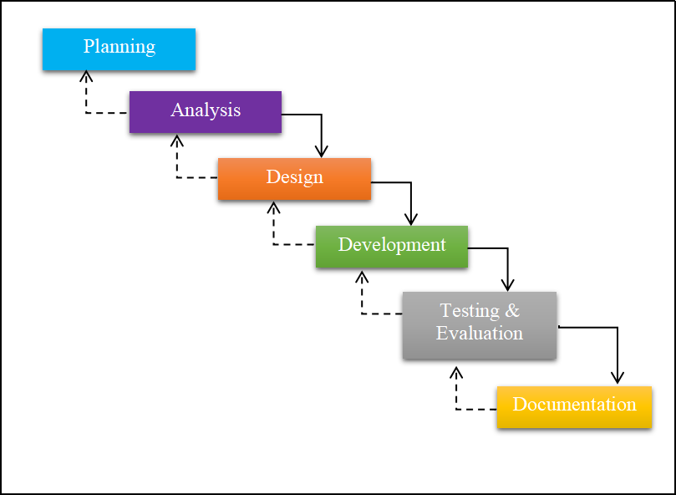
Interview
Brainstorming
Research
Analysis and fact finding
Exdraw Max 7
Star UML
Microsoft Visio 2013
Adapted
Waterfall model.
XAMPP
Google Chrome
Test Plan
Questionnaire
Microsoft Word 2010

Slide 9



Theory: User Interface Design
Principle | How it is implemented
User familiarity | the interface should be based on user-oriented terms and concepts rather than computer concepts. For example, system use concepts such as letters, documents, folders etc., rather than directories, file identifiers, etc.

Slide 10
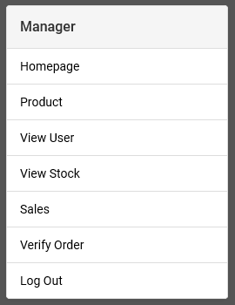
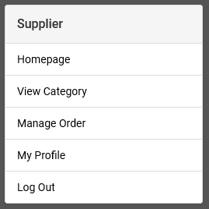
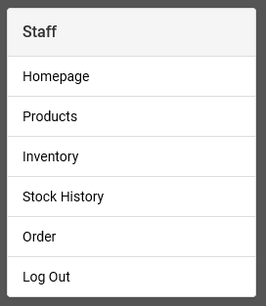
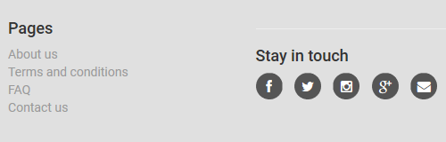
Principle | How it is implemented
Consistency | the system should display an appropriate level of consistency. Commands and menus should have the same format command punctuation should be similar, etc.

Slide 11

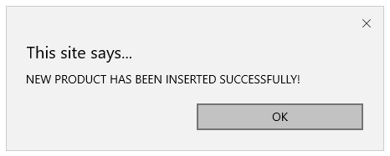
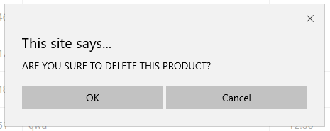
Principle | How it is implemented
Recoverability | the system should provide some resilience to user errors and allow the user to recover from errors. This might include an UNDO facility, confirmation of destructive actions, 'soft' deletes, etc.

Slide 12



Principle | How it is implemented
User guidance | some user guidance such as help systems, online manuals, etc. should be supplied.

Slide 13
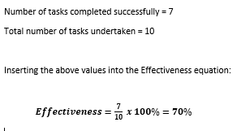
Result & Findings

Slide 14
Limitation
The system has been developed where achieved all the phase.
There are some limitations:
  graph of the flow of stock in and out
  total amount of sales that month.
  The users cannot update their personal information include staff, manager and supplier.
  The manager cannot register the supplier and staff.
Recommendation
  There are suggestions for VOIS system and the future:
    registration details of user
    message not generated to indicate condition
    add graph to view the flow in and out of stock product
    the database of the system can be improved.

Slide 15
Conclusion
In conclusion, discussed about the contribution of the project and the limitation of the project which is inventory management system.
The objective was achieved by completing the task according to the method use as a guideline in developing the system.
All the phases of the development have been done, the documentation phases need to be complete by documenting all the result and the analysis about the system that has been developed.
The data collected from the user feedbacks are recorded and analyze to help in improving the system.
The future enhancement and the suggestion from the expert should be used in order to make the functionality and usability of the system can be used without any problem.

Slide 16



