Slide 1
Contractor selection using fuzzy ahp and topsis algorithms
By: Nur fadhlina binti abu bakar ashe’ari (2017897726)
Supervisor: sir mohd hanapi bin abdul latif

Slide 2
Problem Statement
Issues to be address
Contractor selection on basis of the familiarity (Ting & Chin, 2013)
Preferred criteria different from those obtained in the literature in selecting contractor (Ting & Chin, 2013)
Cheapest tenderers (Huang, 2011)
Reasons to address this issues
Decision support system lessens perplexity and uncertainty
Choose the contractor that scores most
An organizations needs to settle on a proper choices for an achievement of project
Focuses on cost, time and quality of the project (Idrus et al. 2011)
Proposed Solution
Rank the contractors
A system would rank the contractor which help the decision maker

Slide 3
Objectives
To identify requirement in analysing and evaluating the contractor selection
To develop a system with complete rules, criteria and by using Fuzzy AHP and TOPSIS algorithms.
To evaluate the contractor selection system by using functionality test

Slide 4
Scope of the Study
Procurement Department
Transpetro Sdn Bhd, Johor Bahru
Rank the contractor selection
Rank the contractor using Fuzzy AHP and TOPSIS
Fuzzy AHP: obtain weights of the evaluation criteria
TOPSIS: ranking the selected contractor
That have been chosen by the procurement department
Criteria will be used cost, time and quality and past performance

Slide 5
Related Work on Fuzzy AHP and TOPSIS algorithm based on Contractor Selection

Slide 6
Algorithms Characteristic | AHP | Fuzzy AHP | Fuzzy AHP | TOPSIS | TOPSIS and VIKOR
Purpose | Identify contractors with the best potential in a final contractor selection | Select the best construction contractor for Tehran university technical office | Select the best contractor | Lowest bid criterion in contractor selection process | Selection of a contractor for a road building project.
Strength | Flexible and easy to implement | Help decision makers to add or omit any factors according to decision making context. | Effective tools to select the best contractor | Simple to apply simple to understand. | TOPSIS-this contractor is the best in terms of the ranking index VIKOR-indicates that it is the closest to the ideal solution
Weakness |  | Ignore another factors that also important in contractor selection |  | There is no way to check for Consistency
Author(s) | (Fong & Choi, 2000) | (Gholipour et al., 2014) | (Zamani et al., 2013) | (Alptekin & Alptekin, 2017) | (San Cristóbal, 2012)

Slide 7
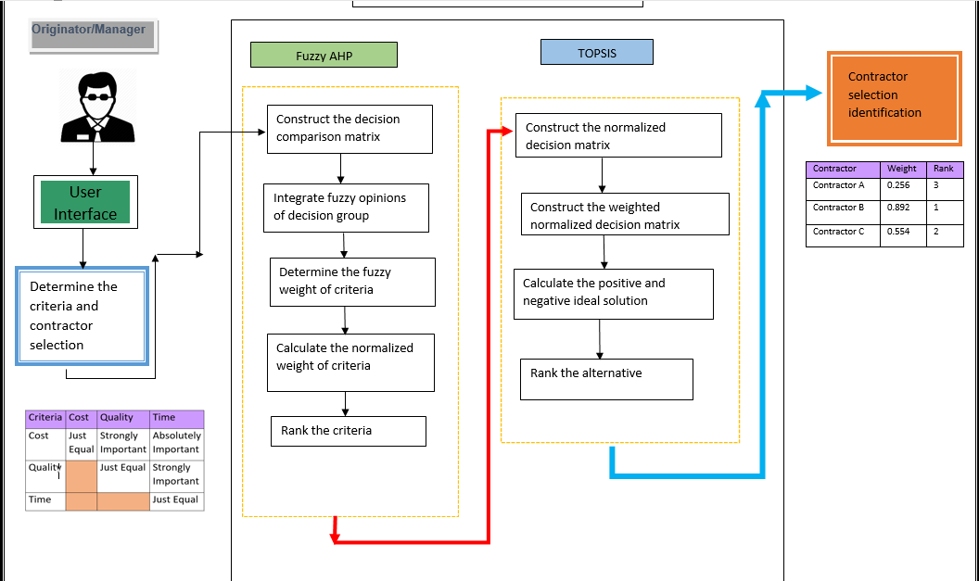
Contractor Selection using Fuzzy AHP and TOPSIS algorithms Conceptual Framework

Slide 8
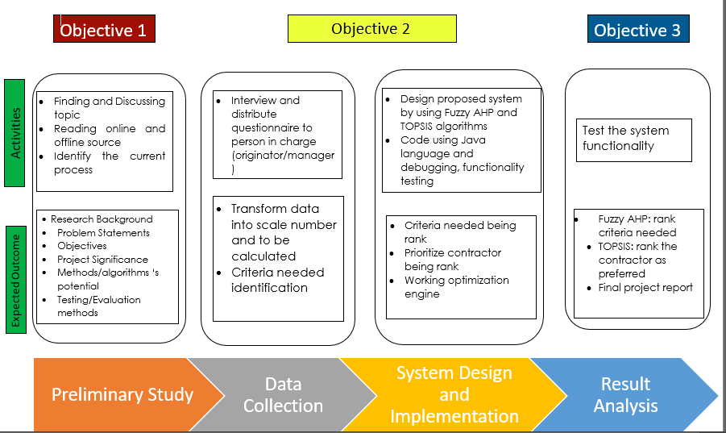
Contractor Selection Methodology Framework

Slide 9
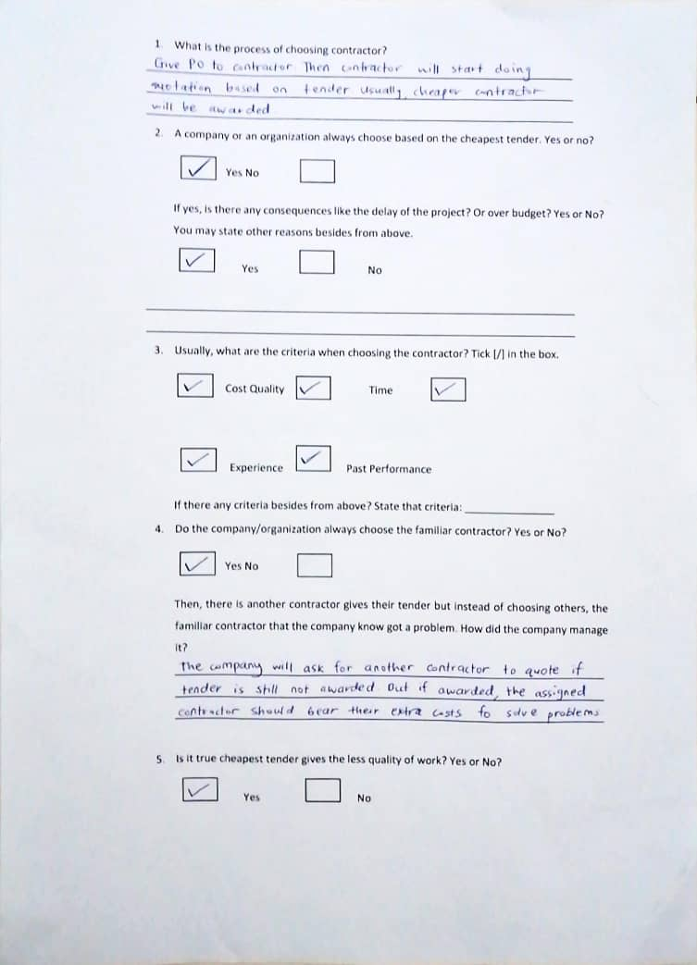
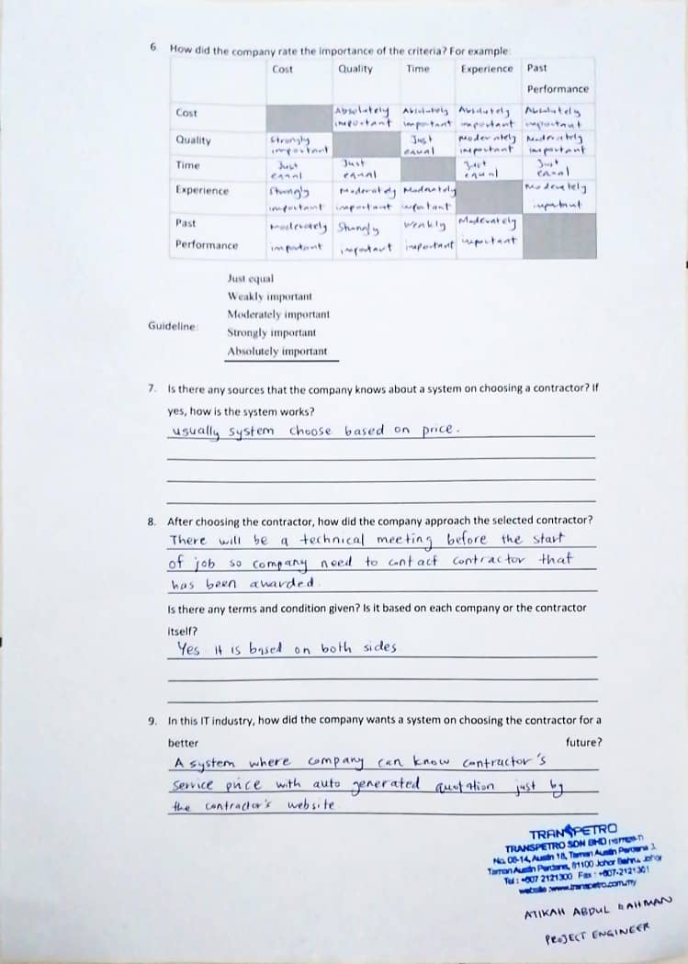
Data Collection (from interview)

Slide 10
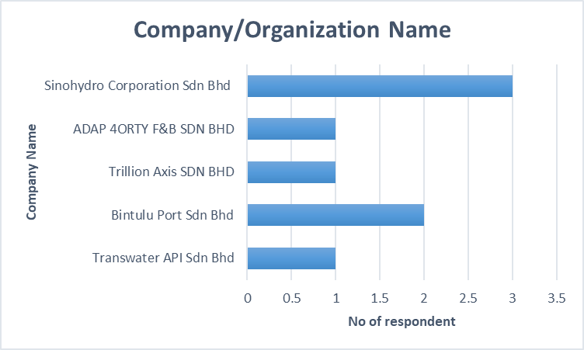
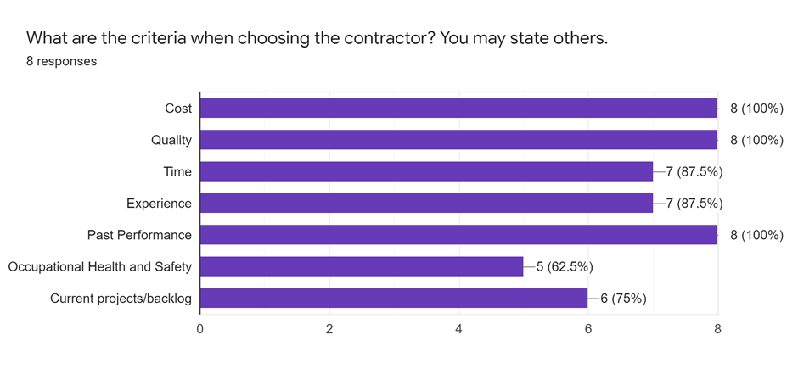
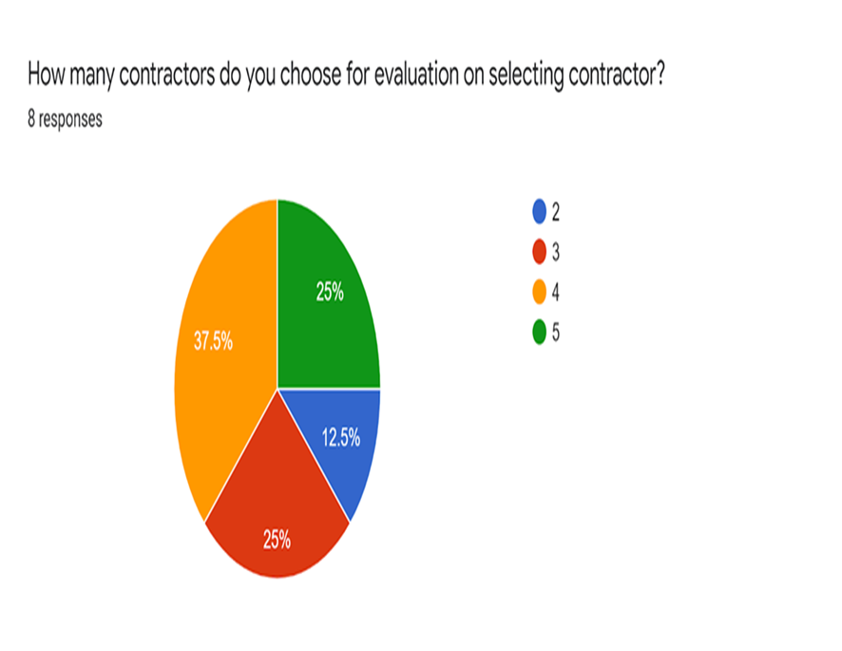
Data Collection (Online Survey)
All of the company select Cost, Quality and Past Performance when choosing the contractor. Followed by Time and Experience. 75% and 62% choose current project/backlog and Occupational Health and Safety of the contractor.
37.5% choose 4 contractors. When the number of contractors are 3&5, both shares the same number of respondents. Only 12.5% of companies choose 2 contractors on selecting the contractor.

Slide 11
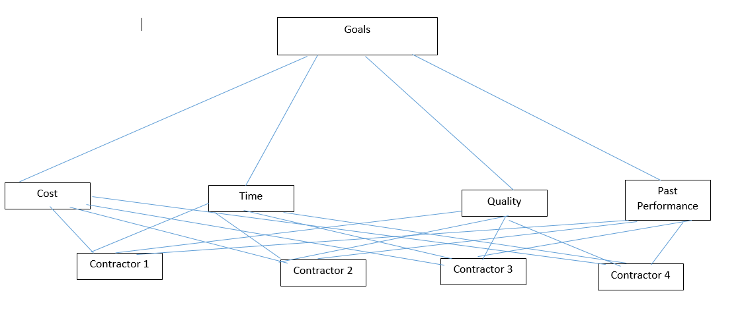
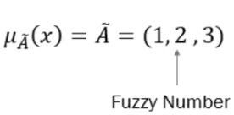
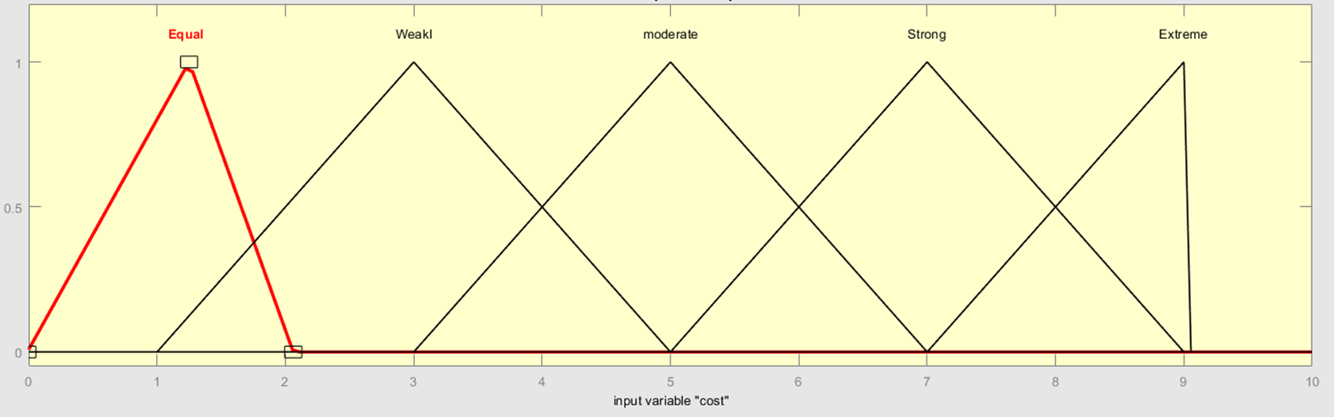
Preparation of Data
The fuzzy value represented by using this symbol
Hierarchy structure of Contractor Selection using Fuzzy AHP and TOPSIS
Equal
Moderate
Strongly
Very Strong
Extremely
If Cost is extremely strongly important compared to Quality, the Triangular Fuzzy Number will be (9,9,9)

Slide 12
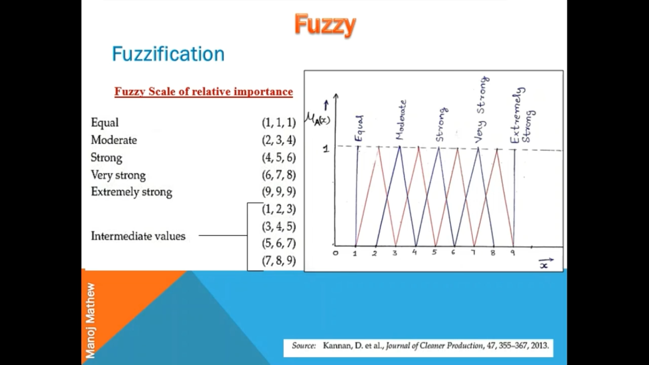
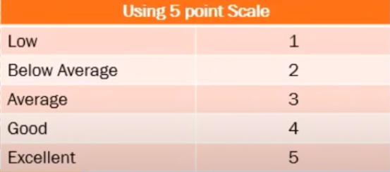
Cont…
Fuzzy scale of relative importance to Fuzzy AHP
TOPSIS point scale
Summary for raw Data
Number of contractors | 4 contractors
Number of criteria needed | 4 criteria
Criteria | Cost, Quality, Time, Past Performance

Slide 13
Contractor Selection Flowchart
TOPSIS
Start
Construct decision matrix
Input score of criteria from decision maker in the form of combo box
Normalized decision matrix
Input score of contractor from decision maker in the form of combo box
Criteria weighing
Construct weighted normalized decision matrix
Y
Convert the linguistic scale into fuzzy number
Consistent
Determine +ve ideal solution and –ve ideal solution
N
Calculate closeness coefficient
Pairwise comparison
Consistency checking
Rank the contractor
Fuzzy AHP
End

Slide 14
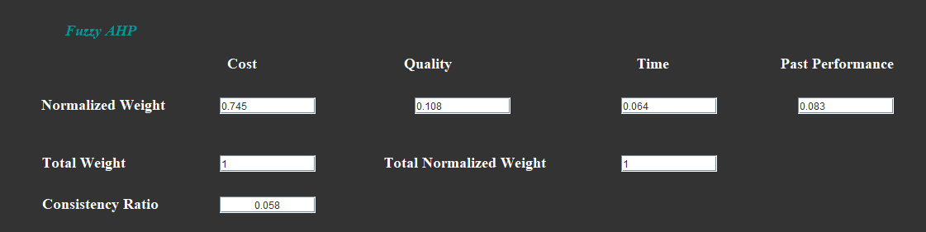
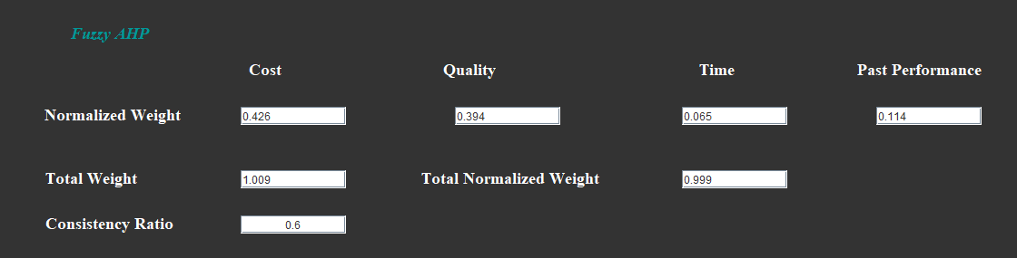
Contractor Selection using FAHP & TOPSIS Setup Description
Experiment Setup | Result
The criteria in Score the Criteria’s page are set as decision maker evaluation | This means that the normalized weight can be proceed for next calculation which is TOPSIS and the Consistency Index is acceptable.
The criteria is set randomly | This means that the normalized weight need to revise back and the Consistency Index is not acceptable since it is greater than 0.1

Slide 15
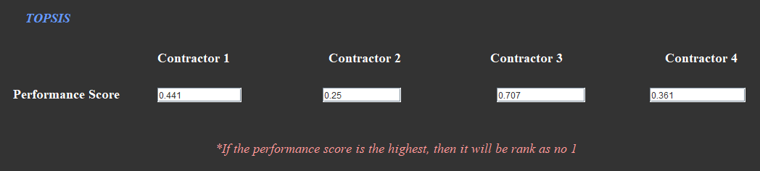
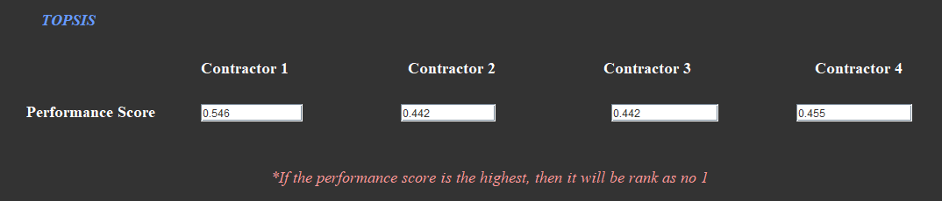
Experiment Setup | Result
The criteria in Score the Contractor’s page are set as decision maker evaluation | The highest performance score of the contractor is Contractor 3
Change the variable for the contractor from Below Average to Excellent or in any scale for Contractor 3 | Contractor 1 has the highest performance score. Hence in this case, the preferred contractor is Contractor 1

Slide 16

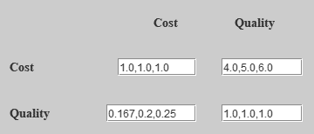



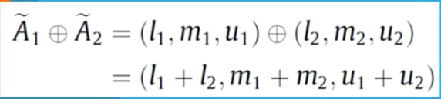

Contractor Selection Steps and Equation
Fuzzy AHP
No | Steps | Equation
1 | Reciprocal Fuzzy Number
2 | Geometric Mean is used to Calculate the weights.
 | This equation is use to multiple two or more fuzzy numbers.
3 | Fuzzy Weight = fuzzy geometric mean value, ri
(( ${1∗4∗4∗7)}^{\frac{1}{4}}$, ( ${1∗5∗5∗7)}^{\frac{1}{4}}$, ( ${1∗6∗6∗8)}^{\frac{1}{4}}$)

Slide 17

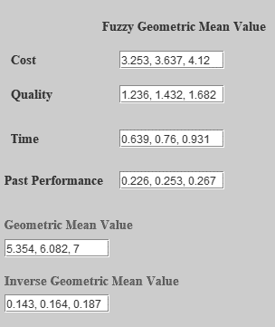
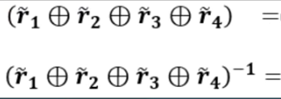

Fuzzy AHP (continue)
No | Steps | Equation
4 | Fuzzy Weight
5 | Fuzzy Geometric Mean value and Inverse of it.

Slide 18

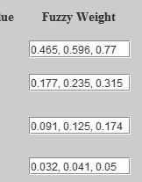
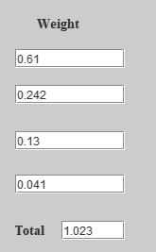

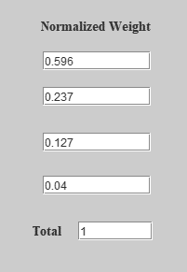
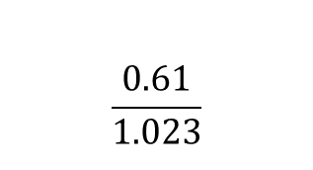
Fuzzy AHP (continue)
No | Steps | Equation
6 | Then, the inverse multiple with fuzzy geometric mean value
7 | De-fuzzification value to get the crisp value | The total weight is not acceptable
8 | Normalized Weight | Hence, this normalized weight is used to further calculations (TOPSIS)
$$\frac{0.61}{1.023}$$

Slide 19
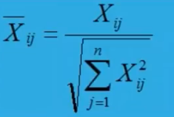
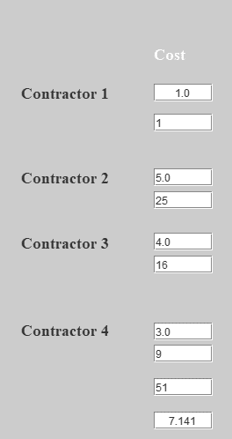



Contractor Selection Steps and Equation
TOPSIS algorithms
No | Steps | Equation
1 | Vector normalization
2
$1^{2}$+$5^{2}$+$4^{2}$+$3^{2}$=51
$$\sqrt{51}=7.141$$

Slide 20
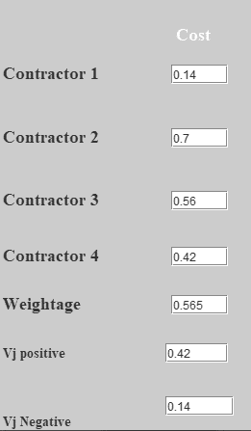

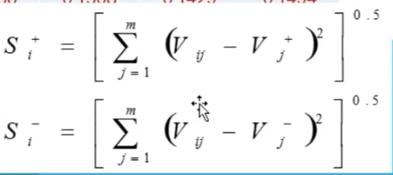
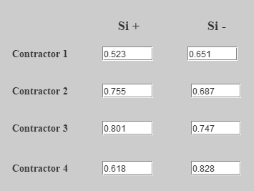
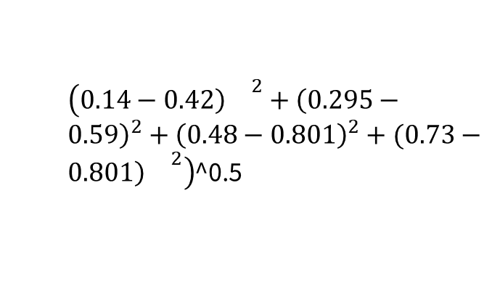
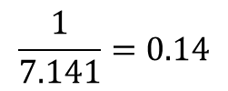
TOPSIS algorithm (continue)
No | Steps | Equation
3 | Normalized performance value (the value in each cell)
4 | Euclidean distance from ideal best and worst.
$$\frac{1}{7.141}=0.14$$
$\left(0.14−0.42{\left)\right.}^{2}+{\left(0.295−0.59\right)}^{2}+{\left(0.48−0.801\right)}^{2}+(0.73−0.801{\left)\right.}^{2}\right)$^0.5

Slide 21
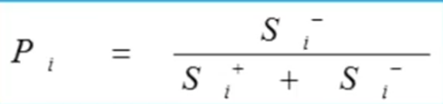
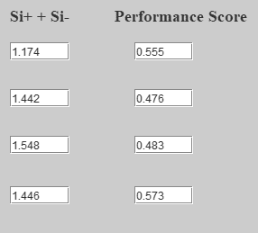
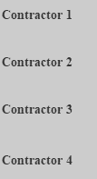
TOPSIS algorithm (continue)
No | Steps | Equation
5 | Performance score (denoted as Pi)
It is clear that, Contractor 4 has the highest performance score followed by Contractor 1, Contractor 3 and lastly Contractor 2

Slide 22
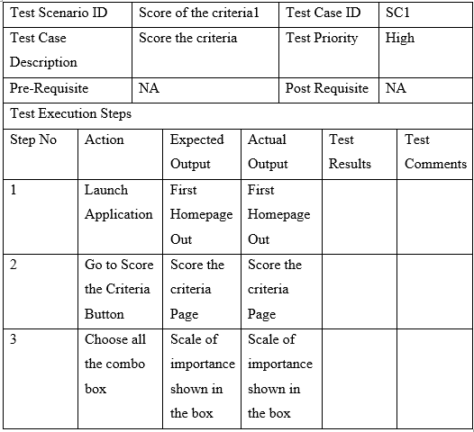
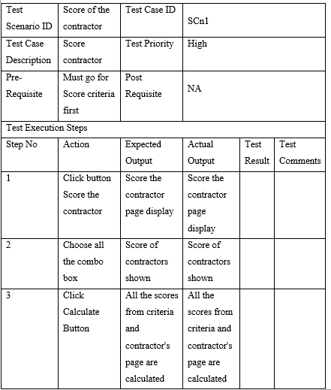
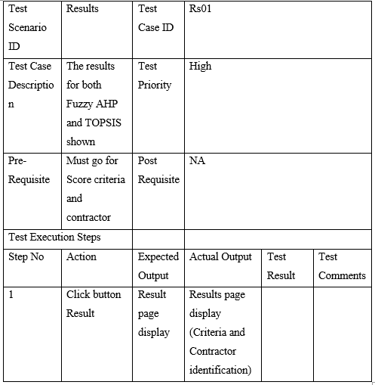
Contractor selection using FAHP&T Testing and Evaluation

Slide 23
Continue
User | Comments
Expert 1 | “The system overall very well-functioning and easy to use. But if you could add something at the last page of TOPSIS. For example, rank them in numbers if the performance score is higher and put them as number 1 and so on or put star symbol if possible since it is easy for us to see which performance score is highest and we can choose that contractor
Expert 2 | “This system is good. I think at some point this system is too details and not suitable for those who is not in the field of understanding your algorithms. Maybe it is good for administration to see if the calculation is right or wrong but for public this is too much information. In fact, you can remove some of the features in this system. Overall, everything is good. Well done!”
User | “Some of the features in this system is quite confusing especially in the Score Criteria’s page and different background colour in that page which inconsistency background colour. I also found that the various functions in this system is well integrated. Overall, the system is easy to navigate and simple. However, for the calculation I don’t understand but for me this system is well understanding for people like me to choose which contractor is the best. Great job.”

Slide 24
Contractor Selection Demonstration

Slide 25



Conclusion
Conclusion
Issues and Limitation
Recommendation
Ease the company with provided criteria and contractors.
Reduces the future work problems like delay of project or bias when choosing the contractor
Fuzzy AHP: rank the criteria weight so that every criterion that has been compared have its equal amount.
TOPSIS: contractor is being ranked based on their performance score.
The system can rank only 4 contractors with 4 criteria
The criteria and contractors cannot be set by user’s preference. Example: if the user wants to set only 3 contractors with given criteria or vice versa.
Contractor selection is by using other algorithms (any MCDM technique)
set both of the criteria and contractors based on the user preferences.

Slide 26
References
Alptekin, O., & Alptekin, N. (2017). Analysis of Criteria Influencing Contractor Selection Using TOPSIS Method. IOP Conference Series: Materials Science and Engineering, 245(6). https://doi.org/10.1088/1757-899X/245/6/062003
Fong, P. S. W., & Choi, S. K. Y. (2000). Final contractor selection using the analytical hierarchy process. Construction Management and Economics, 18(5), 547–557. https://doi.org/10.1080/014461900407356
Gholipour, R., Jandaghi, G., & Rajaei, R. (2014). Contractor selection in MCDM context using fuzzy AHP. 7(1), 151–173.
Huang, X. (2011). An Analysis of the Selection of Project Contractor in the Construction Management Process. International Journal of Business and Management, 6(3), 184–189. https://doi.org/10.5539/ijbm.v6n3p184

Slide 27
Ly, P. T. M., Lai, W. H., Hsu, C. W., & Shih, F. Y. (2018). Fuzzy AHP analysis of Internet of Things (IoT) in enterprises. Technological Forecasting and Social Change, 136(September), 1–13. https://doi.org/10.1016/j.techfore.2018.08.016
Rashid, I., Ismail, S., Mohamed, Z., & Saleh, A. L. (2018). Contractor Selection Criteria : a Study on Malaysian Public Construction Projects. 7, 65–70.
San Cristóbal, J. R. (2012). Contractor selection using multicriteria decision-making methods. Journal of Construction Engineering and Management, 138(6), 751–758. https://doi.org/10.1061/(ASCE)CO.1943-7862.0000488
Ting, S. N., & Chin, L. W. (2013). Selection criteria and the related sub-criteria for the selection of standard form of contract for construction projects in Sarawak. UNIMAS E-Journal of Civil Engineering, 4(2), 33–38.

