Slide 1
BEST STUDENT’S AWARDS USING FUZZY EXPERT SYSTEM
NAME: NUR FAIZATUL ZULAIHKA BINTI MAT RAHIM
MATRIC NUMBER: 2017412274
SUPERVISOR: UMMU FATIHAH BINTI MOHD BAHRIN

Slide 2
PROBLEM STATEMENT
PROPOSED SOLUTION
The human has a tendency for biased decision depending some other criteria‘s which may lead to partiality based on (Patil, 2014).
With the use of fuzzy logic the decision making remains transparent.
Refer to Perlis (2015), it may derive a different and/or same result for other cases, it still depends greatly on how the evaluators evaluate the relevant attributes during the judgment process.
Extremely significant fuzzy environment have been utilized to derive the membership values in the range of [0, 1] which provide some straightforward procedures by constructing the relevant membership functions.
Current method of classifying and grading student academic performance, using arithmetical and statistical techniques, does not necessarily offer the best way to evaluate human acquisition of knowledge and skills.
Fuzzy approaches provide an alternative way of handling various kinds of imprecise data, which often reflect the way people think and make judgments.

Slide 3
OBJECTIVE
To identify the problem in selection of the best students awards .
To develop a system for determine the best student by using fuzzy expert system.
To evaluate the functionality in selection of the best student.

Slide 4
SCOPE
Data used | Target User | Algorithm used
Primary data - done by the interview of the expert Secondary data - obtains by articles, journals and website. | Main user will be the expert and teacher to select a best student. | Fuzzy expert system - Fuzzy generally involved uncertainty and it is important to corporate with expert system to get results in any proposed method (Rasmani,Shahari,Garibaldi & Shen, 2013)

Slide 5
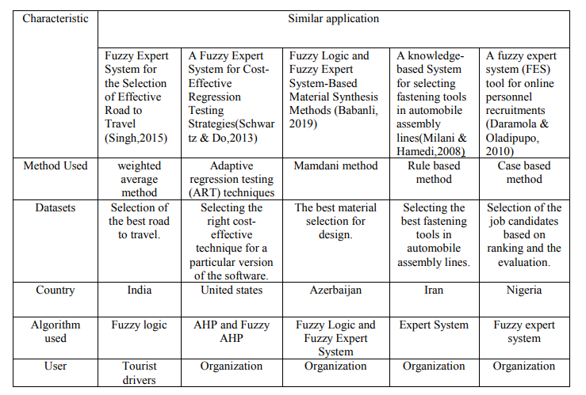
RELATED WORKS(Similar application)

Slide 6
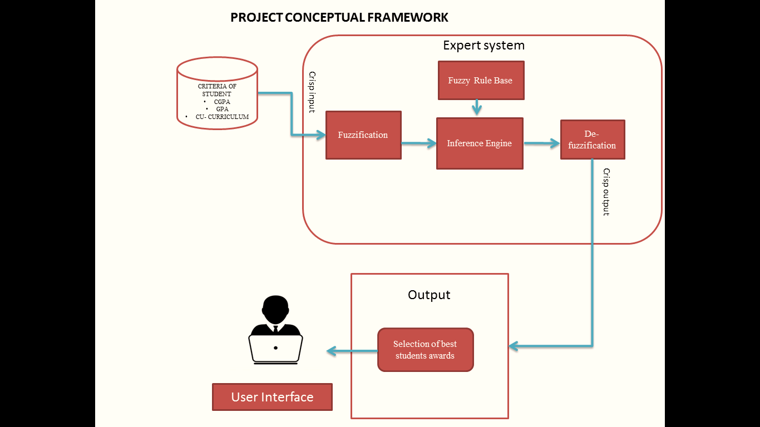
BEST STUDENT’S AWARDS CONCEPTUAL FRAMEWORK
Criteria of student
Academics
Soft skill
Disciplinary

Slide 7
BEST STUDENT’S AWARDS METHODOLOGY FRAMEWORK
Phase
Activities
Outcome
Preliminary study
Identify problems
Obtain information by reading journal, article, website.
Problem statement
Objectives
Scope
Significance of the project
Objective 1 :
To identify a problem in selection of best student awards
Reading journal, article and website
Data of collection: Interview expert
Study of criteria of student
Interview expert to get accurate overview
Get data from expert
Knowledge acquisition
Define linguistic variable
Determine fuzzy sets
Elicit and construct fuzzy rules
Encode fuzzy to perform fuzzy inference into expert system
Evaluate and tune system
Algorithm Design
Fuzzy expert system for selection of best student awards
Objective 2 :
To develop a system by using Fuzzy expert system
System
Design and development
Design user interface
Design system using JAVA
Apply MATLAB Fuzzy Logic Toolbox or Fuzzy Knowledge Builder
User interface
Inference engine
Objective 3 :
To evaluate a functionality in selection of the best student
Implement fuzzy expert system
Coding
Debugging and system testing
Evaluate and tune system
Working engine
Successful program
Final project report
Implementation and evaluation

Slide 8
ANALYSIS PHASE : DATA COLLECTION
Input Data | Output
Criteria of student Academic Soft skill Disciplinary | Result of student Percentage of being a best student(good,average,best)

Slide 9
ANALYSIS PHASE : DATA PREPARATION
LINGUISTIC VARIABLE
Academics Soft skill
Disciplinary Output of best student
Input | Fuzzy sets | Range
Academic | Poor | [0.1-0.3]
 | Average | [0.4 – 0.6]
 | Excellent | [0.7 – 1.0]
Input | Fuzzy sets | Range
Soft skill | Poor active | [0.1-0.6]
 | Average active | [0.7 – 0.8]
 | Excellent active | [0.9 – 1.0]
Input | Fuzzy sets | Range
Disciplinary | Poor | [0.1-0.3]
 | Average | [0.4– 0.8]
 | Free | [0.9 – 1.0]
Linguistic value | Range
Good | [0.1-4.0]
Average | [4.0 – 7.0]
Best | [7.0 – 10.0]

Slide 10
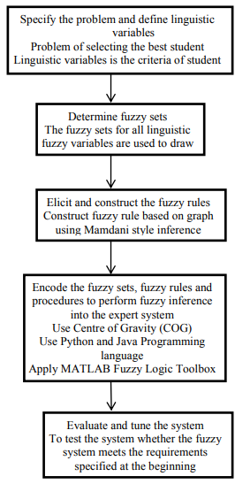
ALGORITHM DESIGN

Slide 11
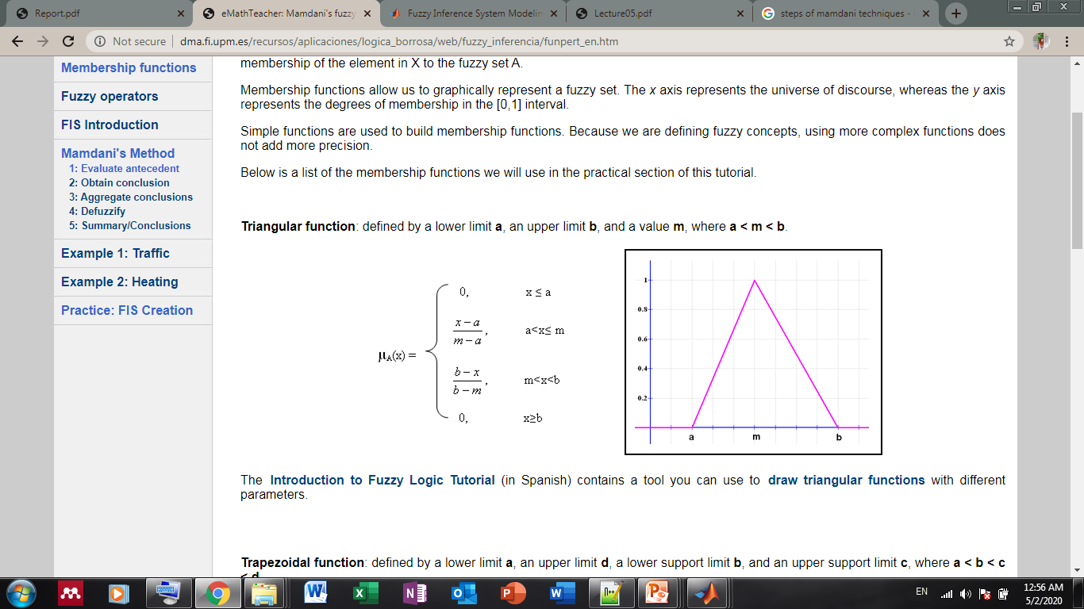
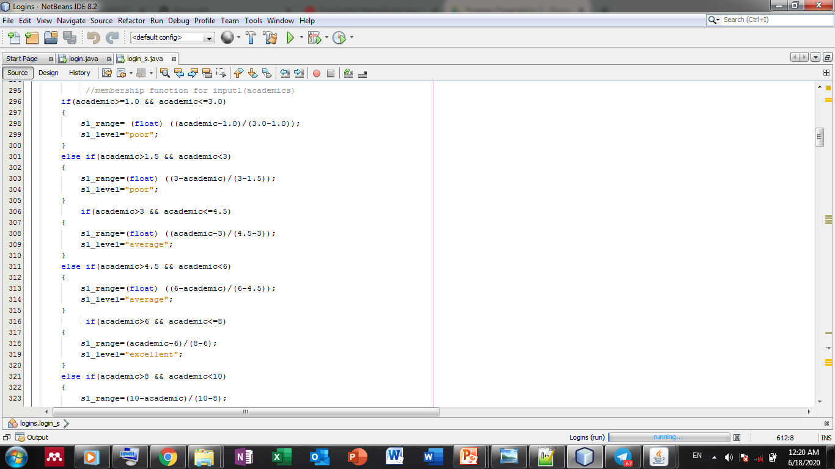
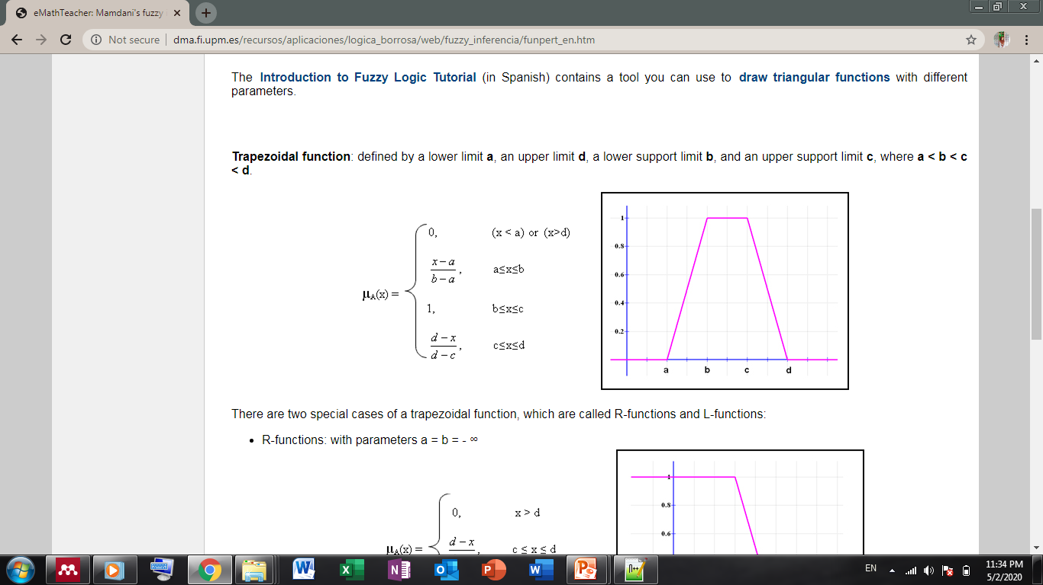
Technique method
1. Calculate membership function of every input

Slide 12
2. Rule evaluation
An Example of Fuzzy IF-THEN Rules which have taken from Deriving of Membership Function
Rule number | IF-Then Rule
Rule 9 | If academic = poor and disciplinary=free and soft skill=active then the student is good.
Rule 15 | If academic = average and disciplinary=average and soft skill=active then the student is average.
Rule 27 | If academic = excellent and disciplinary=free and soft skill=active then the student is best.

Slide 13
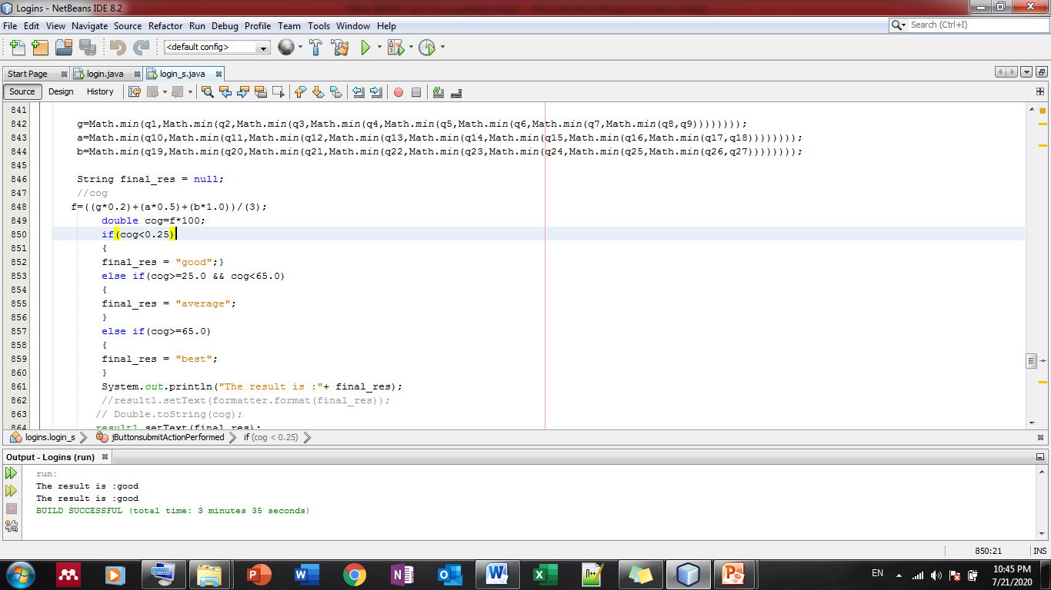
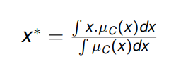
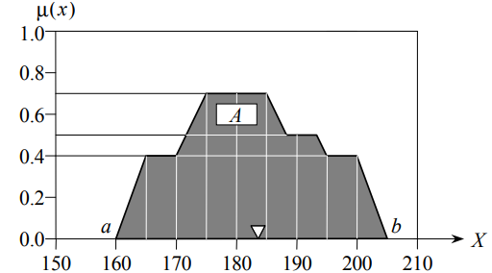
3. Result aggregation
4. Defuzzification
Centroid defuzzification method finds a point representing the centre of gravity of the fuy set,A,on the interval,ab.
A reasonable estimate can be obtained by calculating it over a sample of points.

Slide 14
RESULT ANALYSIS
No | Input |  |  | Output
 | Academic | Soft skill | Disciplinary | System result | Rule result
1 | Poor | Excellent active | Average | Average(36.33%) | Average
2 | Excellent | Excellent active | Free | Average(49.67%) | Average
3 | Average | Poor active | Poor | Good (10.00%) | Good
4 | Excellent | Excellent active | Free | Best (56.67) | Average

Slide 15
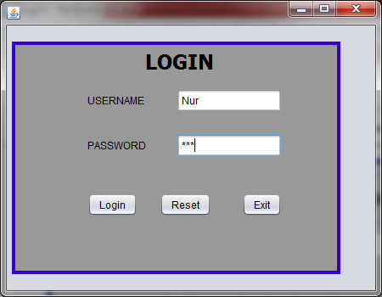

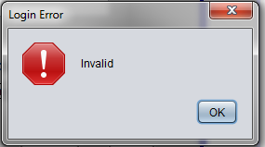
PROJECT TESTING AND EVALUATION
STEP 1: USER LOGIN
VALID USERNAME AND PASSWORD
INVALID USERNAME AND PASSWORD

Slide 16
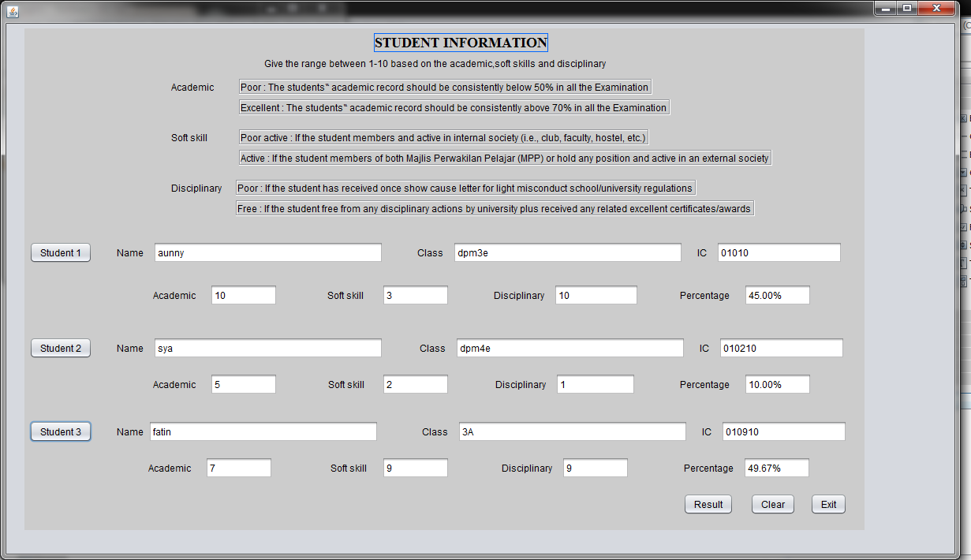
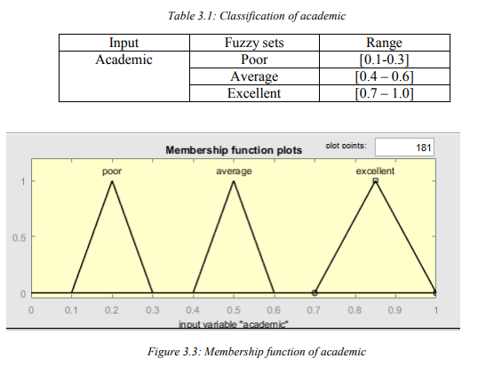
STEP 2 : CALCULATE RESULT USING MAMDANI FUZZY INFERENCE SYSTEM
Calculate membership function

Slide 17
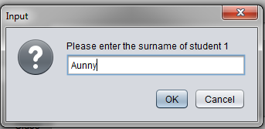
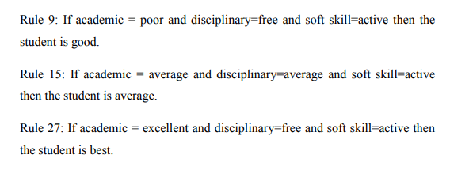
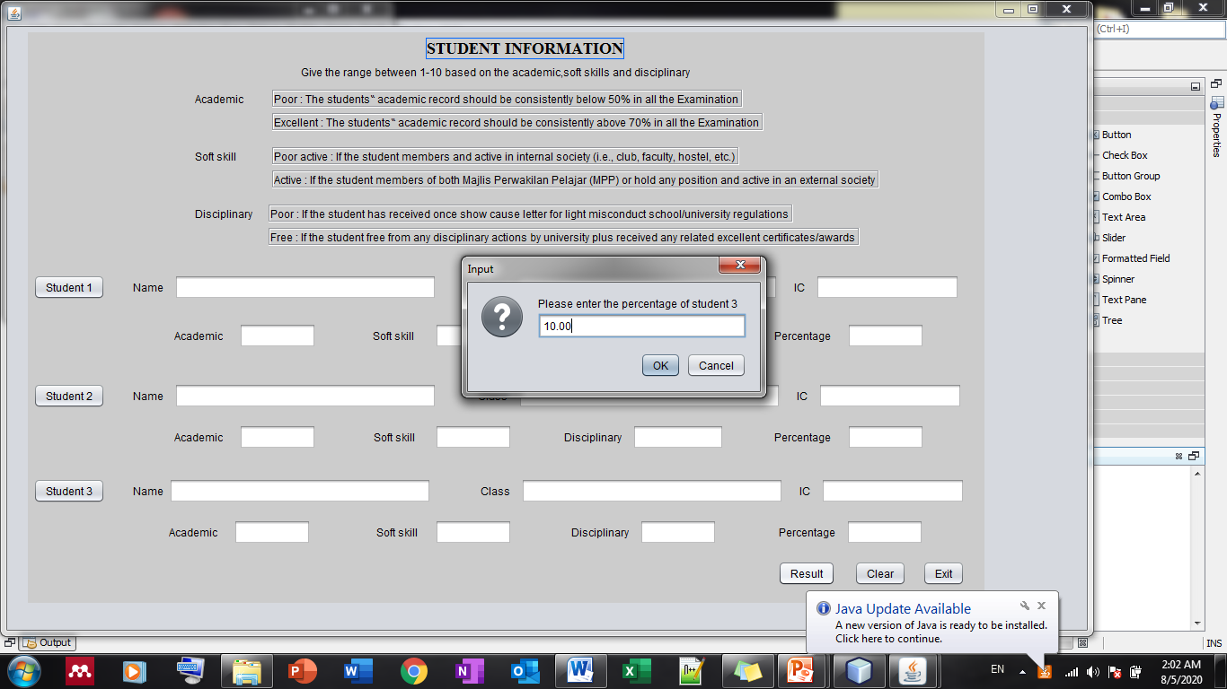
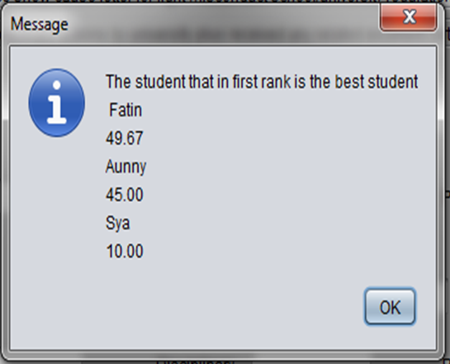
INSERT RULE
STEP 3 : User input surname(for 3 input)
An Example of Fuzzy IF-THEN Rules which have taken from Deriving of Membership Function
STEP 4: User input percentage
(for 3 input)
DEFUZZIFICATION
STEP 5: Output
Output of the system based on range given by the user that has been sorted

Slide 18
SYSTEM DEMO

Slide 19
CONCLUSION
As a conclusion, this Fuzzy expert system was implemented based on the methodology that has been presented. By having this system, many people especially a teacher who involve in the selection can easily select based on its criteria given.

Slide 20
REFERENCES
Alfarsi, G. M. (2018). A rule-based system for advising undergraduate students A RULE-BASED SYSTEM FOR ADVISING. (April).
Amelia, N., Abdullah, A. G., & Mulyadi, Y. (2019). Meta-analysis of student performance assessment using fuzzy logic. Indonesian Journal of Science and Technology, 4(1), 74–88. https://doi.org/10.17509/ijost.v4i1.15804
Ayhan, M. B. (2013). A Fuzzy Ahp Approach For Supplier Selection Problem: A Case Study In A Gearmotor Company. International Journal of Managing Value and Supply Chains, 4(3), 11–23. https://doi.org/10.5121/ijmvsc.2013.4302
Bryant, M. F. (2009). A comparison of the rule and case-based reasoning approaches for the automation of help-desk operations at the Tier-two level. Dissertation Abstracts International: Section B: The Sciences and Engineering, 70(3-B), 1745.
Babanli MB, Huseynov VM. Z- number-based alloy selection problem. Procedia Computer Science. 2016;102: 183-189
Chi, R. T. H., & Kiang, M. Y. (1991). An integrated approach of rule-based and case-based reasoning for decision support. CSC 1991 - Proceedings of the 19th Annual Conference on Computer Science, (March), 255–267. https://doi.org/10.1145/327164.327272
Daramola, J. O., Oladipupo, O. O., & Musa, A. G. (2010). A fuzzy expert system (FES) tool for online personnel recruitments. International Journal of Business Information Systems, 6(4), 444–462. https://doi.org/10.1504/IJBIS.2010.035741
Dewi, R., Verina, W., Tanjung, D. H., & Rahayu, S. L. (2019). Application of AHP Method Based on Competence for Determining the Best Graduate Students. 2018 6th International Conference on Cyber and IT Service Management, CITSM 2018, (Citsm), 6–10. https://doi.org/10.1109/CITSM.2018.8674296
Dongrui, W., & Eng, M. (2005). 2005 IEEE International Conference on Fuzzy Systems Best Student Paper Award. 1–3.
Engin, G., Aksoyer, B., Avdagic, M., Bozanli, D., Hanay, U., Maden, D., & Ertek, G. (2014). Rule-based expert systems for supporting university students. Procedia Computer Science, 31, 22–31. https://doi.org/10.1016/j.procs.2014.05.241
goleman, daniel; boyatzis, Richard; Mckee, A. (2019). Journal of Chemical Information and Modeling, 53(9), 1689–1699. https://doi.org/10.1017/CBO9781107415324.004
Hossain, M. S., Zander, P. O., Kamal, M. S., & Chowdhury, L. (2015). Belief-rule-based expert systems for evaluation of e-government: A case study. Expert Systems, 32(5), 563–577. https://doi.org/10.1111/exsy.12110
i. (n.d.).
Jafarian, A., Nikabadi, M. S., & Amiri, M. (2014). Framework for prioritizing and allocating six sigma projects using fuzzy TOPSIS and fuzzy expert system. Scientia Iranica, 21(6), 2281–2294.
Journal, I. (2018). GIVEN NAME : DR . SAYEL FAMILY NAME : SABHA AUTHOR ADDRESS : MENA COLLEGE OF MANAGEMENT AIMS AND OBJECTIVES : 6(4), 47–52.

Slide 21
Kharola, A., Kunwar, S., Choudhury, G. B., Kharola, A., Kunwar, S., & Choudhury, G. B. (2015). Students Performance Evaluation: A fuzzy logic reasoning approach. PM World Journal, IV(Ix), 1–11. Retrieved from www.pmworldlibrary.net
Kilincci, O., & Onal, S. A. (2011). Fuzzy AHP approach for supplier selection in a washing machine company. Expert Systems with Applications, 38(8), 9656–9664. https://doi.org/10.1016/j.eswa.2011.01.159
Komariah, I., & Matsumoto, T. (2017). Application. Pollution Research, 36(3), 504–512.
Kosfeld, M., & Neckermann, S. (2011). Getting more work for nothing? Symbolic awards and worker performance. American Economic Journal: Microeconomics, 3(3), 86–99. https://doi.org/10.1257/mic.3.3.86
Kousalya, P., & Reddy, G. M. (2011). Selection of a student for all round excellence award using Fuzzy AHP and TOPSIS methods. International Journal of Engineering Research and Applications, 1(4), 1993–2002.
Lecture 5 Fuzzy expert systems : Fuzzy inference. (n.d.). 1–51.
Logic, F. (1965). Chapter 6.
Luu, D., & Sher, W. (2012). Construction Tender Subcontract Selection using Case-based Reasoning. Construction Economics and Building, 6(2), 32–43. https://doi.org/10.5130/ajceb.v6i2.2982
Milani, A. A., & Hamedi, M. (2008). A knowledge-based system for selecting fastening tools in automobile assembly lines. Proceedings of the IEEE International Conference on Industrial Technology, (May 2008). https://doi.org/10.1109/ICIT.2008.4608541
Özyol, M., & Albayrak, Y. E. (2006). The fuzzy AHP process for choice of knowledge-based management styles. IFAC Proceedings Volumes (IFAC-PapersOnline), 9(PART 1), 442–447. https://doi.org/10.3182/20060522-3-fr-2904.00071
Pal, K. (2018). An Application of Rule-Based and Reasoning within a Single Legal Based System. (May). https://doi.org/10.1145/277339.277344
Patil, S. M. (2014). BEST STUDENT AWARD – A FUZZY EVALUATION APPROACH. (May).
Perlis, U. (2015). Evaluation of pre-diploma students using fuzzy approach. Jurnal Intelek, 10(1), 37–41.
Prentzas, J., & Hatzilygeroudis, I. (2003). Integrations of Rule-Based and Case-Based Reasoning. Proceedings of the International Conference on Computer, Communication and Control Technologies, 4, 81–85.
Rahman, A., Slamet, C., Darmalaksana, W., Gerhana, Y. A., & Ramdhani, M. A. (2018). Expert System for Deciding a Solution of Mechanical Failure in a Car using Case-based Reasoning. IOP Conference Series: Materials Science and Engineering, 288(1), 0–6. https://doi.org/10.1088/1757-899X/288/1/012011
Rani, R. (2016). E – RECRUITMENT AND ITS IMPACT UPON ON JOB SEEKERS : A CONTEMPORARY APPROACH . (4), 335–339.
Rashid, A., Ullah, H., & Ur, Z. (2011). Application of Expert System with Fuzzy Logic in Teachers’ Performance Evaluation. International Journal of Advanced Computer Science and Applications, 2(2). https://doi.org/10.14569/ijacsa.2011.020210

