Slide 1
DEAF STUDENT LEARNING STYLE PREDICTION USING FUZZY TOPSIS
Prepared By :
Umi Suhailah Binti Khairul
(2017412252)
Supervisor’s name:
Sharifah Nurulhikmah Binti Syed Yasin

Slide 2
Problem Statement
The deaf inclusion dilemma and some of assumptions made about disability equality in education (Khairul, Miles & McCracken, 2018).
Most of the people use the same method to teach deaf student (Amir & Jelas, 2010). Deaf Student do not have an effective mode of communication with people. Most of them difficult in reading.

Slide 3
Objective
To identify the criteria of predicting deaf student’s learning style.
To develop a learning style prediction system for deaf students based on Grasha Reichmann Learning Style using Fuzzy TOPSIS Algorithm.
To evaluate the functionality and usability of the proposed system.

Slide 4
Scope
User
Deaf Student in secondary school, SMK Ibrahim Fikri,Terengganu.
System
Predicting deaf student learning style by using Fuzzy TOPSIS based on Grasha Reichmann Student Learning Style. The output will show the ranking learning style of a student.
.

Slide 5


Related works
Title | Algorithm | User | Learning Style Model | Country
Decision Support System for Learning Disabilities Children in Detecting Visual-Auditory-Kinaesthetic Learning Style (Azizi et al., 2015) | Fuzzy Clustering | Normal Student | VARK Model | Malaysia
A Decision-Making Approach to Evaluation of Learning Components (Masumba, & Wario, 2016) | Fuzzy TOPSIS | Normal Student | Felder-Silverman Learning Styles Model (FSLSM) | South Africa
Prediction of Learner’s Profile Based on Learning Styles (Kolekar, Pai, & Manohara Pai, 2017) | Fuzzy C Means (FCM) algorithm | Normal Student | Felder-Silverman Learning Styles Model | India
Personalization of learning situations within a virtual environment for training (Mohamed, Abdeslam, & Lahcen, 2017) | Fuzzy Clustering | Normal Student | Personalization of learning situations (PLS) | Morocco
Learning style prediction in e-learning using web interface information (Deborah et al., 2015). | Fuzzy Logic | Normal Student | Felder and Silverman's learning styles | India

Slide 6
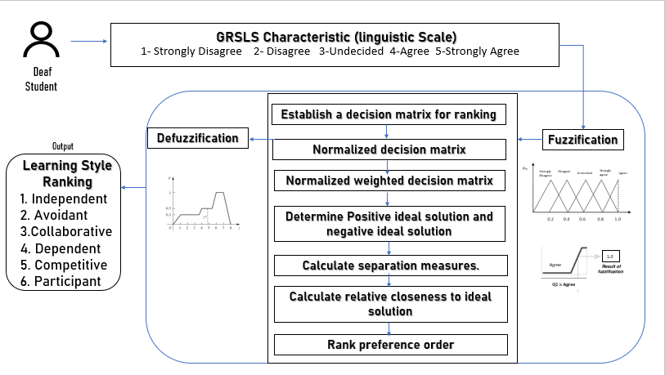
Deaf Student’s Learning Style Prediction Using Fuzzy TOPSIS Conceptual Framework

Slide 7
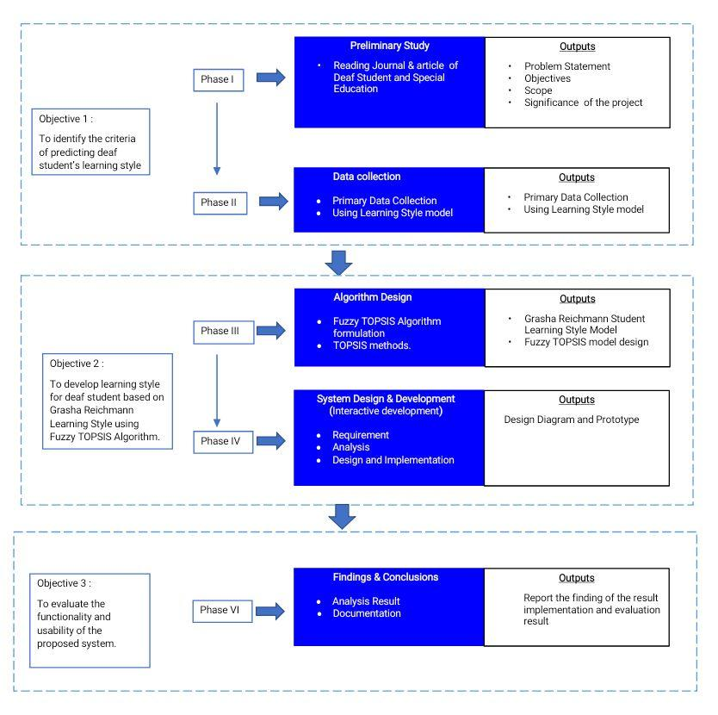
Deaf Student’s Learning Style Prediction Methodology Framework
III
IV
VI

Slide 8
DATA ANALYSIS
Grasha Reichmann Student Learning Style
Attitudes
Student Style
Achievement
Independent
Avoidant
Collaborative
Dependent
Competitive
Participant

Slide 9
Raw Data
Input | Grasha Reichmann Student Learning Style Question 42 question Scale : 1 to 5 1-Sangat Tidak Setuju 2-Tidak Setuju 3-Tidak Pasti 4-Setuju 5-Sangat Setuju
Output | Learning Style Berdikari (Independent) Penghindaran (Avoidant) Kolaboratif (Collaborative) Pergantugan (Dependent) Persaingan (Competitive) Penyertaan (Participative)

Slide 10
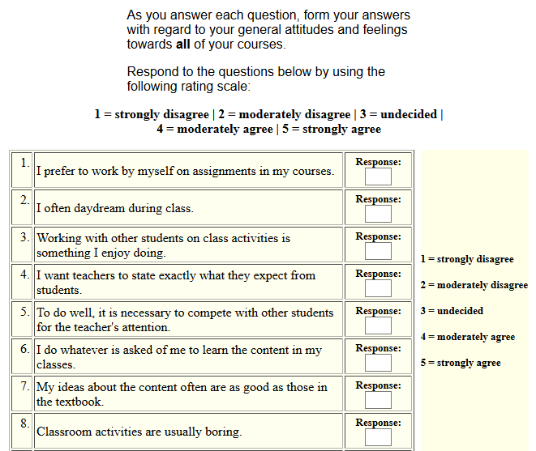
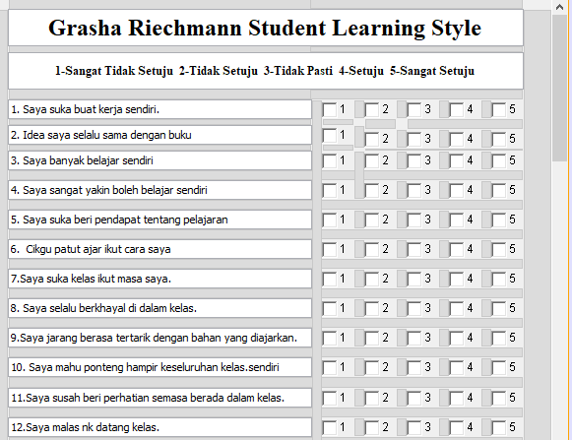
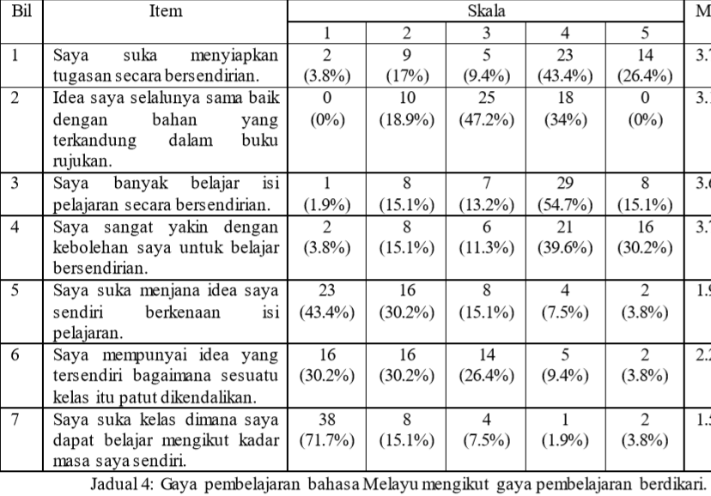
First version question (60 Question)
Source : Grasha Reichmann Student Learning Style
Third Version question (42 Question)
Second version question (42 Question)
Source : GAYA PEMBELAJARAN PELAJAR PROGRAM EKSEKUTIF SARJANA BAHASA MELAYU.

Slide 11
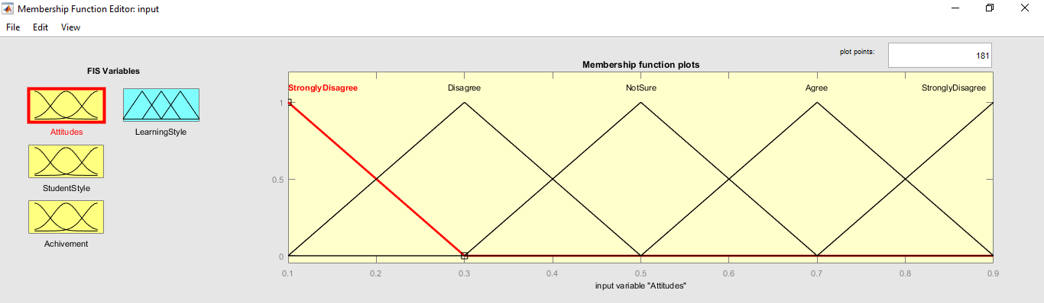
Data to process
Linguistic variable | Triangular fuzzy number
Strongly Disagree | ( 0.0, 0.1, 0.3 )
Disagree | ( 0.1, 0.3, 0.5 )
Not Sure | ( 0.3, 0.5, 0.7 )
Agree | ( 0.5, 0.7, 0.9 )
Strongly Agree | ( 0.7, 0.9, 0.9 )

Slide 12
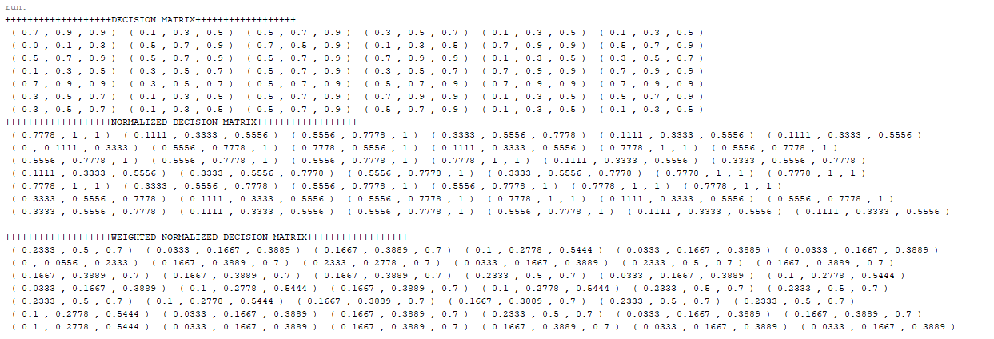
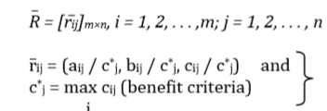
Fuzzy topsis equation
Question 1 until 7
6 pages
Normalized Decision Matrix

Slide 13
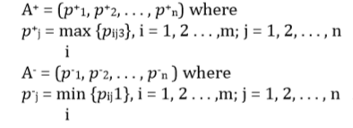

Weightage
Fuzzy Positive Ideal Solution
Fuzzy Negative Ideal Solution

Slide 14

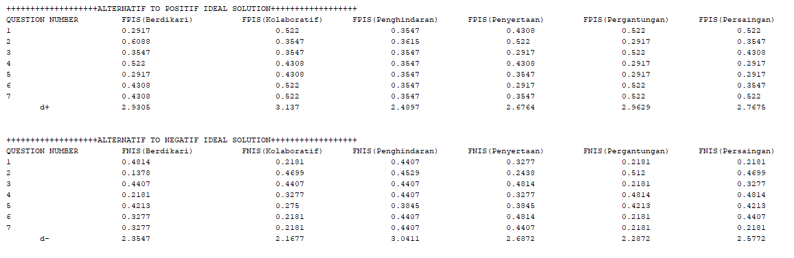

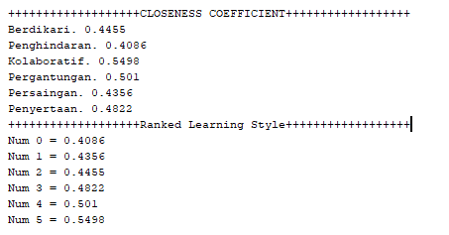
Separation Measures
Closeness Coefficient

Slide 15
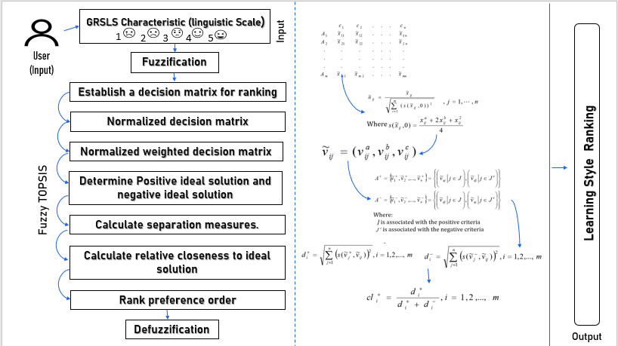
Logical design

Slide 16
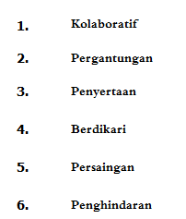
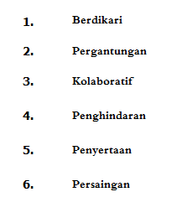
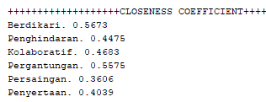
Experiment setup
Attribute | Result
The weightage are set same with other criteria | Berdikari have low value of closeness coefficient than Penyertaan. Berdikari in 4th while Pergantugan 2nd.
The weightage are set different for Berdikari and Pergantugan question. | Berdikari have high value of closeness coefficient than Kolaboratif. Berdikari in 1st while Pergantugan 2nd.

Slide 17
Result & analysis
Student | Learning Style | Mean (Original Calculation) | Range | Using Fuzzy TOPSIS Algorithm ranking
Nur Syamira Bt Aizuddin | Berdikari (Independent) | 3.29 | Moderate | 3
 | Penghindaran (Avoidant) | 2.86 | Moderate | 6
 | Kolaboratif (Collaborative) | 4.00 | High | 1
 | Pergantugan (Dependent) | 3.71 | Moderate | 2
 | Persaingan (Competitive) | 3.26 | High | 5
 | Penyertaan (Participative) | 3.57 | Moderate | 4
For the first ranking in system have high range in original calculation is same as the first rank in the system. This showed that both methods have similarity with the best learning style. This result is valid because of the balance in learning style score in original calculation.
Expert’s View: IRNI YUNITA BT MAT ALI (Counselor of SMK Bukit Diman)
It is easier to identify student learning style in ranking. For the original method, it will make student confuse if the result of learning style is similar.
Each learning style depends on the context or specific learning task. Learning styles were not more or less likely to perform better than others significantly (Head, Students, Styles, Improve, & Pattamathammalul, 2017).

Slide 18

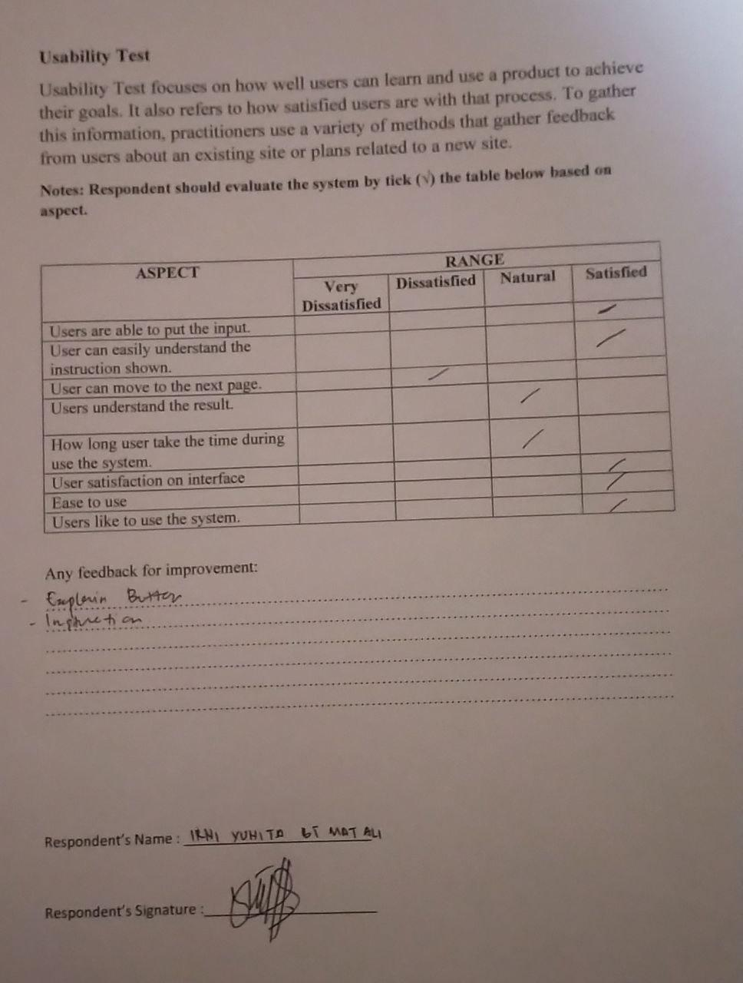
Testing & evaluation : experts
The student able put the input and the student can understand the instruction. The student will need the explanation and guidance for the button displayed. The student can understand the ranking result of learning style and they also maybe can answer the question in short time or in long time, it depend on their mood. The interface is good for secondary school. This system is ease to used. It depend on student interested to like to use the system.

Slide 19
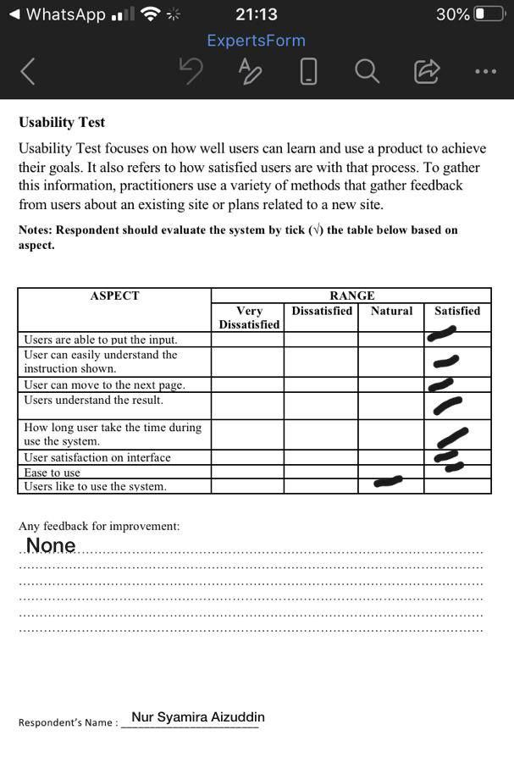
Testing & evaluation
User able to put the input in the system and can easily understand the instruction. User understand how the system work such as the function of the button. User take short time to answer the question and feel satisfied with the system interface. User fell natural towards the system because of there are a lot of question that need to answers to get the result.

Slide 20
System demonstration

Slide 21
Conclusion
The original calculation in Grasha Reichmann Student Learning Style can show the balance learning style of a student while in the system it just showed the ranking of the learning style based on the highest to lowest value. But the ranking learning style will help student be more confident about the result showed.

Slide 22
references
Amir, R., & Jelas, Z. M. (2010). Teaching and learning styles in higher education institutions: Do they match? Procedia - Social and Behavioral Sciences, 7(C), 680–684. https://doi.org/10.1016/j.sbspro.2010.10.092
Azizi, A., Aikhuele, D. O., & Souleman, F. S. (2015). A Fuzzy TOPSIS Model to Rank Automotive Suppliers. Procedia Manufacturing, 2(February), 159–164. https://doi.org/10.1016/j.promfg.2015.07.028
Balioti, V., Tzimopoulos, C., & Evangelides, C. (2018). Multi-Criteria Decision Making Using TOPSIS Method Under Fuzzy Environment. Application in Spillway Selection. Proceedings, 2(11), 637. https://doi.org/10.3390/proceedings2110637
BC Ministry of Education. (2006). Hard of Hearing and Deaf Students: A Resource Guide to support Classroom Teachers. 1–29. Retrieved from https://www2.gov.bc.ca/assets/gov/education/kindergarten-to-grade-12/teach/teaching-tools/inclusive/hard-of-hearing-and-deaf-students.pdf
Cuthbert, P. F. (2005). The student learning process: Learning Styles or Learning Approaches? Teaching in Higher Education, 10(2), 235–249. https://doi.org/10.1080/1356251042000337972
Dadelo, S. (1941). STUDENTS’ PERSONAL LIFE GOALS ASSESSED USING SETTINGS. 1941–1945.
DEBORAH, L. J. E. G. A. T. H. A., SATHIYASEELAN, R., AUDITHAN, S., & VIJAYAKUMAR, P. (2015). Fuzzy-logic based learning style prediction in e-learning using web interface information. Sadhana - Academy Proceedings in Engineering Sciences, 40(2), 379–394. https://doi.org/10.1007/s12046-015-0334-1

Slide 23
references
Education, S., & Faculty, S. (2018). Journal of Exceptional People 2018 –. 1(12).
Erkan, T. E., & Rouyendegh, B. D. (2014). Curriculum Change Parameters Determined by Multi Criteria Decision Making (MCDM). Procedia - Social and Behavioral Sciences, 116(1987), 1744–1747. https://doi.org/10.1016/j.sbspro.2014.01.466
Farhah, K. (2018). Deaf learners’ experiences in Malaysian schools : access , equality and communication Deaf Learners ’ Experiences in Malaysian Schools : Access , Equality. https://doi.org/10.17645/si.v6i2.1345
Ginting, G., Putera, A., Siahaan, U., & Rahim, R. (2017). Technical Approach of TOPSIS in Decision Making. International Journal of Recent Trends in Engineering and Research, 3(8), 58–64. https://doi.org/10.23883/ijrter.2017.3388.wpyuj
Irvanizam, I. (2018). Application of the fuzzy topsis multi-attribute decision making method to determine scholarship recipients. Journal of Physics: Conference Series, 978(1). https://doi.org/10.1088/1742-6596/978/1/012056
Issa, J. (2019). No TitleΕΛΕΝΗ. Αγαη, 8(5), 55.
Jaju, S. A., & Jagtap, S. B. (2018). Fuzzy Logic A method to Develop Human like Capabilities for Artificial Intelligence. International Journal of Computer Sciences and Engineering, 6(12), 860–865. https://doi.org/10.26438/ijcse/v6i12.860865
Jawed, S., Amin, H. U., Malik, A. S., & Faye, I. (2019). Classification of Visual and Non-visual Learners Using Electroencephalographic Alpha and Gamma Activities. 13(May), 1–15. https://doi.org/10.3389/fnbeh.2019.00086
Joshi, D. K., Beg, I., & Kumar, S. (2018). Hesitant probabilistic fuzzy linguistic sets with applications in multi-criteria group decision making problems. Mathematics, 6(4). https://doi.org/10.3390/math6040047

Slide 24
references
Bruce, J. C., & Chilemba, E. B. (2017). BSN graduates’ preferred learning styles: implications for student-centered learning. Journal of Nursing Education and Practice, 7(10), 56. https://doi.org/10.5430/jnep.v7n10p56
Farhah, K. (2018). Deaf learners ’ experiences in Malaysian schools : access , equality and communication Deaf Learners ’ Experiences in Malaysian Schools : Access , Equality. https://doi.org/10.17645/si.v6i2.1345
Head, R., Students, A. O. F., Styles, L., Improve, T. O., & Pattamathammalul, C. (2017). Analysis of Students’ Learning Styles to Improve Facilitation of Thinking Skills. 36–45.
Mohammadi, A., Mohammadi, A., & Aryaeefar, H. (2011). Introducing A New Method To Expand TOPSIS Decision Making Model To Fuzzy TOPSIS. Journal of Mathematics and Computer Science, 02(01), 150–159. https://doi.org/10.22436/jmcs.002.01.16

