Slide 1
Caries detection system in dental x-ray images using fuzzy c-means
By: Nur Sarah Balqis Binti Mohamad Adib
Supervisor: Ts. Dr Rajeswari Raju

Slide 2
Problem Statement
Limitations of dental x-ray images – image not clear due to noise, poor contrast and low resolution.
Dentists hard to analyse and obtain accurate result of caries presence in dental x-ray images.
Can lead to mistake in detection of caries and consume longer time to detect dental caries of a patient.
Proposed solution
Caries detection system using FCM that will show the caries or no caries images to the dentists.

Slide 3
Objectives
To identify requirements in detecting caries that presence in dental x-ray images.
To develop an effective Dental Caries Detection System using Fuzzy c-means.
To test the effectiveness of the proposed Caries Detection System in dental x-ray images.
1
2
3

Slide 4
Scope
Data | Target User | Method | Process | Language
Dental X-ray image dataset from BioMed Central Edition Website (https://bmcoralhealth.biomedcentral.com/) | Medical line (Dentists) | Fuzzy C-Means algorithm | This system is used to detect caries in the dental x-ray images | Java language

Slide 5
Similar Applications
Characteristic/ Features | Dental Image Segmentation Based on the Combination between Fuzzy Clustering and Semi-supervised Fuzzy Clustering Algorithms using Spatial Information (Charan, Raj, &Theresa, 2018). | Deciduous Tooth Extraction in Dental X-ray using Adaptive Fuzzy c-means Clustering and Cavity Finding using SVM (Ali, Hoang, Khan, & Thanh, 2018). | Segmentation Teeth Area using Fuzzy c-means (Informatika, Jember, Informatika, & Indonesia, 2017). | Detection of Oral Cancer using Deep Neural Based Adaptive Fuzzy System in Data Mining Techniques (Lalithamani&Punitha, 2019). | Segmentation of Dental X-ray Images in Medical Imaging using Fuzzy c-means and Neutrosophic Orthogonal Matrices (Ali et al., 2018).
Area of study | Vietnam | India | Indonesia | India | Vietnam
Dataset | Hanoi Medical University Hospital | Data from SRR Engineering College, India | Universiti Teknologi Malaysia (UTM) | Data from healthy patients and cancer patients | Vietnam National University
Model Analysis | Fuzzy c-means | Fuzzy c-means, SVM | Fuzzy c-means | Fuzzy c-means | Fuzzy c-means, neutrosophic orthogonal matrices
Result | Satisfactory prediction | The accuracy is approximately at 98%. | Satisfactory prediction | 91.04% | The accuracy is approximately at 98%.

Slide 6
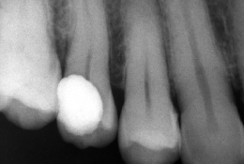
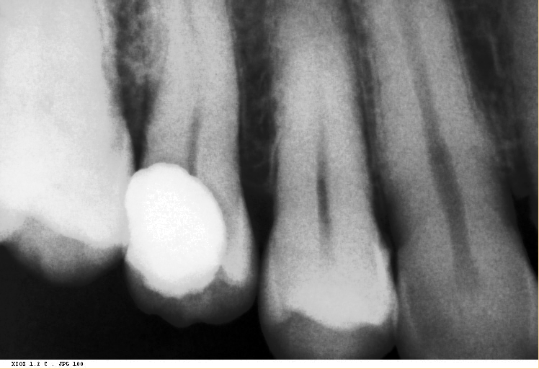
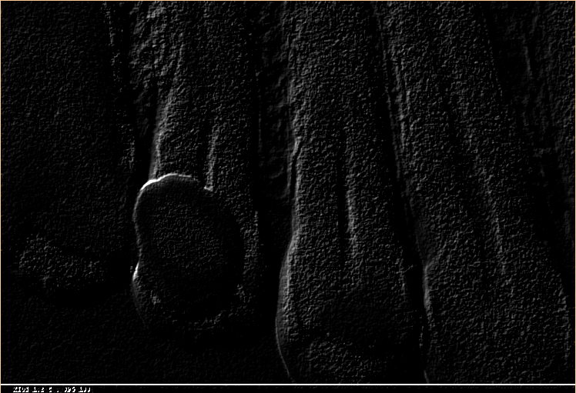
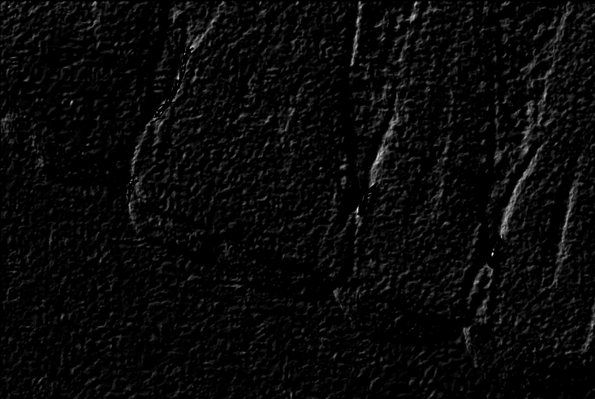
Caries Detection System Conceptual Framework
Image Processing
Dental X-ray Images Dataset
Filter Median
Sharpen Image
Input image
Enhanced Image
Result Analysis
Detection Result
Image clustering and caries detection using FCM
Define parameters
Calculate cluster
Affected by caries
Normal teeth
Calculate distance membership values
Find minimal cluster pixels
Image clustering and caries detection

Slide 7
Caries Detection System
Methodology Framework
Phase
Activities
Outcome
Objective 1 :
To identify requirements in detecting caries that presence in dental x-ray images.
Initial Study
Reading journal and article of :
Dental X-ray
Technique
Image Processing
Similar Study
Problem statement
Objective
Scope
Significant
Requirements in detecting caries
Data Collection
Obtain data from online website
Dental x-ray images to be processed
Objective 2 :
To develop Dental Caries Detection System using Fuzzy c-means.
System Design and Implementation
Design layout system
Pre-processing images
Implement Fuzzy c-means
Writing program using JAVA
Layout of system
Fuzzy c-means clustering
Objective 3 :
To test the efficiency of
the proposed Caries
Detection System in Dental
X-ray Images.
Findings and Conclusion
Evaluation on efficiency and functionality of the system
Result and analysis
Dental Caries Detection System
Final Project Report

Slide 8
Data Analysis
Data collection
Data | Description
Name | Dental x-ray image
Image Type | jpeg
Number of images | 120 images
Image Source | Biomed Central Edition Website (https://bmcoralhealth.biomedcentral.com/)

Slide 9
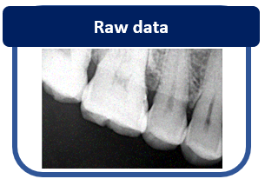
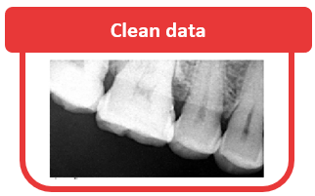
Data Analysis (cont.)
Data preparation
Image enhancement
Filtering noise
Sharpen image

Slide 10
Fuzzy c-means process flow
Input image
Random initialization of cluster center
Initialize membership values
Calculate cluster
Calculate distance membership values
Find minimal cluster
return

Slide 11
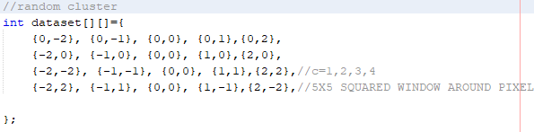
Fuzzy c-means Implementation(cont.)
Randomly initialize cluster center and membership values
is the average of all points that belong to that cluster
Points: pixels in the image
Center of cluster: pixels in the image with cluster center 3 and membership values at (0,0)
-2 -1 0 1 2
-2
-1
0
1
2

Slide 12
Fuzzy c-means Implementation(cont.)
2. Calculate cluster based on membership values
to find minimal or nearest cluster to group 3 partitions
to differentiate between background images, ground teeth region and caries region
3. Find minimal cluster
Loop until all the cluster are stable
Convert to 2-dimensional image (grayscale)
4. Output image is shown

Slide 13
Experiment setup
Test for 120 dental x-ray images
Upload raw data
an x-ray image is upload to test whether the image has caries or not
Perform pre-processing
Consists of two method to enhance the image using filter median and sharpen image
Apply FCM
To test whether the proposed algorithm can show the caries region
If the image has caries, a dark region will show in the image
The output images all are in grayscale, people might confuse to see the dark region of the caries
Therefore, the output images are converted to 2-dimensional images.

Slide 14
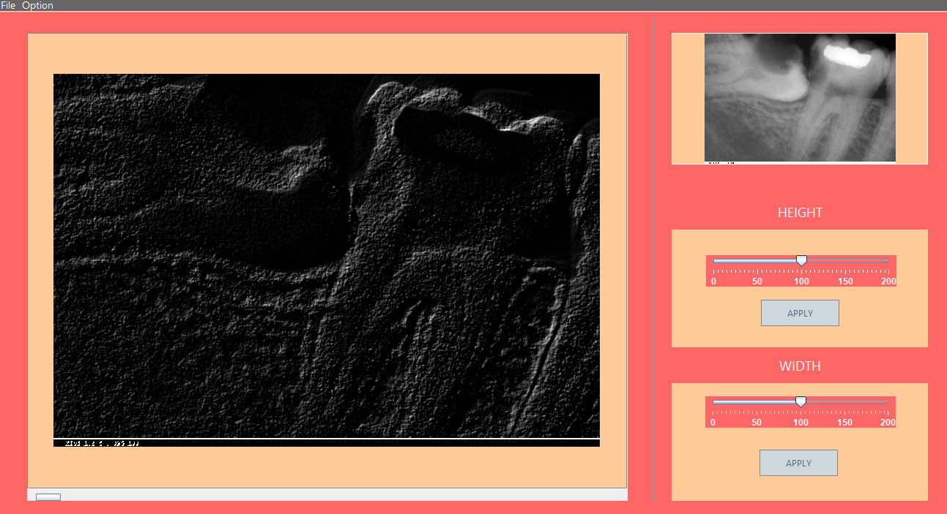
Experiment setup(cont.)
System output
Output image at the system:
Caries shown in a dark region compared to the other two regions

Slide 15
Experiment setup(cont.)
Caries Detection System in Dental X-ray Images using FCM
Tested for all 120 dental x-ray images
Accuracy: 0.9023
Calculate the accuracy based on how many images contain caries and no caries after performed FCM
Compare accuracy with previous research papers to show efficiency of proposed algorithm
Previous Research Papers Accuracy
Deciduous Tooth Extraction in Dental X-ray using Adaptive Fuzzy c-means Clustering and Cavity Finding using SVM 0.9800 (Ali, Hoang, Khan, & Thanh, 2018).
Detection of Oral Cancer using Deep Neural Based Adaptive Fuzzy System in Data Mining Techniques 0.9104 (Lalithamani&Punitha, 2019).
Segmentation of Dental X-ray Images in Medical Imaging using Fuzzy c-means and Neutrosophic Orthogonal Matrices 0.9800 (Ali et al., 2018).
compare

Slide 16
Result Analysis
Caries
No caries
59 images
Actual data
61 images
Caries
No caries
Tested data
46 images
74 images

Slide 17
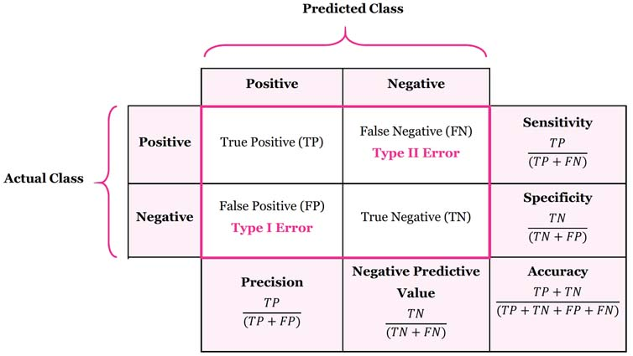
Result Analysis (cont.)
Accuracy
(46+74)/(46+74+10+3)=0.9023
Computational Analysis
Confusion matrix
To evaluate on system performance
Sensitivity
46/(46+3)=0.9388
From tested data:
TP = 46
TN = 74
FP = 10
FN = 3
Specificity
84/(74+10)=0.8936
Precision
46/(46+10)=0.8214

Slide 18
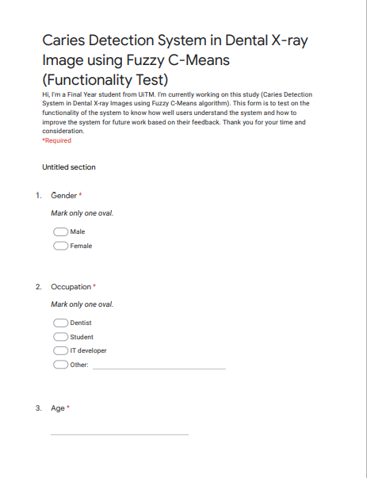
Project Testing & Evaluation
Sample questions
Functionality Test
Functions (or features) are tested by feeding them input and examining the output.
ensures that the requirements are properly satisfied by the application.
Tested on respondents using video demonstration and evaluate on Google Form.

Slide 19

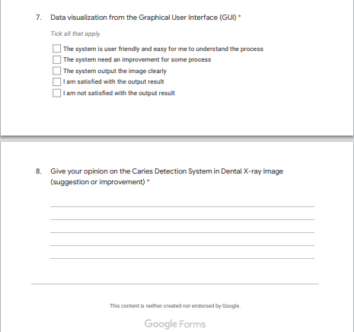
Project Testing & Evaluation(c0nt.)

Slide 20
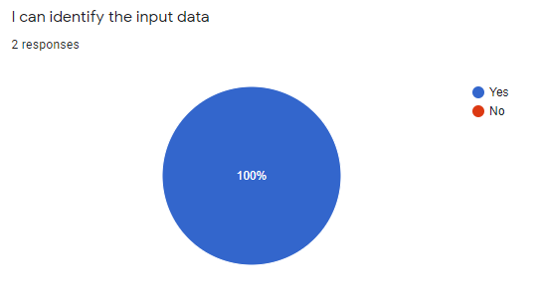
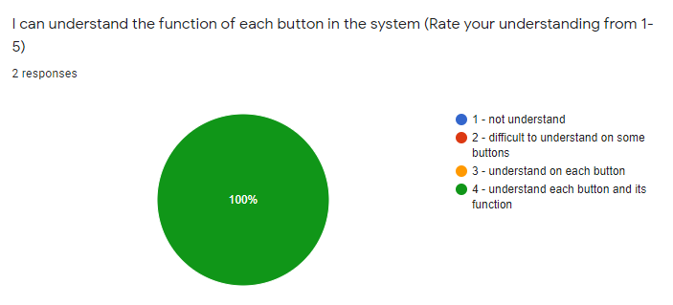
Project Testing & Evaluation(c0nt.)

Slide 21
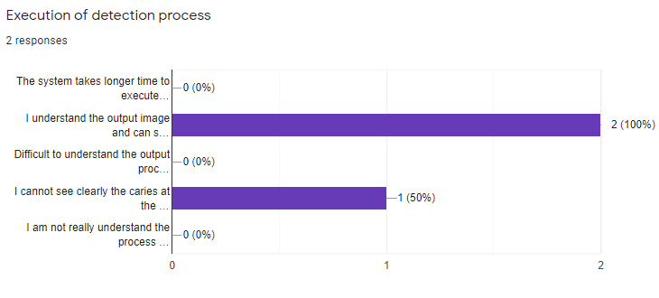
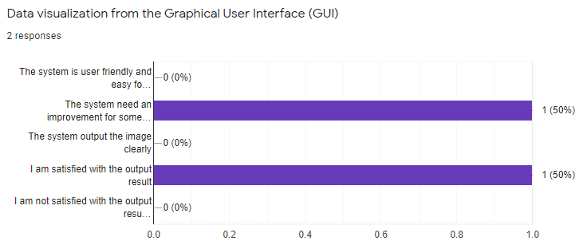
Project Testing & Evaluation(c0nt.)

Slide 22
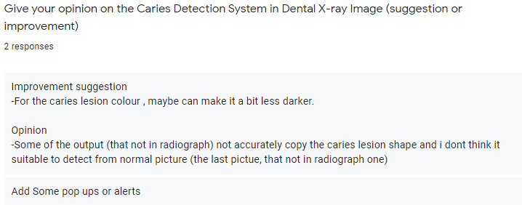
Project Testing & Evaluation(c0nt.)
Respondent 1:
Nurul Hazwani Husna Binti Kornain
Student
School of Dental Sciences, USMKK
“some of the output (not in radiograph) not accurately copy the caries lesion shape and I don’t think it suitable to detect from normal picture”
“for the caries lesion colour, maybe can make it a bit less darker”
Respondent 2:
Norabayah Binti Mohamed Najib
System Test Manager
Tenaga Nasional Berhad, TNB
“add some pop ups or alerts”

Slide 23
Caries Detection System Demonstration
video

Slide 24
Conclusion
In conclusion, this study achieved its objectives. From the results, we can see that Fuzzy c-means can be used to cluster or segment the image to show there is no caries or not in the dental x-ray images based on the segmented region. The functionality of the system works well as expected except for several parts but it still show a good performance of the system based on the results showed previously. However, the system can be improved for future works using suitable and latest method.

Slide 25
Reference
Al-augby, S. H. M., Nermend, K., Majewski, S., & Majewska, A. (2015). A Comparison Of K-Means And Fuzzy C-Means Clustering Methods For A Sample Of Gulf Cooperation Council Stock Markets. (June).
Alireza, Kashani; Kashani, Amir; Milani, Nargess; Akhlaghi, Peyman; Khezri, Kaveh (2008). Robust Color Classification Using Fuzzy Reasoning and Genetic Algorithms in RoboCup Soccer Leagues. Robocup. Lecture Notes in Computer Science. 5001. pp. 548–555. doi:10.1007/978-3-540-68847-1_59. ISBN 978-3-540-68846-4.
Bhaskar (2012). Mean and Standard Deviation for Table and Grouped Data. Retrieved from https://knowpapa.com/sd-freq/
Camargo, S. J., Robertson, A. W., Gaffney, S. J., Smyth, P., &Ghil, M. (2007). Cluster analysis of typhoon tracks. Part I. General properties. Journal of Climate, 20(14), 3635–3653.
Charan, K. L., Raj, P. V. A., & Theresa, M. M. (2018). Deciduous Tooth Extraction In Dental X-Ray Using Adaptive Fuzzy C-Means Clustering And Cavity Finding Using SVM.
Data Clustering (2019). Retrieved from https://sites.google.com/site/dataclusteringalgorithms/
Etehadtavakol, M., Sadri, S., & Ng, E. Y. K. (2010). Application of K- and fuzzy c-means for color segmentation of thermal infrared breast images. Journal of Medical Systems, 34(1), 35–42.9.
Farhang, Y. (2017). Face Extraction from Image based on K-Means Clustering Algorithms. International Journal of Advanced Computer Science and Applications, 8(9), 96–107.
Fariza, A., Arifin, A., Astuti, E., & Kurita, T. (2019). Segmenting Tooth Components in Dental X-Ray Images Using Gaussian Kernel- Based Conditional Spatial Fuzzy C-Means Clustering Algorithm. International Journal of Intelligent Engineering and Systems, 12(3), 108–117.

Slide 26
Reference
Gagula-Palalic, S. (2012). Fuzzy C-means Model and Algorithm for Data Clustering. Southeast Europe Journal of Soft Computing, 1(1).
Göbel, F., & Martin, H. (2018). Unsupervised Clustering of Eye Tracking Data. Spatial Big Data and Machine Learning in GIScience (Workshop at GIScience 2018), 25–28.
Informatika, T., Jember, U. M., Informatika, T., & Indonesia, U. I. (2017). HardianOktavianto1 ,IzzatiMuhimmah 2 , TaufiqHidayat 2 1. 04(02), 75–82.
Lalithamani, K., &Punitha, A. (2019). Detection of Oral Cancer Using Deep Neural Based Adaptive Fuzzy System in Data Mining Techniques. (5), 397–404.
Palle, M. (2012). Dental X-Ray Image Analysis by Using Image Processing Techniques. 2(6), 184–189.
Phon-Amnuaisuk, S., & Au, T. W. (2015). Computational Intelligence in Information Systems: Proceedings of the Fourth INNS Symposia Series on Computational Intelligence in Information Systems (INNS-CIIS 2014). Advances in Intelligent Systems and Computing, 331, 233–234.
Rustempasic, I., & Can, M. (2013). Diagnosis of Parkinson’s Disease using Fuzzy C-Means Clustering and Pattern Recognition. Southeast Europe Journal of Soft Computing, 2(1), 42–49.
Result of Clustered Data (2019). Retrieved from http://mathalytics.blogspot.com/2015/04/k-means-clustering-machine-learning.html
Saxena, N., & Kumar, P. M. (2018). A comprehensive study on data clustering for breastcancer prognosis and risk exposure. 118(24), 1–17.
Son, L. H., Tuan, T. M., Fujita, H., Dey, N., Ashour, A. S., Ngoc, V. T. N., … Chu, D. T. (2018). Dental diagnosis from X-Ray images: An expert system based on fuzzy computing. Biomedical Signal Processing and Control, 39, 64–73. https://doi.org/10.1016/j.bspc.2017.07.005
Steps of Clustering (2019). Retrieved from https://pdfs.semanticscholar.org/9805/154482ba62c1d38a09fd2418d78be43e1c9d.pdf
Steps of Segmentation (2019). Retrieved from https://www.researchgate.net/figure/Clustering-procedure-The-typical-cluster-analysis-consists-of-four-steps-with-a-feedback_fig1_3303538
Tuan, T. M., Ngan, T. T., Hoa, N. T., &Loi, N. B. (2016). Between Fuzzy Clustering And Semi-Supervised Fuzzy. 18–23.
V, B. S. (2012). Development of a Data Clustering Algorithm for Predicting Heart. 48(7), 8–13.
Vasuda, P., &Satheesh, S. (2010). Improved Fuzzy C-Means Algorithm for MR Brain Image Segmentation. International Journal on Computer Science and Engineering, 2(5), 1713–1715.
Wang, X., Wang, Y., & Wang, L. (2004). Improving fuzzy c-means clustering based on feature-weight learning. Pattern Recognition Letters, 25(10), 1123–1132.
Yang, H. L., Peng, J. H., Xia, B. R., & Zhang, D. X. (2013). Remote sensing classification using fuzzy C-means clustering with spatial constraints based on random field. European Journal of Remote Sensing, 46(1), 305–316.

