Slide 1
MOBILE FIRST-PERSON SHOOTER GAME USING BASIC THETA* ALGORITHM
MUHAMMAD SYURAHBIL BIN ABD ROHAMAN
Sir ZAWAWI BIN ABDUL WAHAB

Slide 2
Problem statement
The most common pathfinding in video games, A* doesn’t always produce the true shortest path
If algorithm is badly optimized, it will take a lot of resources and the game would not run smoothly
Unity Engine has its own pathfinding solution using A* algorithm, but it has a lot of bugs

Slide 3
OBJECTIVES
To identify the pathfinding algorithm in video games that produce the true shortest path.
To develop a mobile game using Basic Theta* algorithm.
To evaluate the performance of Basic Theta* algorithm with built in Unity A* pathfinding.

Slide 4
SCOPE
Users | Data | Technical
Only for Android users Suitable for 13 years old and above due to the nature of the game (blood) | Maps Starting location Ending location | Running on Android 5.0 (Lollipop) and above

Slide 5
RELATED WORKS
No. | Title | Platform |  |  | Pathfinding | Dynamic Obstacle Avoidance | Map Presentation
 |  | PC | Mobile | Others
1 | A* and Basic Theta* Algorithm in Android-Based Games |  | Android |  | A* Basic Theta* | NA | Square Grid
2 | Applying Theta* in Modern Game | ✓ |  |  | A* Basic Theta* | NA | Square Grid
3 | Path Planning with Modified A Star Algorithm for a Mobile Robot |  |  | Robotic | A* Basic Theta* Phi* JPS (A*) | NA | Square Grid
4 | Hybrid Pathfinding in StarCraft | ✓ |  |  | Potential Fields Boids | NA | Square Grid
5 | Pathfinding in Car Racing Game | ✓ |  |  | A* | DPA* | Square Grid

Slide 6
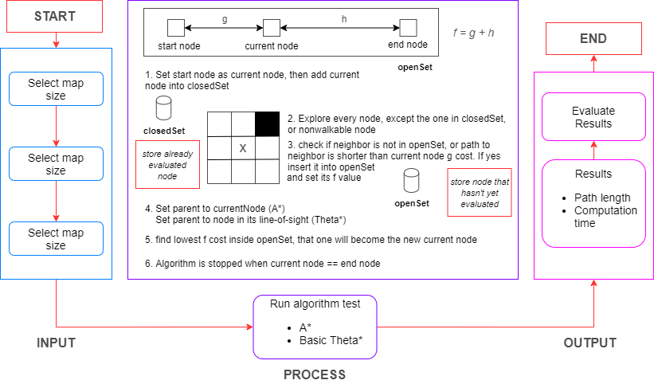
ZOMBIE SURVIVAL CONCEPTUAL FRAMEWORK

Slide 7
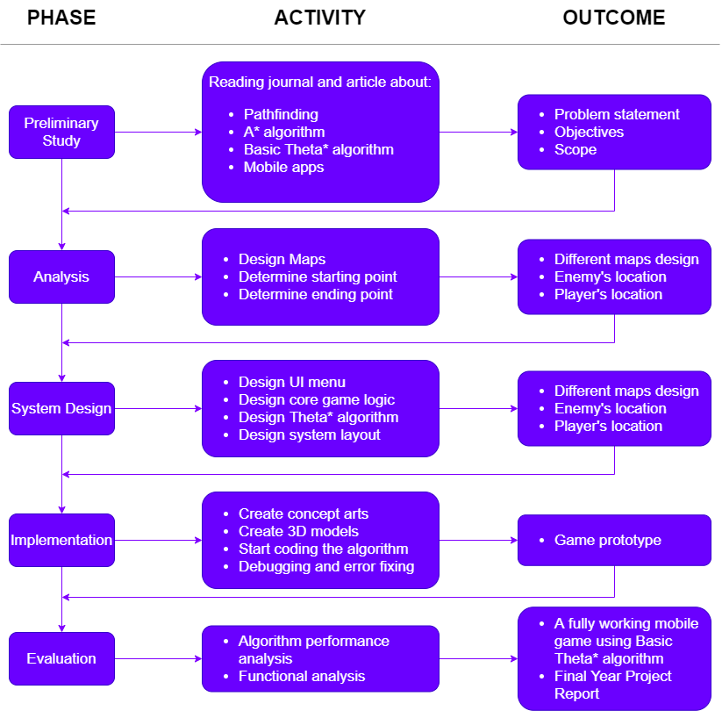
ZOMBIE SURVIVAL methodology FRAMEWORK
Objective 1
To identify the pathfinding algorithm in video games that produce the true shortest path.
Objective 2
To develop a mobile game using Basic Theta* algorithm.
Objective 3
To evaluate the performance of Basic Theta* algorithm with built in Unity A* pathfinding.

Slide 8
Data DESCRIPTION
Data | Data Type | Description
Map | Polygon-based map | Map that consist of walkable region and nonwalkable region (obstacle)
Starting Position | Vector3 (x,y,z) coordinate | Position of enemy in game
Ending Position | Vector3 (x,y,z) coordinate | Position of player in game

Slide 9
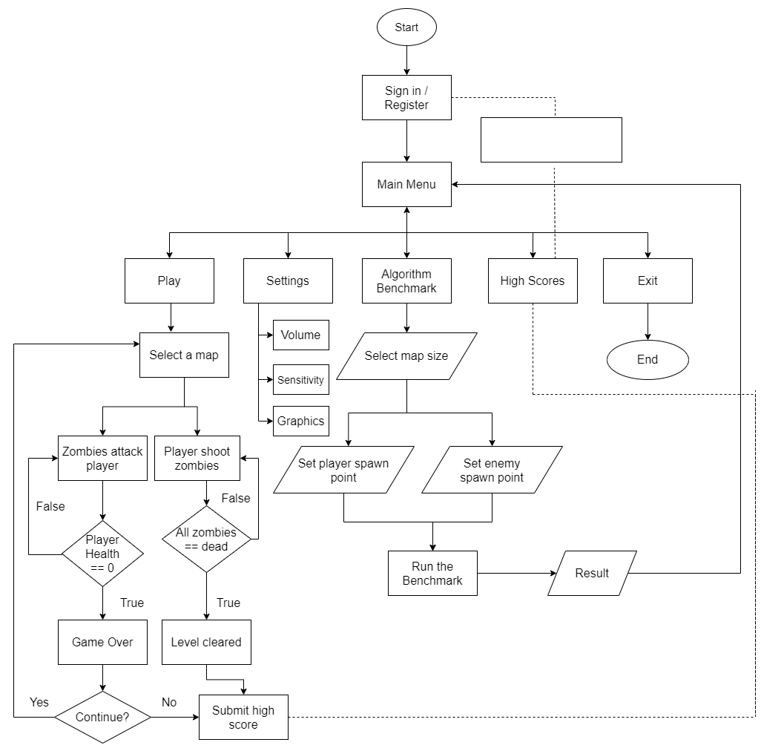
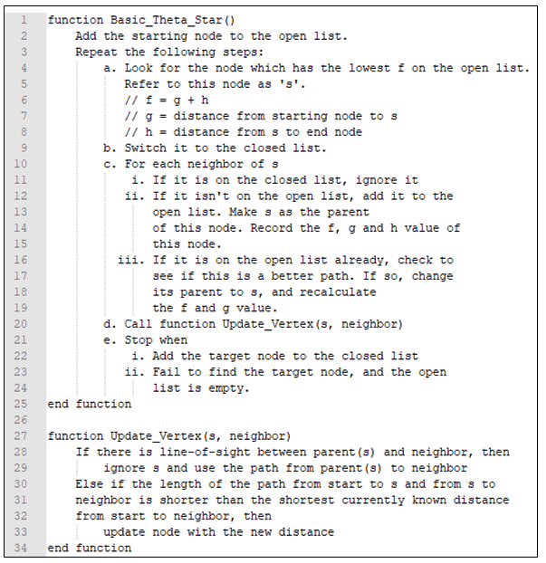

LOGICAL DESIGN of zombie survival app
PSEUDOCODE OF BASIC THETA* ALGORITHM

Slide 10
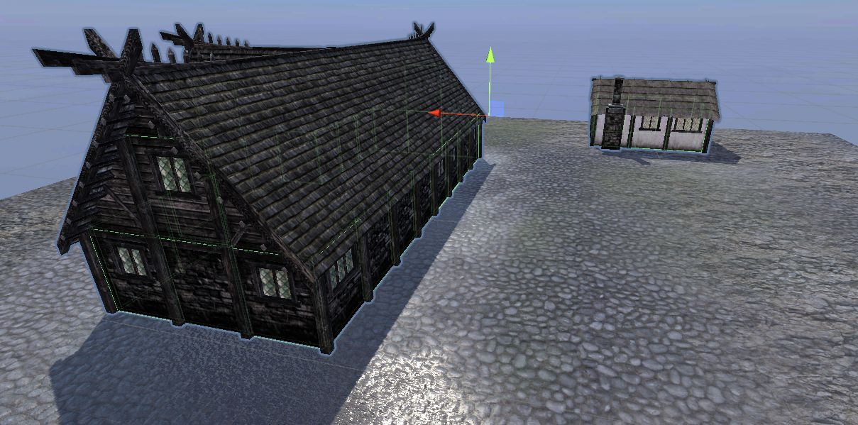
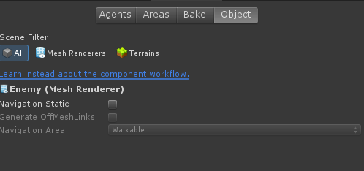
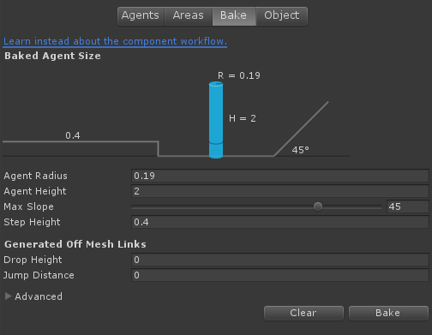
Experimental setup (1/3)
Select walkable and nonwalkable gameobjects
Assign them with their related options
Bake the map

Slide 11
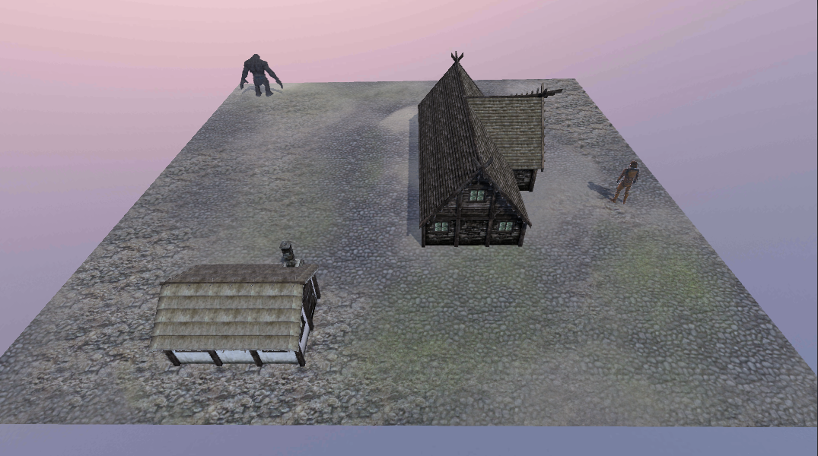
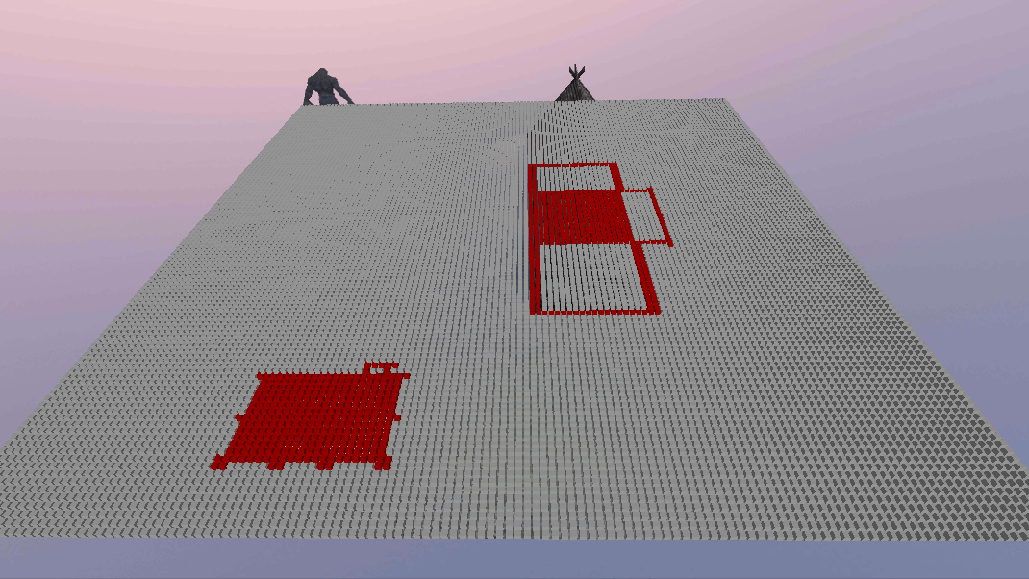
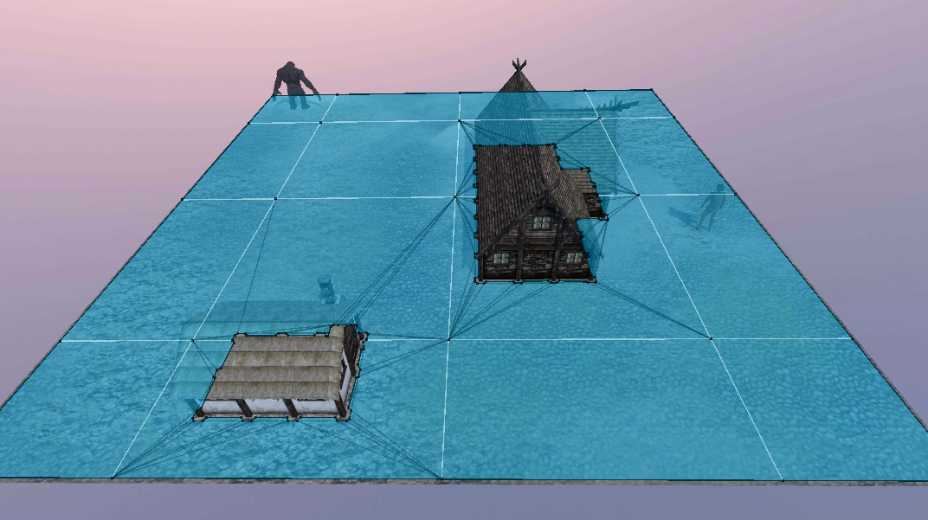
Experimental setup (2/3)
After baking process
Original map
Grid map
Navigation Mesh

Slide 12
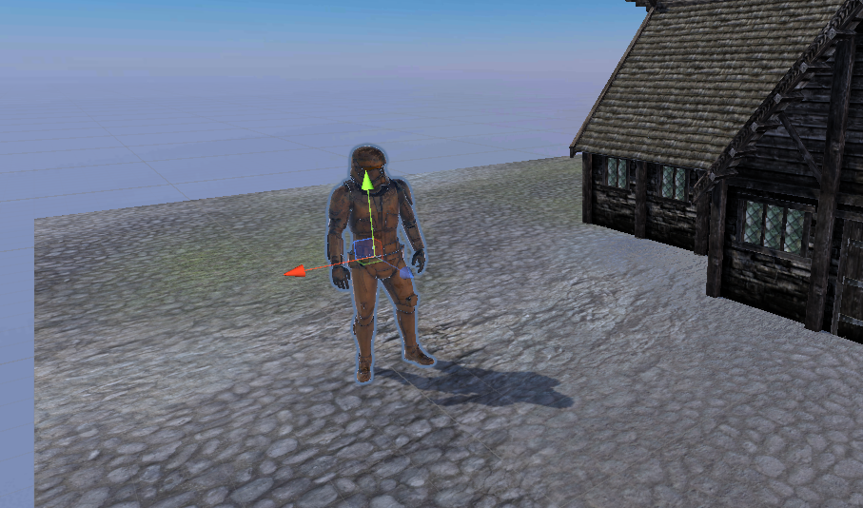
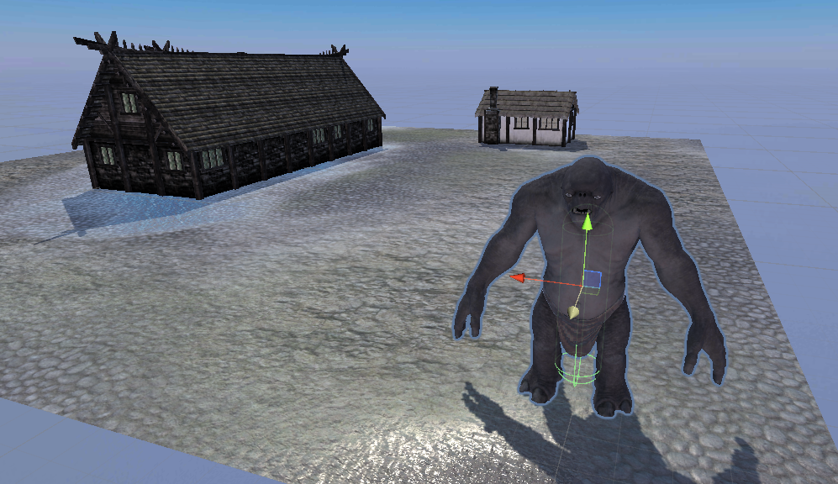
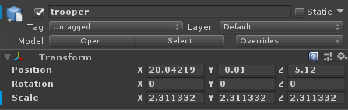
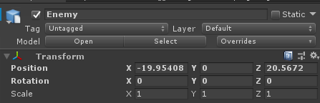
Experimental setup (3/3)
Move the player and the enemy to any position on the map
Player’s location
Enemy’s location

Slide 13
RESULTS & ANALYSIS
Experiment 1: 50 x 50 map
Path generated by Theta* is the shortest
A* using NavMesh has the lowest computation time
Only small difference between Theta* and A* using grid

Slide 14
RESULTS & ANALYSIS
Experiment 2: 100 x 100 map
Theta* still produce the shortest path length
A* still the fastest computation time

Slide 15
RESULTS & ANALYSIS
Experiment 3: 200 x 200 map
Still the same result as before for total path length
Computation time increase a lot on algorithms that use grid map representation
No significant change of A* using NavMesh computation time
Based on 3 experiments, Theta* perform the best in term of path length
A* using NavMesh perform the best in term of computation time

Slide 16

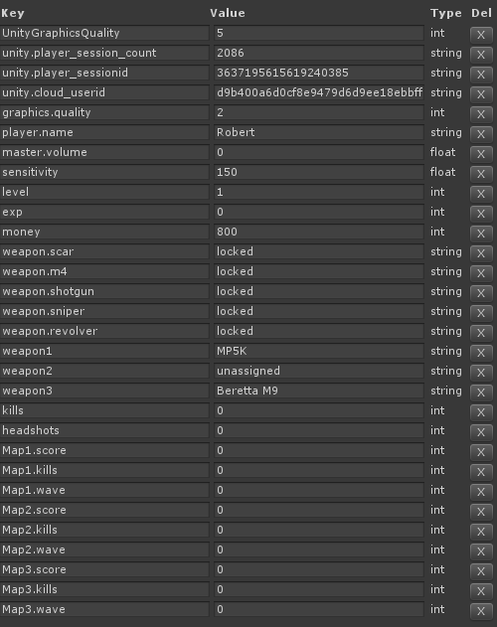
FUNCTIONALITY TEST
Player’s registration
PlayerPrefs (Database)
Player is successfully registered and data are initialized inside the player database

Slide 17


FUNCTIONALITY TEST
Player’s settings
PlayerPrefs (Database)
Settings that have been modified are properly stored inside the PlayerPrefs

Slide 18
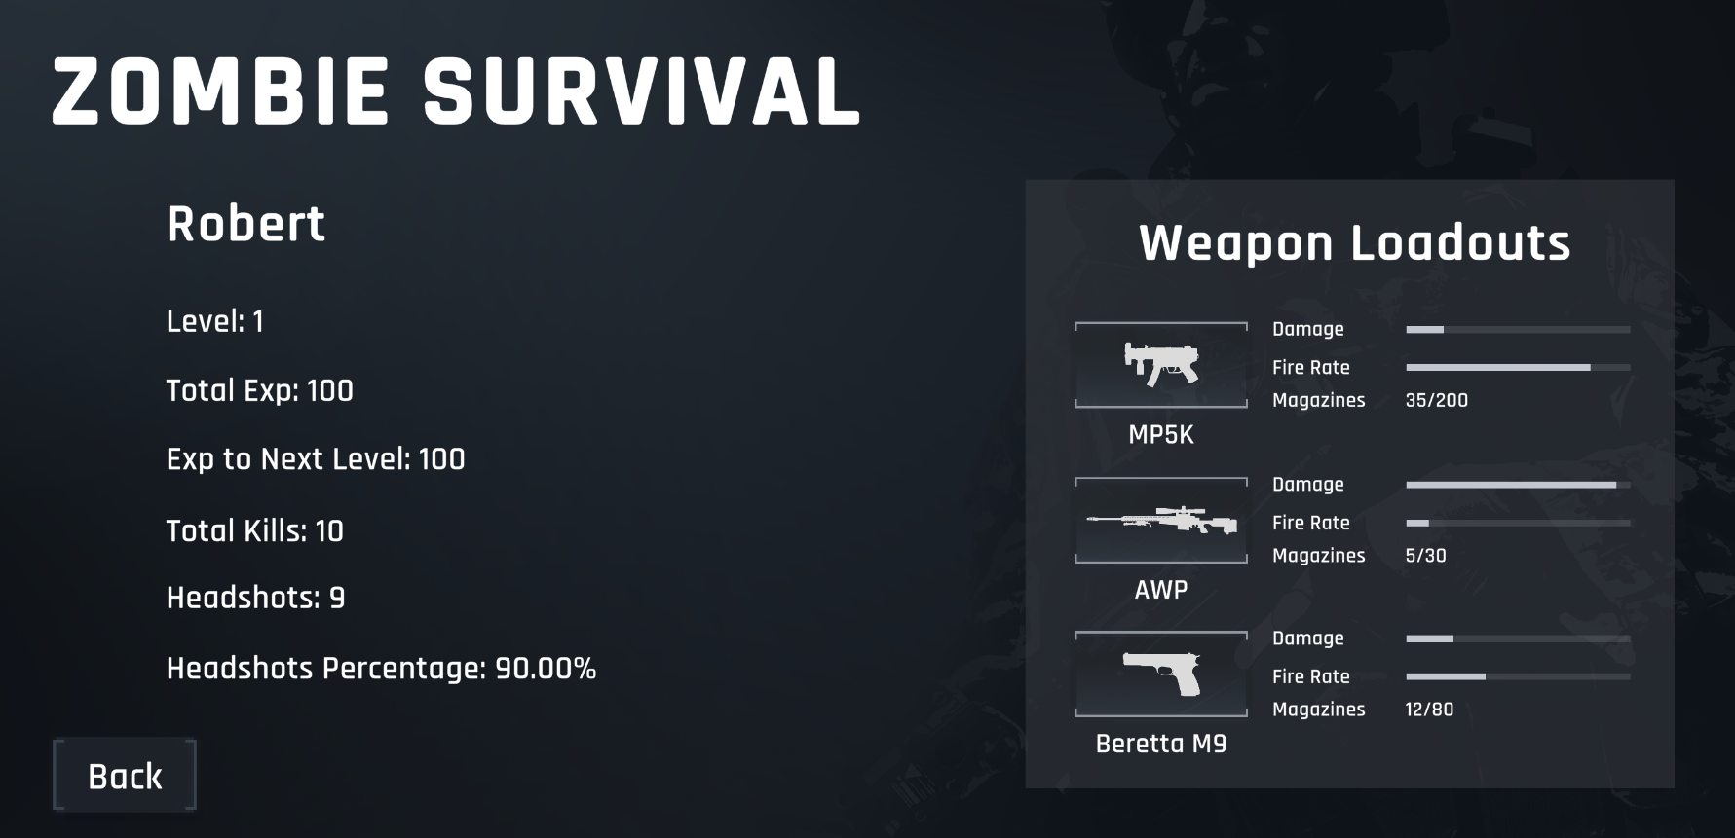
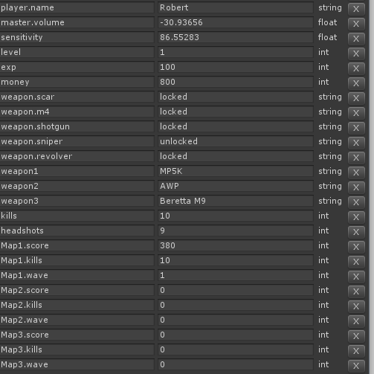
FUNCTIONALITY TEST
Player’s Profile
PlayerPrefs (Database)
Player’s information and weapon loadouts information are retrieved successfully from the PlayerPrefs

Slide 19
CONCLUSION
Basic Theta* algorithm produced shorter pathway compared to A*.
A* still has advantage of faster computation time.
A few optimizations can be made to decrease the computation time of Theta*.
Basic Theta* is also implemented in the mini game inside the app and it works nicely.

Slide 20
references
Duchon, F., Babinec, A., Kajan, M., Beno, P., Florek, M., Fico, T., & Jurišica, L. (2014). Path planning with modified A star algorithm for a mobile robot. Procedia Engineering, 96, 59–69. https://doi.org/10.1016/j.proeng.2014.12.098
Firmansyah, E. R., Masruroh, S. U., & Fahrianto, F. (2017). Comparative analysis Of A∗ and basic theta∗ algorithm in android-based pathfmding games. Proceedings - 6th International Conference on Information and Communication Technology for the Muslim World, ICT4M 2016, 275–280. https://doi.org/10.1109/ICT4M.2016.56
Hagelbäck, J. (2016). Hybrid Pathfinding in StarCraft. IEEE Transactions on Computational Intelligence and AI in Games, 8(4), 319–324. https://doi.org/10.1109/TCIAIG.2015.2414447
Huu Le, P. T. (2018). Applying Theta* in Modern Game. Journal of Computers, 13(5), 527–536. https://doi.org/10.17706/jcp.13.5.527-536
Sazaki, Y., Primanita, A., & Syahroyni, M. (2018). Pathfinding car racing game using dynamic pathfinding algorithm and algorithm A∗. Proceedings - ICWT 2017: 3rd International Conference on Wireless and Telematics 2017, 2017-July, 164–169. https://doi.org/10.1109/ICWT.2017.8284160

