Slide 1
SECURED CLOUDS SYSTEM FOR SHARING AND STORING TEXT DOCUMENT USING HYBRID CRYPTOGRAPHY
PREPARED BY: FATHINI BINTI BADRUDIN
2017449868
SUPERVISOR: SIR MAZLAN BIN OSMAN

Slide 2
PROBLEM STATEMENT
Data security
  The confidential data are not secured when send or upload on cloud. It also can be altered by the hackers.
  Sol: The data will be encrypt before send to the cloud.
Transmission in Cloud Computing:
  During the transmission on sending the data, the data would be steal by the unauthorized user.
  Sol: It use the public and private key when encrypt the data and send to the cloud.

Slide 3
OBJECTIVES SCOPE
To identify the types of data security issues in cloud system.
To develop the system that secure the data in cloud system using AES and RSA algorithm.
To evaluate the functionality of this system.
User:
  The user need basic knowledge on how to use this system.
Data:
  The system can read all file that want to encrypt and make it on XML format.
Method:
  This system used the hybrid cryptography (AES and RSA)
Process:
  This read the file that user browse and generate the key before enrypted it and convert into .text as an output.

Slide 4
SIMILAR APPLICATION
Application Area | Issues/Problem domain
Health-care cloud | Storage for sensitive data Access from unauthorized channel Data leaked
Cloud computing | Multi-tenancy Elasticity Availability of information Information integrity
Multi-cloud storage | Management complexity Concurrency control
Wireless sensor networks | Routing security Secure localization Key management Small memory
RDBMS (Nary storage model) | Data security Online transaction processing

Slide 5
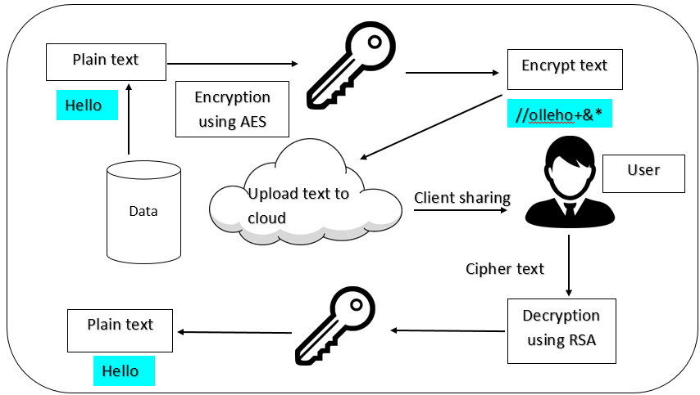
CLOUDS SYSTEM CONCEPTUAL FRAMEWORK

Slide 6
CLOUDS SYSTEM METHODOLOGY FRAMEWORK
Preliminary Study
Data Collection
System Design and Analysis
Result Analysis
Reading journal and article of:
Cryptography algorithm
Cloud computing
Security
Identify problems
Secondary data
Do some research about the data using Kaggle.
Medical data
Design the proposed system by using AES and RSA algorithm.
Code using python language and debugging.
Test the system functionality
Activities
Problem statement
Objectives
Scope
Significance of study
Transform the data into file.
The data can do the cryptography.
The data can read in the excel file
Working optimization engine
AES: to encrypt the file
RSA : to decrypt the file
Final project report
Expected outcome
Objective 1
Objective 2
Objective 3

Slide 7
COLLECTION OF DATA
Data type
Medical data (secondary data)
Number of data
200
Source
Kaggle website

Slide 8
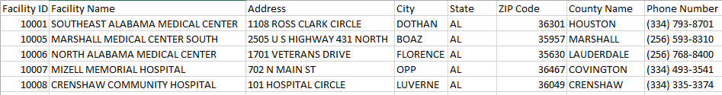
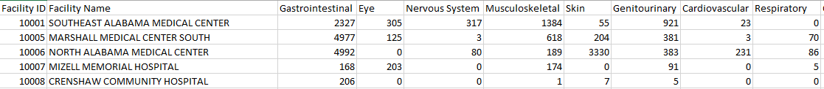
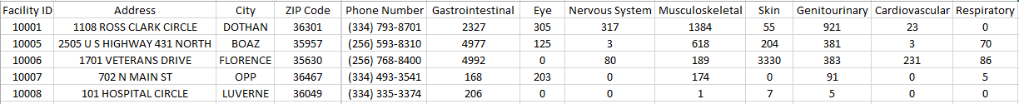
RAW DATA
Information of the patient
Information about disease of the patient
SAMPLE DATA

Slide 9
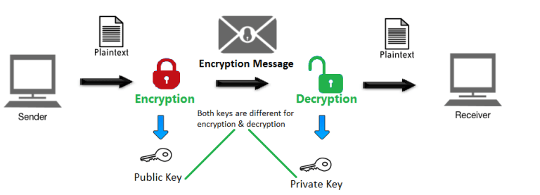
CRYPTOGRAPHY ARCHITECTURE

Slide 10
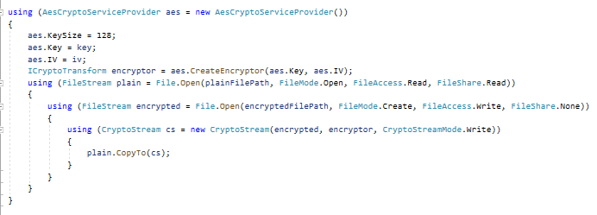
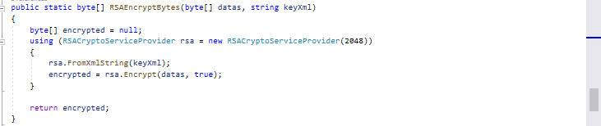
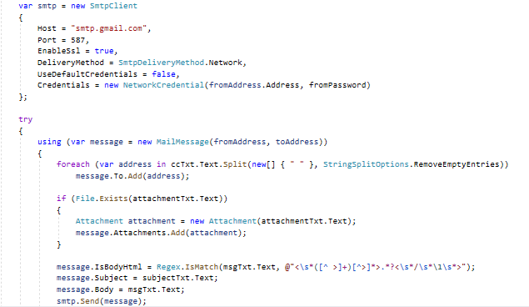
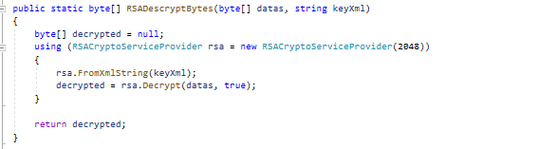
EXPERIMENT SETUP
AES algorithm
SMTP setup
RSA algorithm

Slide 11
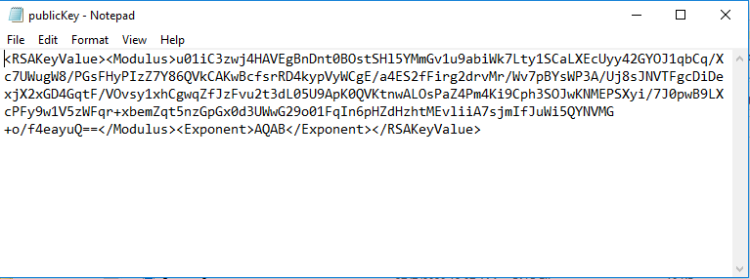
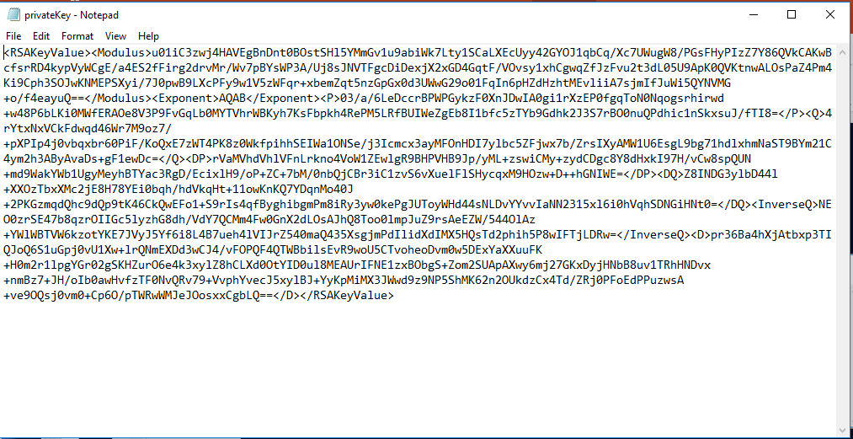
RESULT ANALYSIS

Slide 12
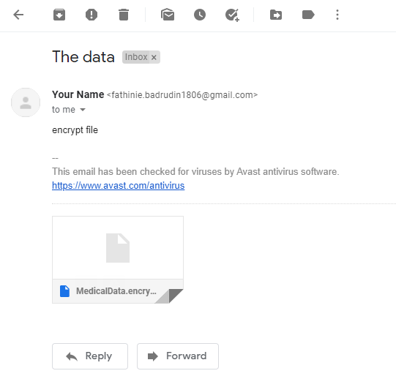
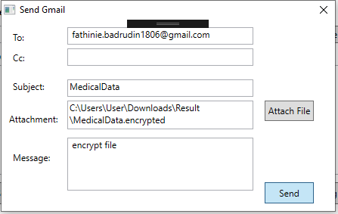
RESULT ANALYSIS

Slide 13
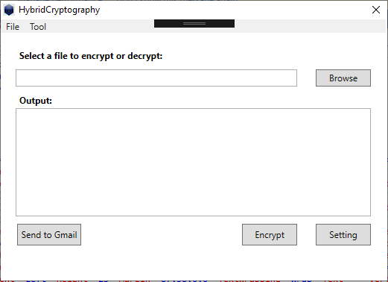
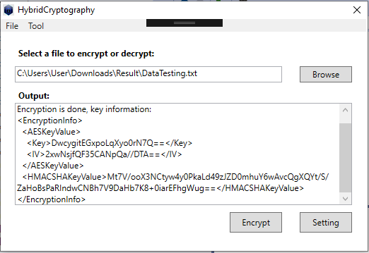
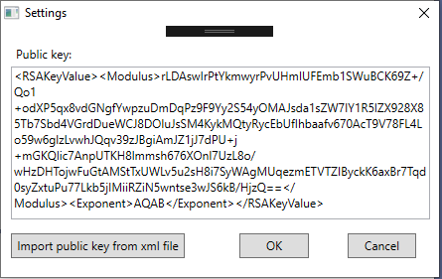
PROJECT TESTING
Select the file that want to encrypt.
The file have been encrypted.
Generate key on tool button and import it into setting button

Slide 14
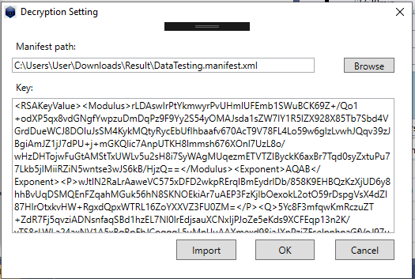
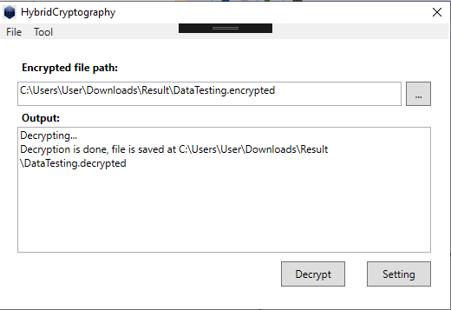
This figure shows the decryption window which need to import the private key on previous encryption.
The decryption is done, and the file were place on the file which be encrypt.

Slide 15
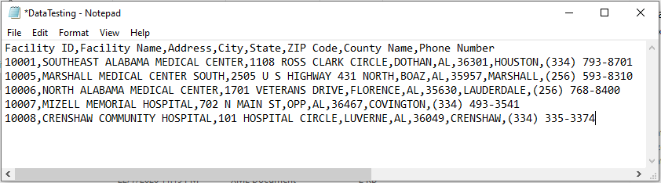
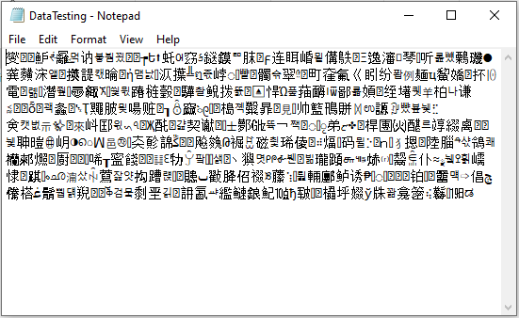
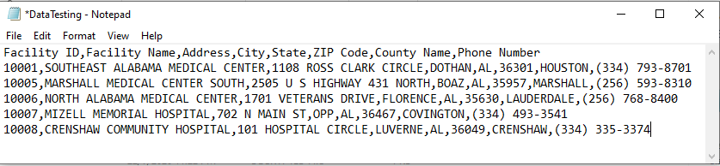
Encrypt file
Plain text
Decrypt file, which is convert into plain text.

Slide 16
CLOUD SYSTEM DEMO

Slide 17
CONCLUSION
The system were built on objective two and the functionality of this system were achieve on objective three. The user can get the result of the encryption and decryption process. The message will secure during transfer into cloud. From doing this project, many lesson and new knowledge are learnt.

Slide 18
REFERENCES
Bala, I. (2014). Review of Cryptography With Ecc. 1(4), 10–12.
Calloway, D. L. (2008). Running head: LITERATURE REVIEW OF
CRYPTOGRAPHY & NETWORK SECURITY. (September), 1–27.
Chinnasamy, P., & Deepalakshmi, P. (2018). Design of Secure Storage for Healthcare Cloud using Hybrid Cryptography. 2018 Second International Conference on Inventive Communication and Computational Technologies (ICICCT),
(October), 1717–1720. https://doi.org/10.1109/ICICCT.2018.8473107
Francis, N. (2018). An Analysis of Hybrid Cryptographic Approaches for Information Security. 13(3), 124–127.
Huma, K., Sheraz, M., Malik, A., Safdar, S., Jabeen, B., Arshad, R., … Encryption, H. (2018). Integration and Combination of Cryptographic Algorithm for Data Security in Cloud. 16(7), 198–203.
Kalagiakos, P., & Bora, M. (2012). Cloud security tactics: Virtualization and the VMM. 2012 6th International Conference on Application of Information and Communication Technologies, AICT 2012 - Proceedings. https://doi.org/10.1109/ICAICT.2012.6398491
Kaur, J., Bharti, V., & Singh, S. (2018). Secure Cloud Data Access and Storage Policies. 16(5), 38–44.
Mendes, R., Oliveira, T., Cogo, V. V., Neves, N. F., & Bessani, A. N. (2019). CHARON: A Secure Cloud-of-Clouds System for Storing and Sharing Big Data. IEEE Transactions on Cloud Computing, XX(March), 1–12. https://doi.org/10.1109/TCC.2019.2916856

Slide 19
CONT.
Tianfu, W., & Babu, K. (2012). Design of a Hybrid Cryptographic Algorithm.
International Journal of Computer Science & …, 2(2), 277–283. Retrieved from http://www.ijcscn.com/Documents/Volumes/vol2issue2/ijcscn2012020222.pdf
Various Schemes for Database Encryption - A Survey. (2017). 12(19), 8763–8767.
Ramadan, E. H. H., & Djamilou, M. A. (2017). Using Cryptography Algorithms to Secure Cloud Computing Data and Services American Journal of Engineering Research ( AJER ). (10), 334–337.
Ramya, T., Rama, V. V, Vidyanikethan, S., & College, E. (2017). Cryptography
Algorithms and Attacks. International Research Journal of Engineering and
Technology(IRJET), 4(5), 1317–1321. Retrieved from https://www.irjet.net/archives/V4/i5/IRJET-V4I5398.pdf
Rizk, R., & Alkady, Y. (2015). Two-phase hybrid cryptography algorithm for wireless sensor networks. Journal of Electrical Systems and Information Technology, 2(3), 296–313. https://doi.org/10.1016/j.jesit.2015.11.005
Raza, M., Imtiaz, A., & Shoaib, U. (2019). A review on security issues and their impact on hybrid cloud computing environment. International Journal of Advanced Computer Science and Applications, 10(3), 353–357. https://doi.org/10.14569/IJACSA.2019.0100346

Slide 20
CONT.
Shakeeba Khan, M. S., & Sakshi Deshmukh, M. S. (2014). International Journal of
Computer Science and Mobile Computing Security in Cloud Computing Using
Cryptographic Algorithms. International Journal of Computer Science and Mobile Computing, 3(9), 517–525. Retrieved from www.ijcsmc.com
Subbalakshmi, S., & Madhavi, K. (2018). Security challenges of Big Data storage in Cloud environment: A Survey. International Journal of Applied Engineering
Research, 13(17), 13237–13244. Retrieved from http://www.ripublication.com
Suganya, N. (2014). A Framework based on Security Issues in Cloud Computing.

Slide 21
THANK YOU

