Slide 1
Application of
Projectile
Motion in Basketball:
Determine Angle in Free
Throw by Using GUI
NAME : NIK NUR SHARINA binti SHAMSUDDIN
2017669354
SV NAME : PN. SITI MUSLIHA binti NOR AL - DIN

Slide 2
INTRODUCTION
This project will be using blueJ software to get Initial velocity, Optimal Release Angle, Max Height of The Ball can Reach and Time Taken for The Ball to Reach The Basketball Hoop.
It also will discuss about the relationship between the optimal release angle with the height of the players, the relationship between initial velocity with the height of the players and the relationship between the optimal release angles with the time taken for the ball to reach the basketball hoop.

Slide 3
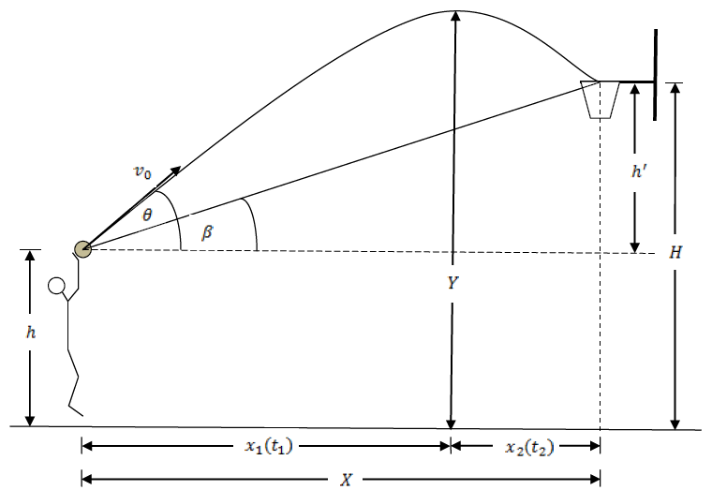
PROBLEM STATEMENT
What is the best angle for him to shoot a free throw?
Before shooting the ball, what is the minimum initial velocity to send the ball from player to the hoop?
If the height of the ball give effect to shooting?
What is the time taken for the ball to reach the basketball hoop?

Slide 4
OBJECTIVE
To determine the perfecting of the release angle in the free throw by using GUI.
To obtain the impact of angle due to the high basketball player.
To calculate the initial velocity and its relationship between the height of the basketball players.
To find the effectiveness of the optimal release angle to the time taken for the ball to reach the basketball hoop and the maximum height of the ball can reach.

Slide 5
PROJECT BENEFITS
This research will help the coach and the entire basketball player’s performance in basketball free throws by using the concept of projectile motion with a combination of Mathematical Modeling.
They can aim at what is the right angle that they should take in the free throw to score their game

Slide 6
LITERATURE REVIEW
Based on the Kozar(1994), it states that free throw was being considered as an important shot in the basketball where twenty percent from the point are mostly scored by the free throw.
Based on the Okuba & Hubbard he shooting of the free throw should be easier in the game since the player is all alone without any defense .

Slide 7
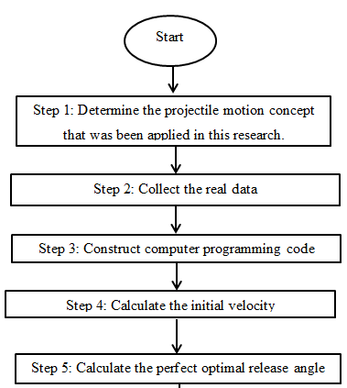
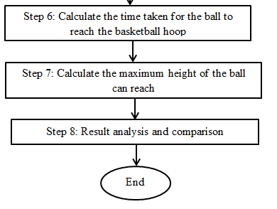
METHADOLOGY

Slide 8
EXPECTED RESULT
The increasing height of the basketball players will affect and decreasing the initial velocity, optimal release angle and time taken for the ball to reach the hoop.

Slide 9
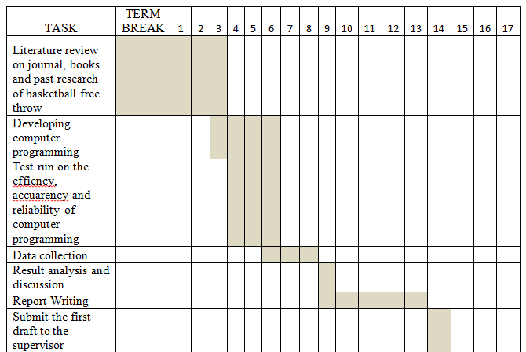
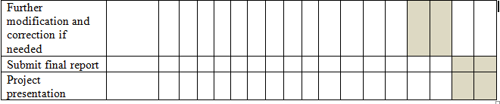
PROJECT SCHEDULING (GANT CHART)

Slide 10
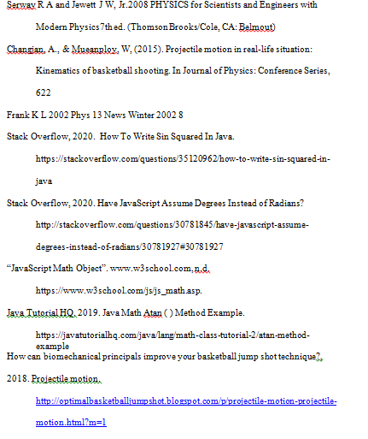
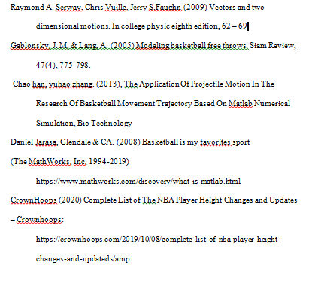
REFERENCES

