Slide 1



HYBRID OF MODIFIED BISECTION METHOD AND NEWTON’S METHOD FOR SOLVING NONLINEAR EQUATIONS
NURHASBIAH BINTI MAT NOOR
2017696372
BACHELOR OF SCIENCE (HONS.) COMPUTATIONAL MATHEMATICS
SUPERVISOR: ENCIK MUHAMMAD FAUZI BIN EMBONG

Slide 2

Background Of Study
Numerical analysis is a related branch of mathematics that deals with devising efficient methods for obtaining numerical solutions to difficult mathematical problems.
According to Atkinson (1989), most numerical analysis specializes in small subfields, but they share some common concerns, perspectives, and mathematical methods of analysis.
It deals with all aspects of numerical problem solving, from theory development and understanding of numerical methods to practical implementation as a reliable and efficient computer program.
Three method of numerical analysis to be compared with new approach method, Hybrid method: - Modified Bisection method
- Newton’s method
- Secant method.

Slide 3

Problem Statement
A new Hybrid method is proposed in this project to investigate its efficiency, compared to Modified Bisection method, Newton’s method and Secant method.
2
1
There are many methods in finding root for nonlinear equations, the effectiveness and efficiency of the method may be different depend on the research’s interest.

Slide 4



Objectives
To propose a Hybrid of Modified Bisection method and Newton’s method for solving nonlinear equation.
OBJECTIVES
To analyses the performance of this new proposed method based on the number of iterations, CPU times and errors.
To compare the performance of this new proposed method with Modified Bisection method, Newton’s method and Secant method.

Slide 5
Significant Of Study
There are several factors that will determine the method to be used in Modified Bisection, Newton’s method and Secant method which are the number of iterations, CPU times and the performance of this new proposed method.
Thus, a Hybrid method is effectively developed to find the accurate root and it will be created to reduce the number of iterations.

Slide 6


Literature Review
The secant method is a very effective numerical procedure used to solve nonlinear equations of the form f(x)=0. It is derived through a linear interpolation procedure and uses only values of f(x) close to the root of f(x)=0, hence it computes f(x) only once per iteration.
(Sidi, A., 2008)
The Modified Bisection method is an extension of bisection method to solve nonlinear equations is a construct to reduce the number of iterations and numerical error in nonlinear equation.
(Tanakan, 2013)
The Hybrid algorithm computes Modified Bisection method steps initially then apply Newton’s method steps without considering the given function and interval. However, the complexity of this algorithm requires higher CPU time.
(Hussein, K. A., et. al, 2015).
Newton’s method does not require initial interval.
(Lerman, 1993)

Slide 7




Methodology
Modified Bisection
Method
Newton’s method
Secant method
Hybrid method
Guess an interval [a,b] which f(a) and f(b) has different sign.
Divide the interval, $m=\frac{a+b}{2}$ and find f(m).
Determine if root exists, $f\left(a\right).f\left(m\right)<0$, then$rε\left(a,m\right)$ or $f\left(m\right).f\left(b\right)<0$, then$rε\left(m,b\right)$
Compute for $w=−\frac{k}{g}$ where $g=\frac{f\left(b\right)−f(a)}{b−a}$ and $k=f\left(b\right)−g\left(b\right)$ or $k=f\left(a\right)−g(a)$.
Determine if root exists, $f{(a}_{k}).f\left(w_{k}\right)<0$, then$\left(a_{k},w_{k}\right)$ or $f(w_{k}).f(b_{k})<0$, then$\left(w_{k},b_{k}\right)$
If |f(w)|<TOL, then STOP program ELSE repeated until desired iterations or accuracy.
Find an initial number $x_{0}$
Compute $f\left(x_{0}\right)$ and $f′(x_{0})$
Compute $x_{n}=x_{n−1}−\frac{f(x_{n−1})}{f′(x_{n−1})}$ where n=0,1,….
Repeated until desired iteration
Find two starting point, $x_{0}$ and $x_{1}$
Compute $f(x_{0})$ and $f(x_{1})$
Compute $x_{n+1}=x_{n}−\frac{\left(x_{n−1}−x_{n}\right)f(x_{n})}{f\left(x_{n−1}\right)−fx_{n})}$ where n=1,2,…
Determine if the root exists |$x_{n+1}−x_{n}|<TOL,$ then $r=x_{n+1}$ else $x_{n−1}=x_{n};x_{n}=x_{n+1}$
Repeated until the desired iteration
Guess an interval [a,b] which f(a) and f(b) has different sign.
Compute into $x_{i}=\frac{(a+b)}{2}$ and $f(x_{i})$
If $f\left(a\right).f\left(x_{i}\right)<0,$ then $b_{k}=w_{k}$ else $a_{k}=w_{k}$
Compute for $w=−\frac{k}{g}$ where $g=\frac{f\left(b\right)−f(a)}{b−a}$ and $k=f\left(b\right)−g\left(b\right)$
If $f\left(a_{k}\right).f\left(w_{k}\right)<0,$ then $b_{k}=w_{k}$ else $a_{k}=w_{k}$
Compute $f^{′}\left(x_{i}\right)$ and $k=\frac{f(x_{i})}{f′(x_{i})}$
Repeated until desired iteration

Slide 8
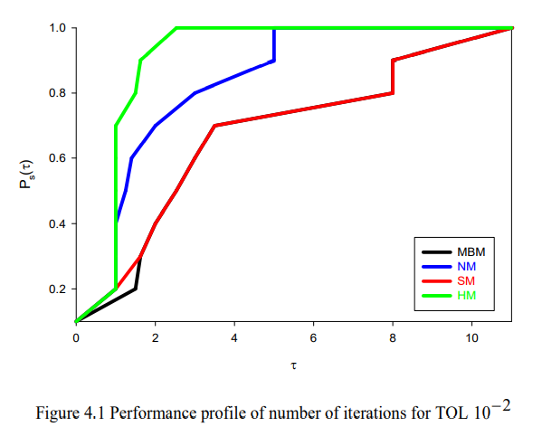
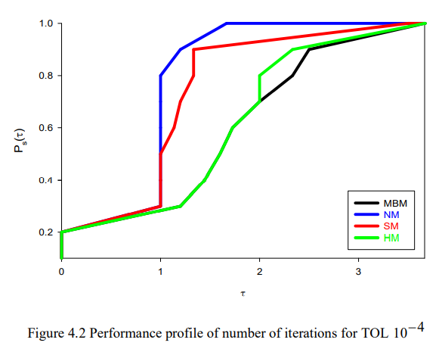
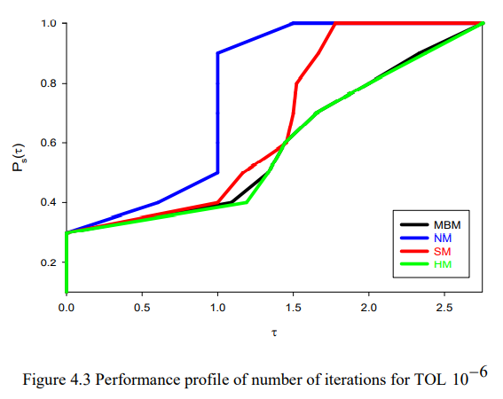
Result And Discussion
Number of iterations
In term of number of iterations, it is showed that Newton’s method is the best method for tolerance 10^-4 and 10^-6 followed by Secant method. Hybrid method only the best solution for 10^-2 tolerance factor because it determined by the top right of the performance profiles.

Slide 9
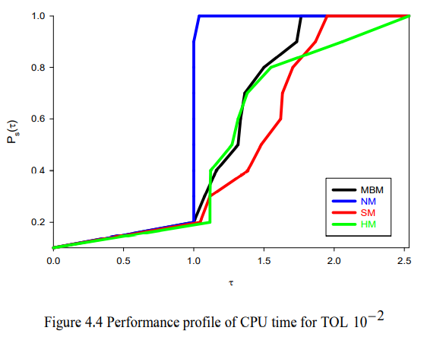
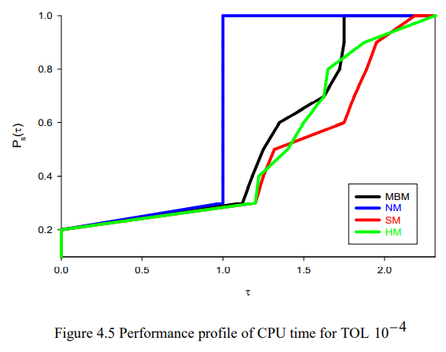
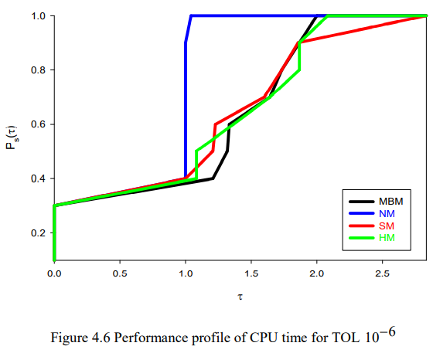
Result And Discussion
CPU Time
Based on CPU time, it shows the Newton’s method has the highest performance due to the highest curve on the left side of plot. So, it also considered as the best method for all tolerance factors used.

Slide 10
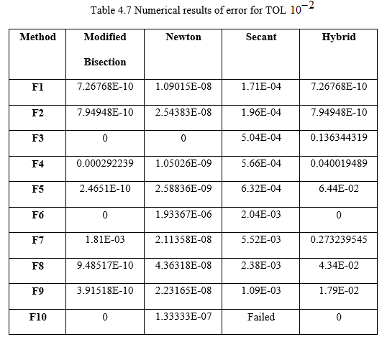
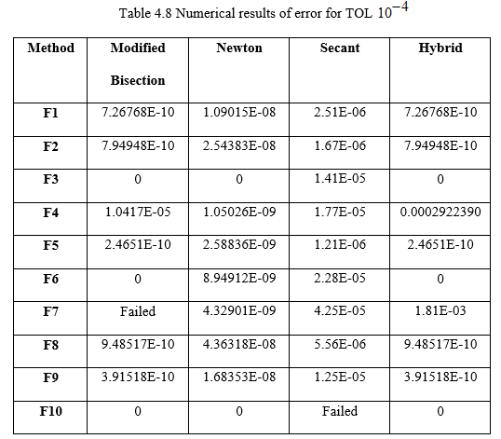
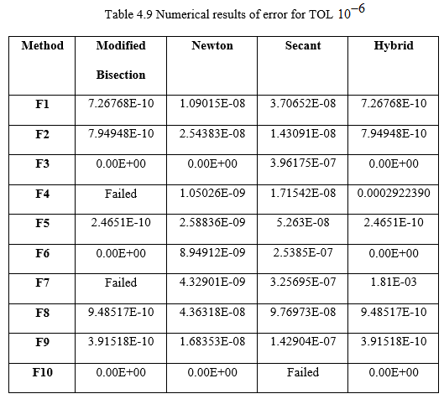
Result And Discussion
Error
Observing from each test functions and methods, Newton’s method has the smallest percentage errors value compared to others. Therefore, Newton’s method could be considered as the most accurate to the actual value for all tolerance factor.

Slide 11

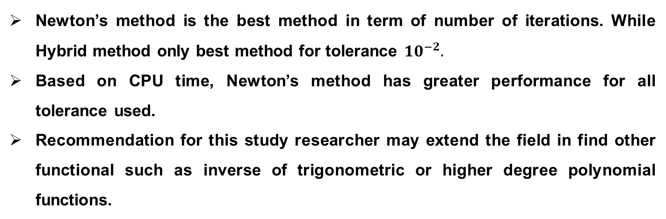
Conclusion and Recommendation
Newton’s method is the best method in term of number of iterations. While Hybrid method only best method for tolerance ${10}^{−2}.$
Based on CPU time, Newton’s method has greater performance for all tolerance used.
Recommendation for this study researcher may extend the field in find other functional such as inverse of trigonometric or higher degree polynomial functions.

Slide 12
Gantt Chart
2019 | 2020
Activities | SEPT | OCT | NOV | DEC | JAN | FEB | MAC | APR | MAY | JUNE | JULY
Literature review
Proposal presentation
Proposal submission
Data collection
Abstract submission
Data analysis
Final draft submission
Examiner evaluation
Final report submission

Slide 13
References
Ali, M. R. M., Fakhri, M. I., Hayati, N., Ramli, N. A., & Jusoh, I. (2017). The n-th section method: A modification of Bisection. Malaysian Journal of Fundamental and Applied Sciences, 13(4), 728-731.
Hussein, K. A., Hoomod, H. K., & Altaee, A. A. H. (2015). A New Approach to Find Roots of Nonlinear Equations by Hybrid Algorithm to Bisection and NewtonRaphson Algorithms. Iraqi Journal of Information Technology, 7(1 اللغة الانكليزية ,(75-82.
Lerman, S. R. (1993). Problem solving and computation for scientists and engineers: an introduction using C. Prentice-Hall, Inc.
Sidi, A. (2008). Generalization Of The Secant Method For Nonlinear Equations. Applied Mathematics E-Notes, 8, 115-123.
Tanakan, S. (2013). A new algorithm of modified bisection method for nonlinear equation. Applied Mathematical Sciences, 7(123), 6107-6114.

Slide 14
THANK
YOU

