Slide 1
SUPPLIER SELECTION FOR CONTRACTORS USING FUZZY TOPSIS
BY : MOHAMED SHAFIQ BIN MOHAMED YUSOF
SUPERVISOR : SIR MOHD HANAPI BIN ABDUL LATIF

Slide 2

PROBLEM STATEMENT
Fuzzy set theory combined with multicriteria decision making (MCDM) methods has been extensively used to deal with uncertainty inthe supplier selectiondecisionprocess (Lima Junior, Osiro, & Carpinetti, 2014)
There are several criteria and alternatives to be considered in the construction industry and choosing the best multi-criteria decision‐making approach has become a critical step for selecting suppliers (Karabayir, Botsali, Kose, & Cevikcan, 2020)
The causes of abandoned construction project in Malaysia are include suppliers of construction material, transportation companies, manufacturers of plant and machinery, and etc. (Hisham & Yahaya, 2007)

Slide 3

OBJECTIVE
To identify the requirement and criteria for analyzing and evaluating the supplier.
To develop a system using Fuzzy TOPSIS algorithm in selecting the suppliers
To evaluate the system functionality and efficiency

Slide 4

SCOPE
Contractors or company around Malaysia. The company that are chose for this project is Ventech Consult, an engineering consultation company located in Kota Bharu, Kelantan.
4 criterias and 3 suppliers will be used in the Fuzzy TOPSIS application.

Slide 5
SUPPLIER SELECTION
Country | Algorithm | Purpose
Tehran, Iran | Fuzzy TOPSIS | Supplier Selection for automotive spare parts manufacturers (Memari, Dargi, Akbari Jokar, Ahmad, & Abdul Rahim, 2019)
Kabale, India | Fuzzy TOPSIS | Supplier Selection for public Disposal Unit (Scleven, 2014)
Lincoln, United Kingdom | Fuzzy TOPSIS | Supplier Selection for development of petroleum industries facilities (Wood, 2016)
India | AHP and TOPSIS | Supplier Selection for headlamp supplier (Jain, Sangaiah, Sakhuja, Thoduka, & Aggarwal, 2018)
Istanbul, Turkey | Fuzzy AHP | Supplier Selection for white good manufacturer (Kahraman, Cebeci, & Ulukan, 2003)

Slide 6
SUPPLIER SELECTION
Characteristics | Fuzzy TOPSIS | Fuzzy AHP and Fuzzy TOPSIS | Fuzzy AHP | TOPSIS
Ranking order for selection | Selection of Flywheel Material (Purohit & Ramachandran, 2015) | Facility Location Selection (Ertuǧrul & Karakaşoǧlu, 2008) | Evaluating teaching performance (Chen, Hsieh, & Do, 2015) | Personnel selection (Kelemenis & Askounis, 2010)
Supplier selection in automotive industries | Automotive spare parts manufacturers in Iran (Memari et al., 2019) | Headlamp supplier selection in India (Jain et al., 2018). | Evaluating sustainable supply in India Automotive Industry (Kumar & Garg, 2017) | Fuel cell strategic technologies development solutions in the automotive industry (Sadeghzadeh & Salehi, 2011)
Best Material Selection | Grinding Wheel Abrasive Material Selection (Maity & Chakraborty, 2013) | Green Material Selection(Sa, Nhung, Van Chien, Tuan, & Van Tu, 2018) | Material selection in customized garment design and development process (Hong et al., 2016) | Material selection of metallic bipolar plates for polymer electrolyte fuel cell (Shanian & Savadogo, 2006)
Safety evaluation for selection | Road safety performance evaluation (Bao, Ruan, Shen, Hermans, & Janssens, 2012) | Assessing safety conditions at worksites in construction industry (Basahel & Taylan, 2016) | Behavior-based safety management (Daǧdeviren & Yüksel, 2008) | Health, safety, and environmental risk assessment of steel production (Jozi & Majd, 2014)
Supplier Selection | Supplier selection for development of petroleum industries facilities (Wood, 2016). | Supplier selection for automotive production chain(Lima Junior, Osiro, & Carpinetti, 2014) | Multi-criteria supplier selection (Kahraman et al., 2003) | Supplier Selection Problem (Jadidi, Firouzi, & Bagliery, 2010)
SIMILAR APPLICATION

Slide 7
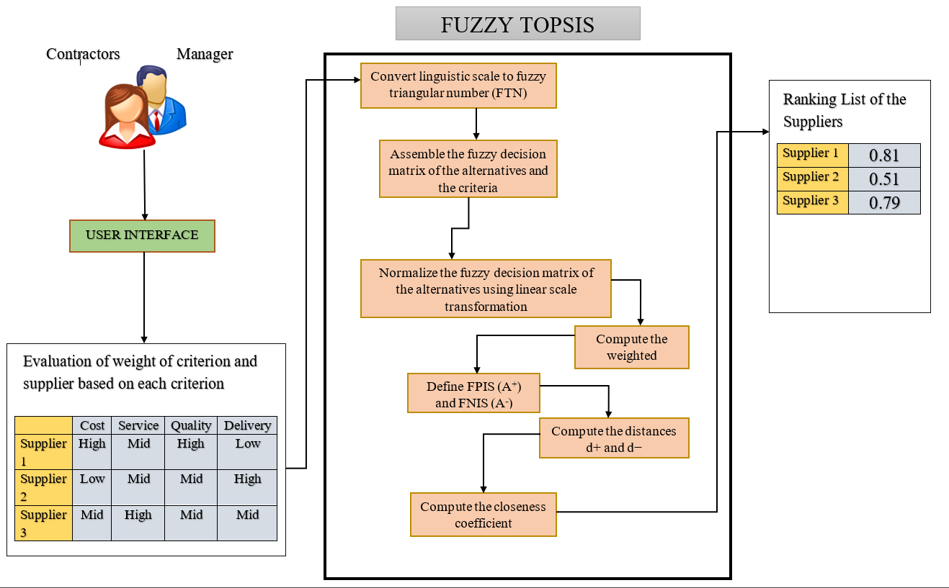
SUPPLIER SELECTION CONCEPTUAL FRAMEWORK

Slide 8
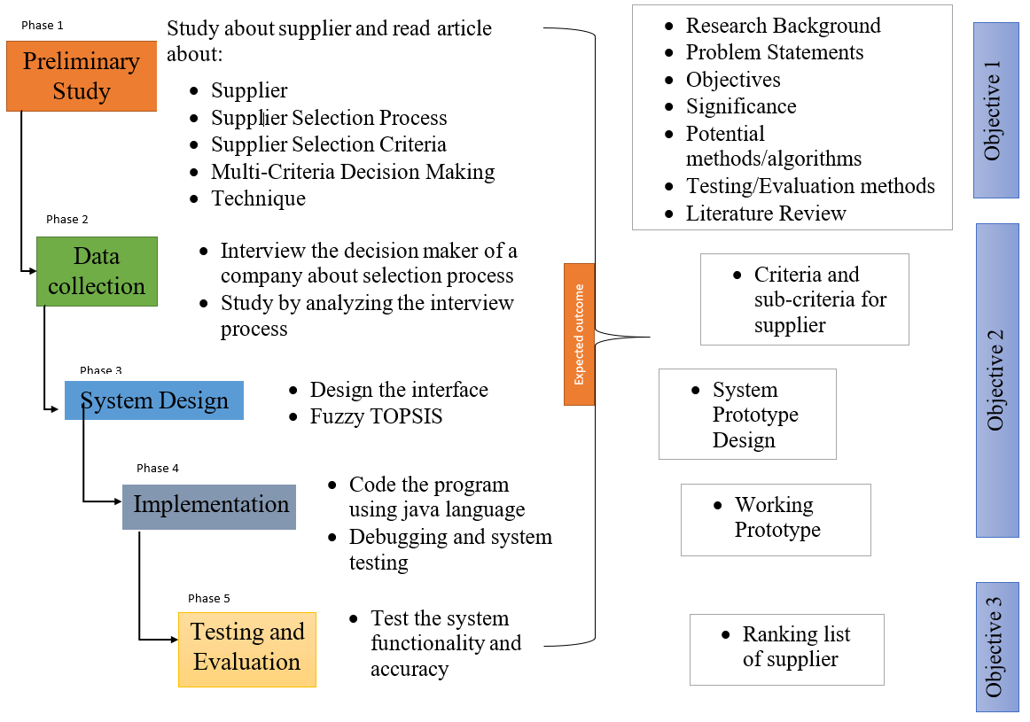
SUPPLIER SELECTION METHODOLOGY FRAMEWORK

Slide 9
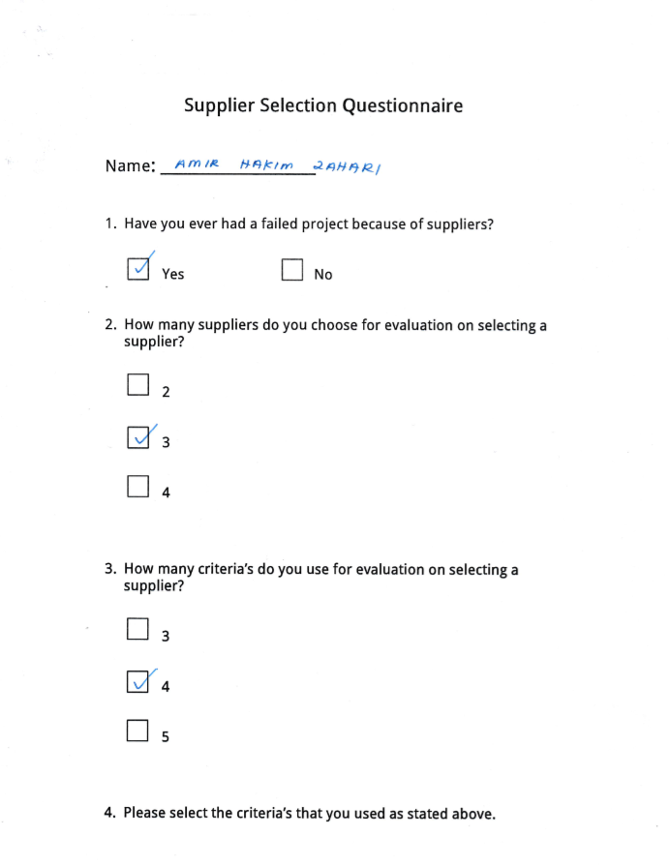
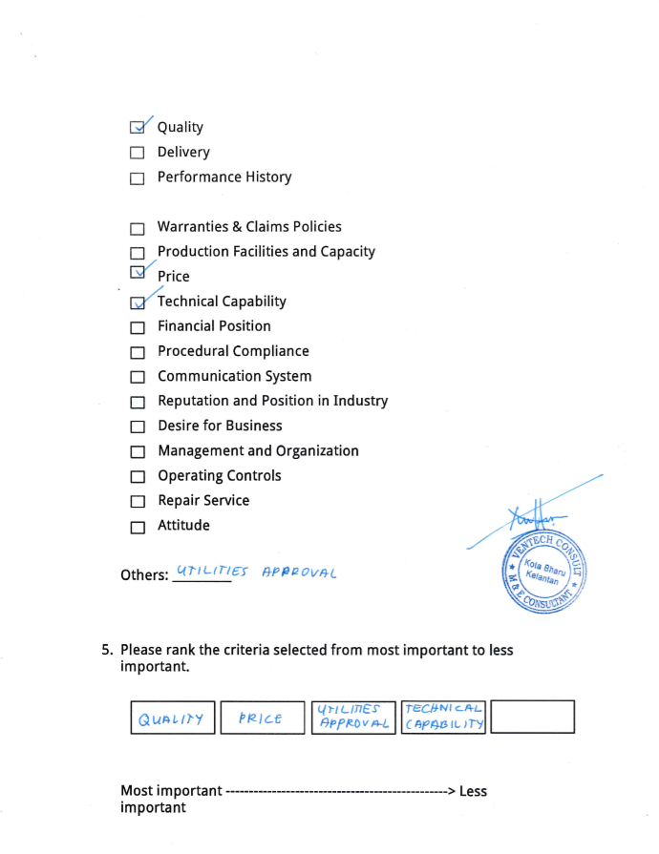
SAMPLE OF DATA

Slide 10
DATA COLLECTION (RAW DATA)

Slide 11
DATA COLLECTION (RAW DATA)

Slide 12
DATA COLLECTION (RAW DATA)

Slide 13
SUMMARY OF RAW DATA
Number of supplier that will be used For this project | 3
Number of criteria's that will be used For this project | 4
Criteria’s that will be used | Quality, Price, Delivery, Performance History

Slide 14
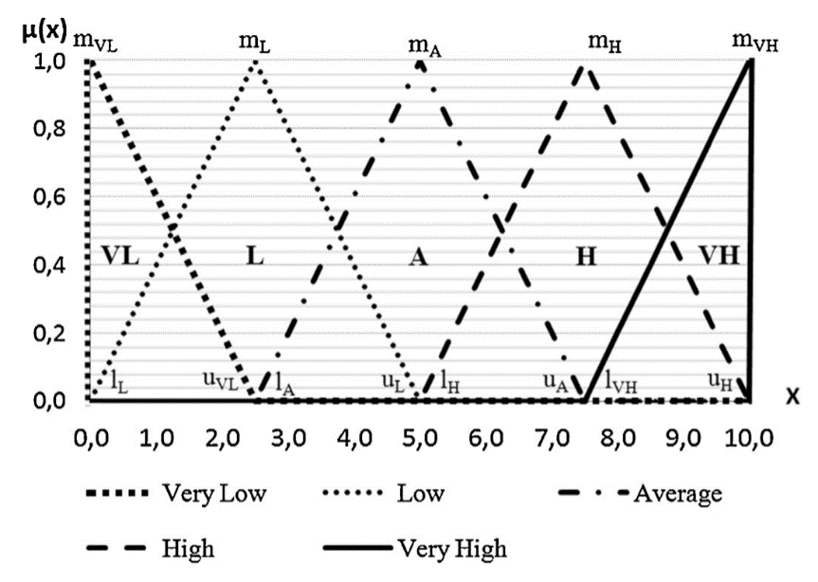
DATA PREPARATION FOR CRITERIA
Linguistic terms | Fuzzy triangular number
Very Low | (1, 1, 3)
Low | (1, 3, 5)
Good | (3, 5, 7)
High | (5, 7, 9)
Excellent | (7, 9, 9)

Slide 15
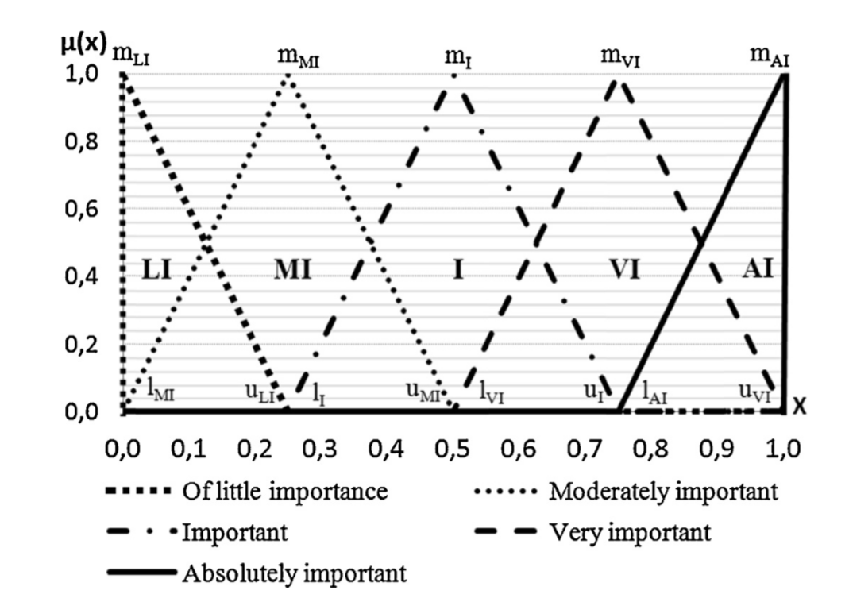
DATA PREPARATION FOR SUPPLIER
Linguistic terms | Fuzzy triangular number
Little Important | (1, 1, 3)
Moderately Important | (1, 3, 5)
Important | (3, 5, 7)
Very Important | (5, 7, 9)
Absolutely Important | (7, 9, 9)

Slide 16
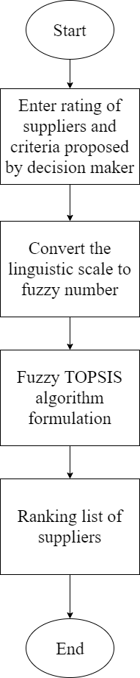
SUPPLIER SELECTION PROCESS FLOW CHART

Slide 17
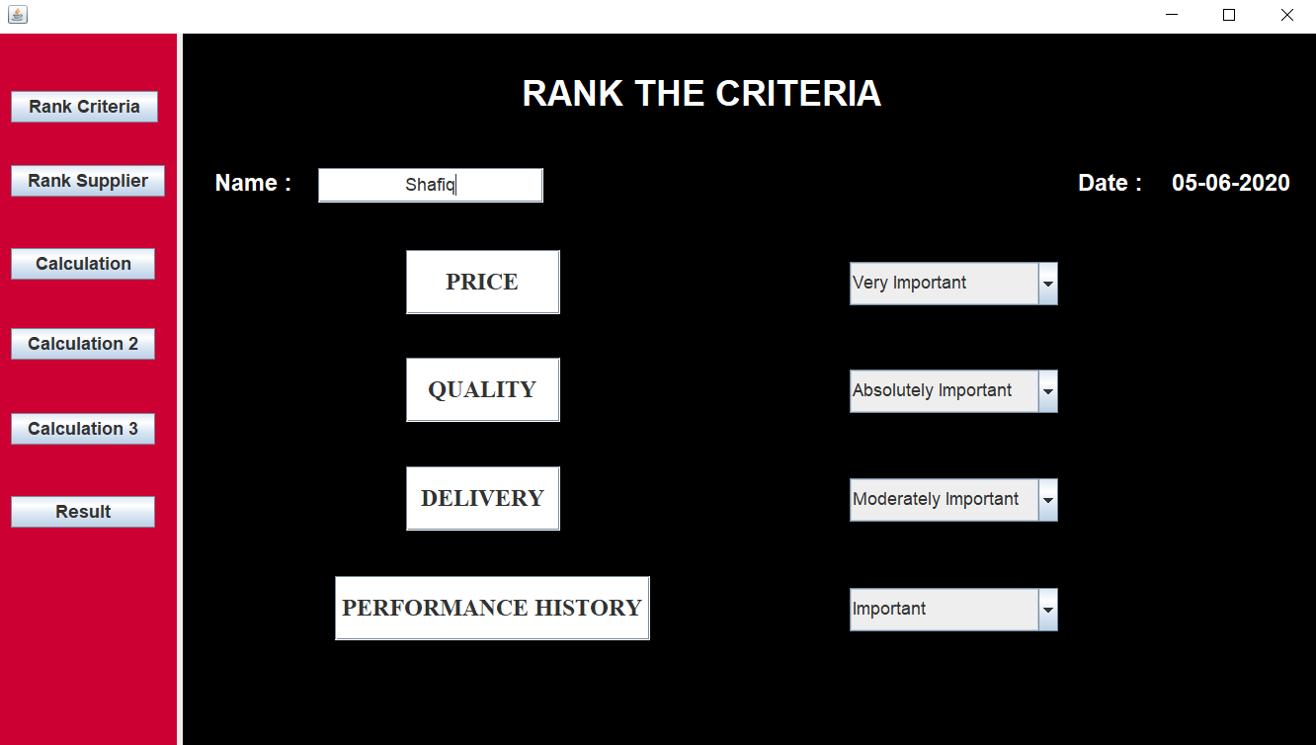
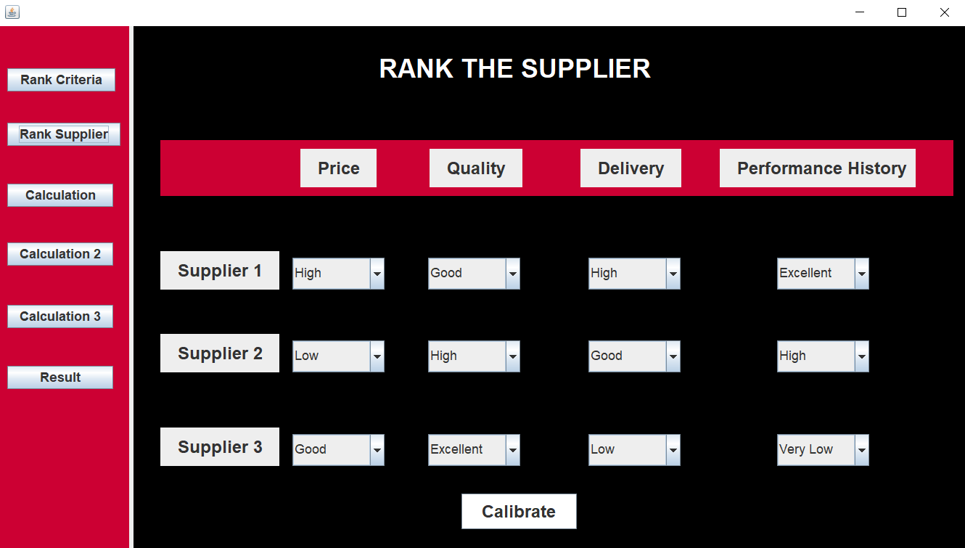
FUZZY TOPSIS ALGORITHM STEPS & EQUATION
Rank the weight of the criteria
Rank the supplier based on the criteria

Slide 18
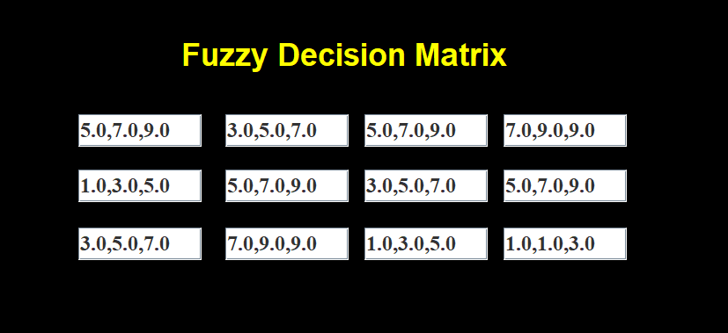
FUZZY TOPSIS ALGORITHM STEPS & EQUATION
Fuzzy decision Matrix

Slide 19
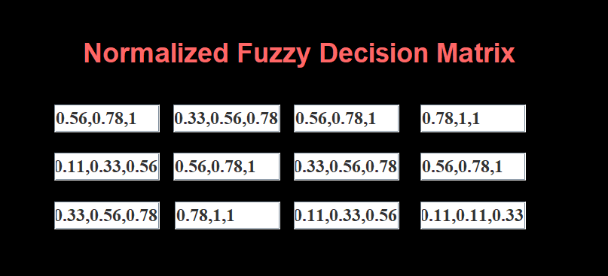
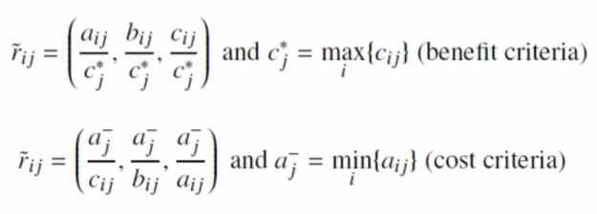
FUZZY TOPSIS ALGORITHM STEPS & EQUATION
Normalized Fuzzy decision Matrix

Slide 20
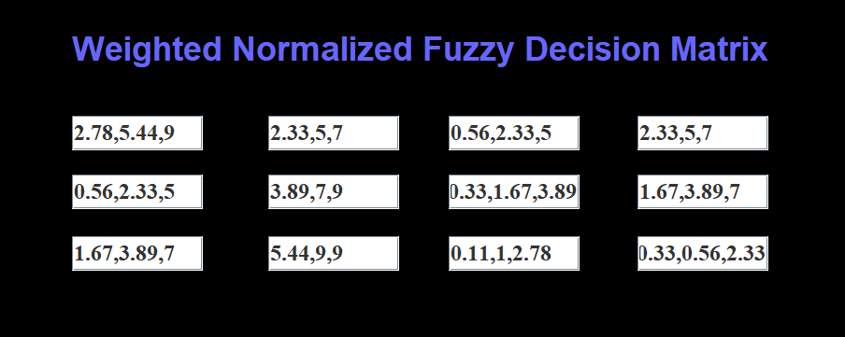
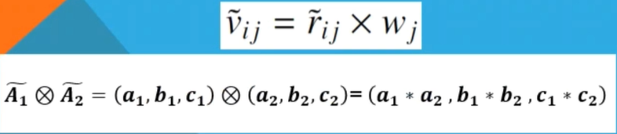
FUZZY TOPSIS ALGORITHM STEPS & EQUATION
Weighted Normalized Fuzzy decision Matrix

Slide 21
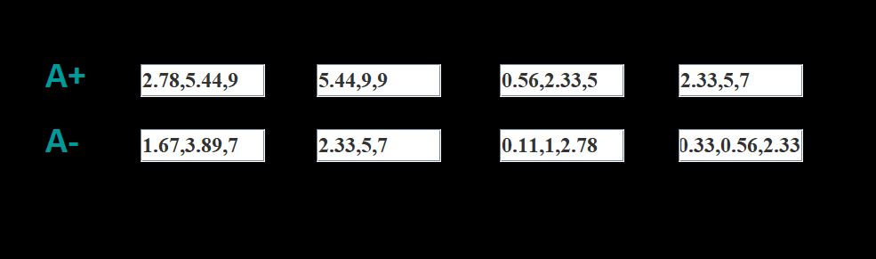
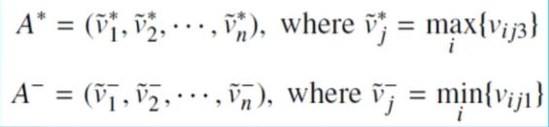
FUZZY TOPSIS ALGORITHM STEPS & EQUATION
Fuzzy Positive Ideal Solution (A+) and Fuzzy Negative Ideal Solution (A-)

Slide 22
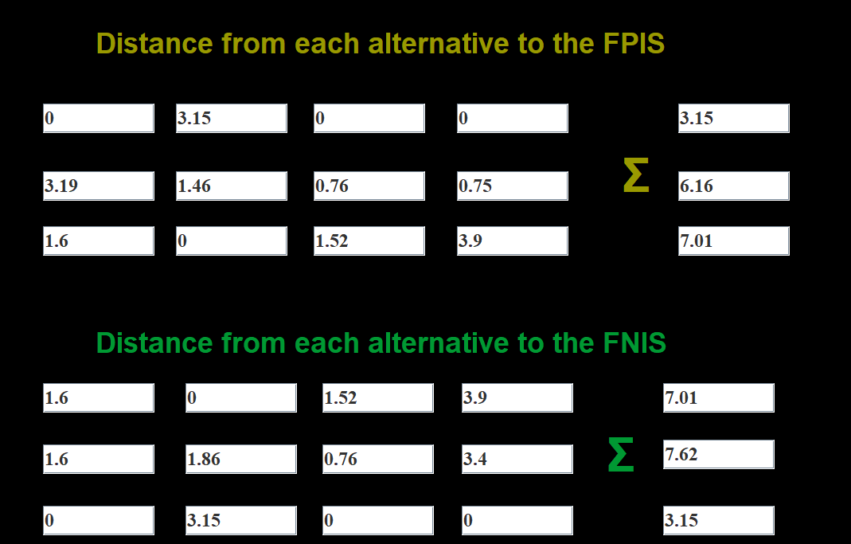
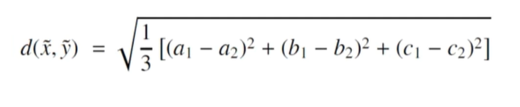
FUZZY TOPSIS ALGORITHM STEPS & EQUATION
Distance from each alternative to the Fuzzy Positive Ideal Solution (d+) and Fuzzy Negative Ideal Solution (d-)

Slide 23
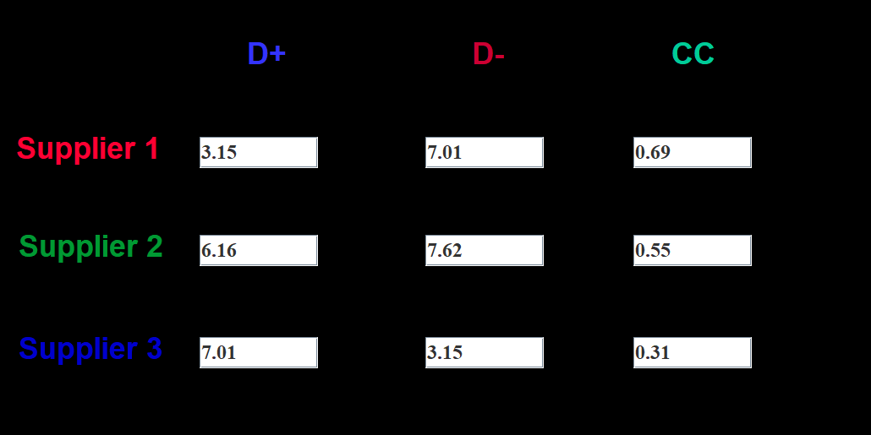

FUZZY TOPSIS ALGORITHM STEPS & EQUATION
Closeness coefficient for each alternative

Slide 24
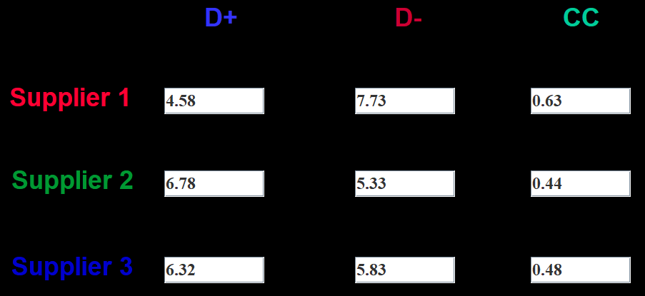
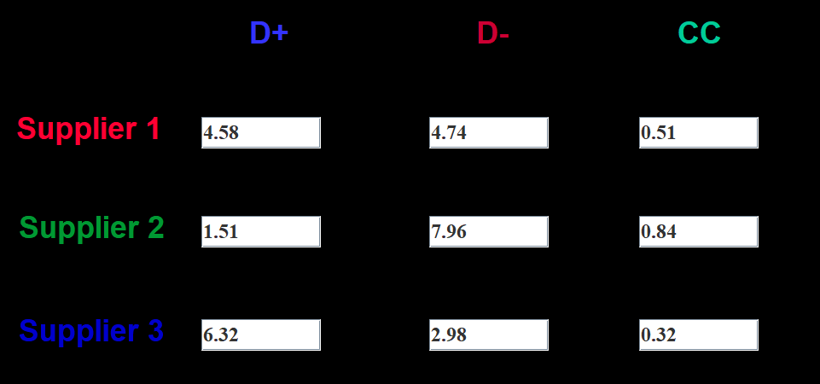
EXPERIMENT SETUP DESCRIPTION
Attribute | Result
The weight of criteria are set according to average contractors choices. Suppliers are rank randomly | Supplier 1 has the highest closeness coefficient
The weight of criteria are set according to average contractors choices. Supplier 1 and 3 are rank randomly but favourable to supplier 2 | Supplier 2 has the highest closeness coefficient

Slide 25
PROJECT TESTING AND EVALUATION
Test case | Result
Criteria : Price – Important Quality – Absolutely Important Delivery – Very Important Performance History – Very Important Supplier : Supplier 1 – Good, High, Excellent, High Supplier 2 – Good, High, Excellent, Good Supplier 3 – High, Good, Excellent, Excellent | Closeness coefficient Supplier 1 : 0.6 Supplier 2 : 0.34 Supplier 3 : 0.66 Best choice is Supplier 3
“It was not clear at first but with guidance, the result shown from the system is accurate from what I usually chose”
Tested by :
Amir Hakim bin Zahari
( Assistant Engineer
Ventech Consult
Kota Bharu )

Slide 26
PROJECT TESTING AND EVALUATION
Test case | Result
Criteria : Price – Absolutely Important Quality – Absolutely Important Delivery – Very Important Performance History – Important Supplier : Supplier 1 – Good, High, Excellent, Low Supplier 2 – Low, Good, Low, High Supplier 3 – Low, Very Low, Good, High | Closeness coefficient Supplier 1 : 0.83 Supplier 2 : 0.41 Supplier 3 : 0.28 Best choice is Supplier 1
“The system was difficult to understand without assuming what supplier 1,2,3 is. However, the result shown is understandable”
Tested by :
Mat Yusoff Bin Abd Latiff
( Contractor
Masdmax Resources
Puchong)

Slide 27
PROJECT TESTING AND EVALUATION
Test case | Result
Criteria : Price – Very Important Quality – Absolutely Important Delivery – Very Important Performance History – Important Supplier : Supplier 1 – Excellent, High, High, High Supplier 2 – Good, Low, Good, Good Supplier 3 – Low, Good, Good, Very Low | Closeness coefficient Supplier 1 : 1.00 Supplier 2 : 0.30 Supplier 3 : 0.15 Best choice is Supplier 1
“The system was simple and easy to use. The result shown is accurate and consistent”
Tested by :
Ahrveendraj a/l Munusamy
( Fresh Graduate Student
Universiti Tenaga Nasional
Kajang)

Slide 28
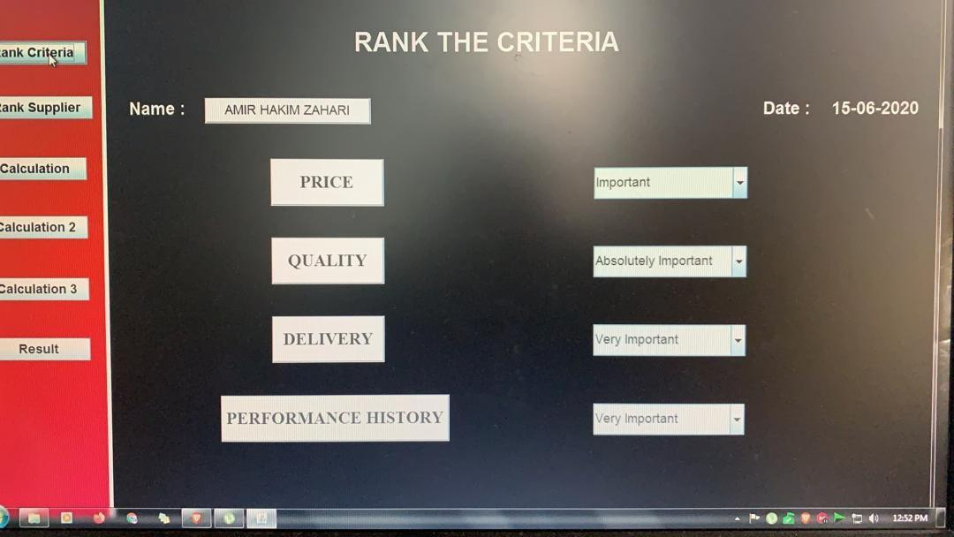
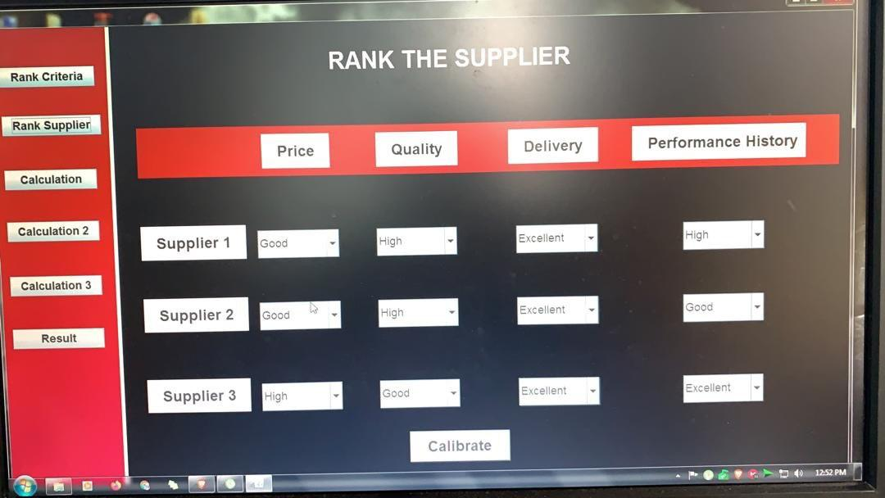
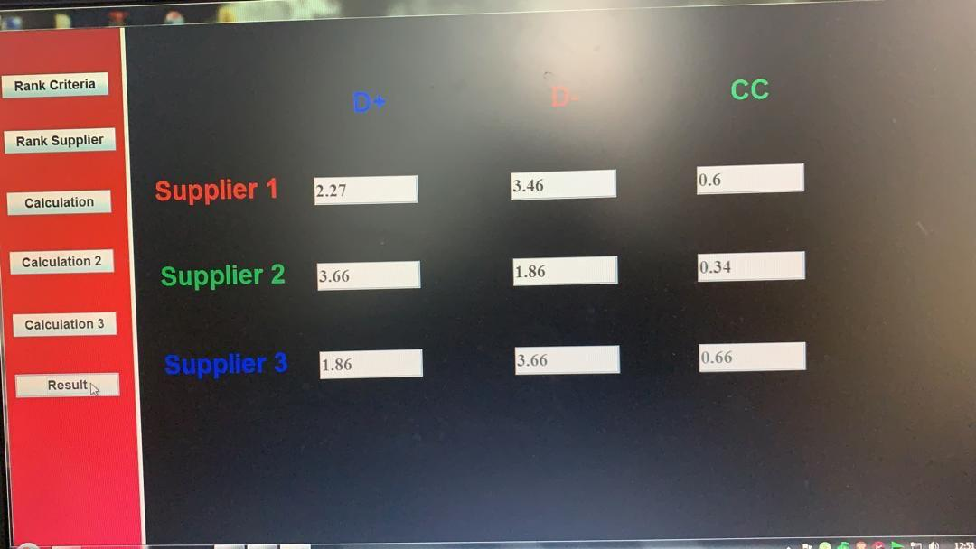
PROJECT TESTING AND EVALUATION
Photos from Amir Hakim

Slide 29

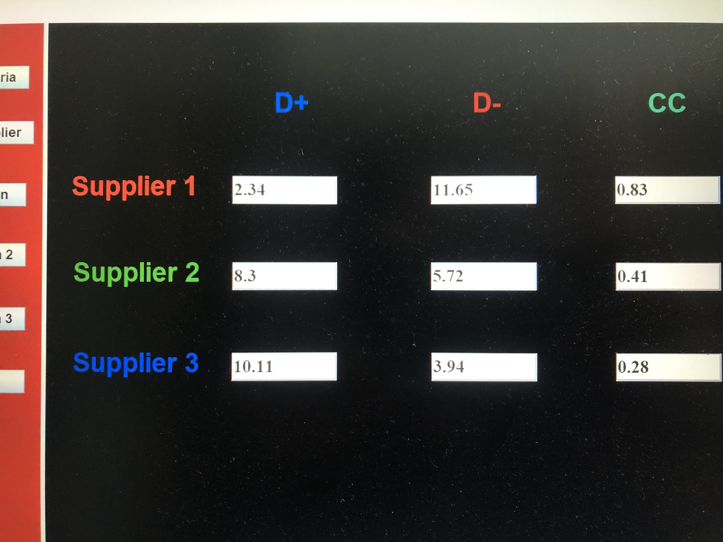
PROJECT TESTING AND EVALUATION
Photos from Mat Yusoff

Slide 30
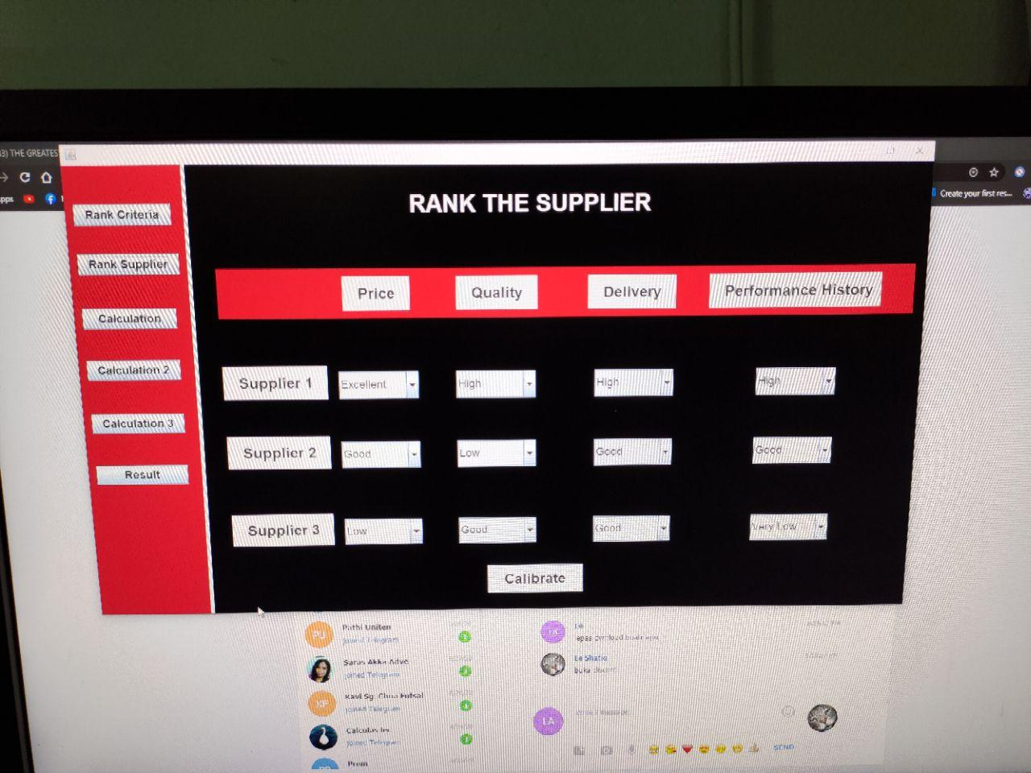
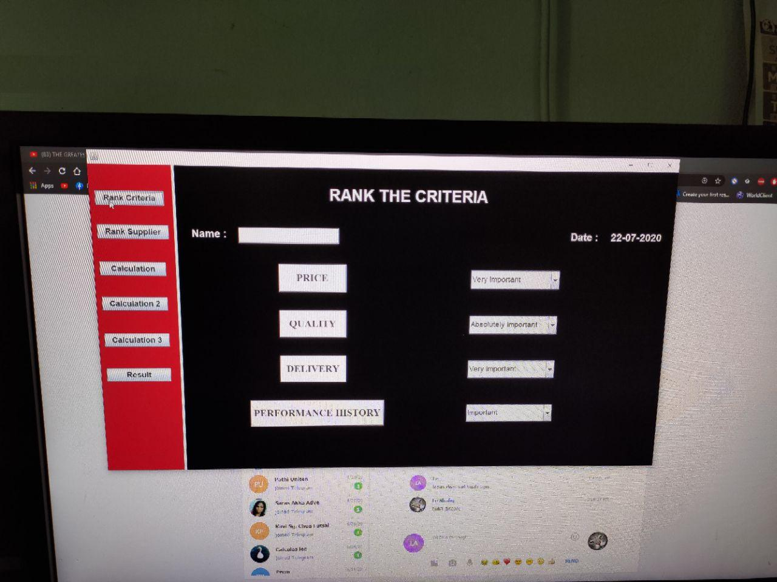
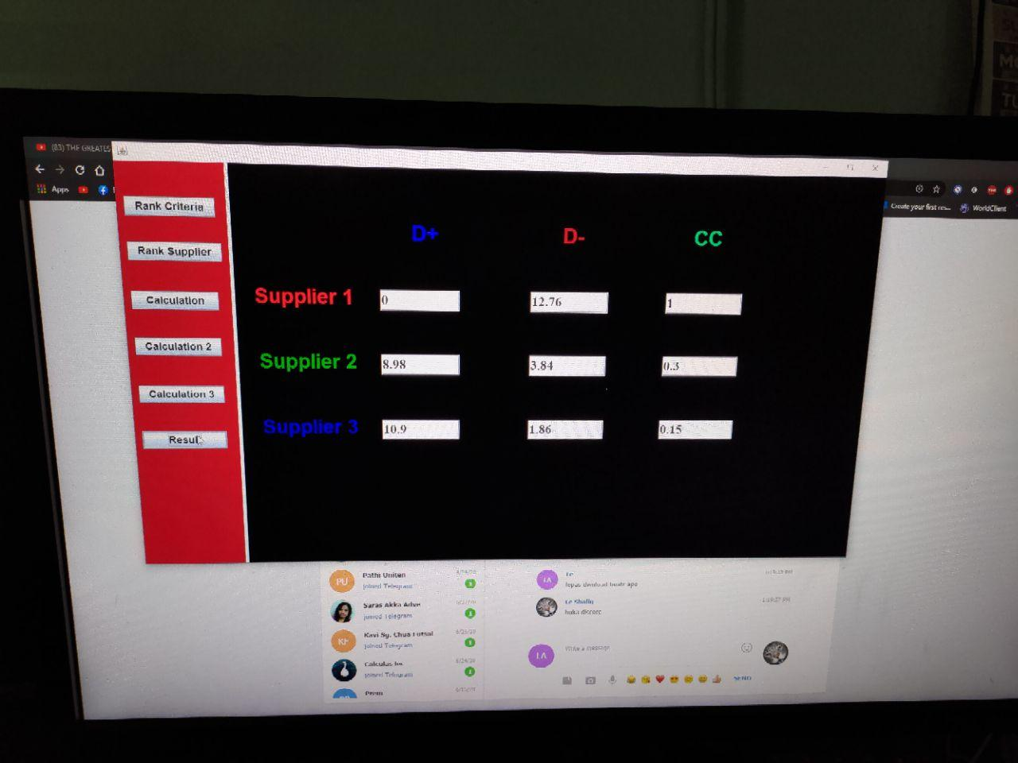
PROJECT TESTING AND EVALUATION
Photos from Ahrveendraj

Slide 31
SYSTEM DEMONSTRATION

Slide 32
PROJECT ISSUES AND LIMITATION
Array-based implementation such as array, queue, stack etc. cannot be used to build the system (Netbean). Hence , supplier cannot be sort to rank as sorting algorithm require array-based implementation.
Number of criteria and supplier are static. The system can only rank 3 suppliers with 4 criteria's given.

Slide 33
CONCLUSION
As a conclusion, all of the three objectives supplier selection system are achieved. The system can aid and support the decision maker or contractor in choosing the right supplier. Hence, it is recommended to improve the system flexibility and functionality of the system in the future to give the user more option for evaluation.

Slide 34
REFERENCES
Alavi, I., & Alinejad-Rokny, H. (2011). Comparison of fuzzy AHP and fuzzy TOPSIS methods for Plant species selection (Case study: Reclamation plan of sungun Copper Mine; Iran). Australian Journal of Basic and Applied Sciences, 5(12), 1104–1113.
Bao, Q., Ruan, D., Shen, Y., Hermans, E., & Janssens, D. (2012). Improved hierarchical fuzzy TOPSIS for road safety performance evaluation. Knowledge-Based Systems, 32, 84–90. https://doi.org/10.1016/j.knosys.2011.08.014
Basahel, A., & Taylan, O. (2016). Using fuzzy AHP and fuzzy TOPSIS approaches for assessing safety conditions at worksites in construction industry. International Journal of Safety and Security Engineering, 6(4), 728–745. https://doi.org/10.2495/SAFE-V6-N4-728-745
Celik, E., Erdogan, M., & Gumus, A. T. (2016). An extended fuzzy TOPSIS–GRA method based on different separation measures for green logistics service provider selection. International Journal of Environmental Science and Technology, 13(5), 1377–1392. https://doi.org/10.1007/s13762-016-0977-4
Chen, J. F., Hsieh, H. N., & Do, Q. H. (2015). Evaluating teaching performance based on fuzzy AHP and comprehensive evaluation approach. Applied Soft Computing Journal, 28, 100–108. https://doi.org/10.1016/j.asoc.2014.11.050

Slide 35
REFERENCES
Daǧdeviren, M., & Yüksel, I. (2008). Developing a fuzzy analytic hierarchy process (AHP) model for behavior-based safety management. Information Sciences, 178(6), 1717–1733. https://doi.org/10.1016/j.ins.2007.10.016
Dharmarajan, R., & Sharmila, C. (2017). The Evaluation of Topsis and Fuzzy-Topsis Method for Decision Making System in Data mining. International Research Journal of Engineering and Technology, 4(1), 1027–1031. Retrieved from https://irjet.net/archives/V4/i1/IRJET-V4I1180.pdf
Duica, M. C., Florea, N. V., & Duica, A. (2018). Selecting the Right Suppliers in Procurement Process along Supply Chain-a Mathematical Modeling Approach. Valahian Journal of Economic Studies, 9(1), 47–58. https://doi.org/10.2478/vjes-2018-0005
Ertuǧrul, I., & Karakaşoǧlu, N. (2008). Comparison of fuzzy AHP and fuzzy TOPSIS methods for facility location selection. International Journal of Advanced Manufacturing Technology, 39(7–8), 783–795. https://doi.org/10.1007/s00170-007-1249-8
Kelemenis, A., & Askounis, D. (2010). A new TOPSIS-based multi-criteria approach to personnel selection. Expert Systems with Applications, 37(7), 4999–5008. https://doi.org/10.1016/j.eswa.2009.12.013

Slide 36
REFERENCES
Grondys, K., Kott, I., Sukiennik, K., & Seroka-stolka, O. (2015). THE IMPORTANCE OF SUPPLIER SELECTION PROCESS. https://doi.org/10.26649/musci.2015.03
Hong, Y., Curteza, A., Zeng, X., Bruniaux, P., & Chen, Y. (2016). Sensory evaluation based fuzzy AHP approach for material selection in customized garment design and development process. IOP Conference Series: Materials Science and Engineering, 133(1). https://doi.org/10.1088/1757-899X/133/1/012058
Jain, V., Sangaiah, A. K., Sakhuja, S., Thoduka, N., & Aggarwal, R. (2018). Supplier selection using fuzzy AHP and TOPSIS: a case study in the Indian automotive industry. Neural Computing and Applications, 29(7), 555–564. https://doi.org/10.1007/s00521-016-2533-z
Jozi, S. A., & Majd, N. M. (2014). Health, safety, and environmental risk assessment of steel production complex in central Iran using TOPSIS. Environmental Monitoring and Assessment, 186(10), 6969–6983. https://doi.org/10.1007/s10661-014-3903-6
Kahraman, C., Cebeci, U., & Ulukan, Z. (2003). Multi‐criteria supplier selection using fuzzy AHP. Logistics Information Management, 16(6), 382–394. https://doi.org/10.1108/09576050310503367

Slide 37
REFERENCES
Kumar, D., & Garg, C. P. (2017). Evaluating sustainable supply chain indicators using fuzzy AHP: Case of Indian automotive industry. Benchmarking, 24(6), 1742–1766. https://doi.org/10.1108/BIJ-11-2015-0111
Maity, S. R., & Chakraborty, S. (2013). Grinding wheel abrasive material selection using fuzzy TOPSIS method. Materials and Manufacturing Processes, 28(4), 408–417. https://doi.org/10.1080/10426914.2012.700159
Memari, A., Dargi, A., Akbari Jokar, M. R., Ahmad, R., & Abdul Rahim, A. R. (2019). Sustainable supplier selection: A multi-criteria intuitionistic fuzzy TOPSIS method. Journal of Manufacturing Systems, 50(April 2018), 9–24. https://doi.org/10.1016/j.jmsy.2018.11.002
Mirawati, N. A., Othman, S. N., & Risyawati, M. I. (2015). Supplier-Contractor Partnering Impact on Construction Performance: A Study on Malaysian Construction Industry. Journal of Economics, Business and Management, 3(1), 29–33. https://doi.org/10.7763/joebm.2015.v3.150
Moayeri, M., Shahvarani, A., Behzadi, M. H., & Hosseinzadeh-Lotfi, F. (2015). Comparison of fuzzy AHP and fuzzy TOPSIS methods for math teachers selection. Indian Journal of Science and Technology, 8(13). https://doi.org/10.17485/ijst/2015/v8i13/54100

Slide 38
REFERENCES
Oke, A., & Abiola-Falemu, J. (2009). Relationship between building collapse and poor quality of materials and workmanship in Nigeria. COBRA 2009 - Construction and Building Research Conference of the Royal Institution of Chartered Surveyors, (February 2017), 873–884.
Pavan, M., & Todeschini, R. (2009). Multi-Criteria Decision Making View all Topics Multicriteria Decision-Making Methods. 1–10.
Purohit, P., & Ramachandran, M. (2015). Selection of flywheel material using multicriteria decision making fuzzy topsis. Indian Journal of Science and Technology, 8(33). https://doi.org/10.17485/ijst/2015/v8i33/80028
Sadeghzadeh, K., & Salehi, M. B. (2011). Mathematical analysis of fuel cell strategic technologies development solutions in the automotive industry by the TOPSIS multi-criteria decision making method. International Journal of Hydrogen Energy, 36(20), 13272–13280. https://doi.org/10.1016/j.ijhydene.2010.07.064
Scleven, A. (2014). SUPPLIER SELECTION AND PROCUREMENT PROCESS AMONG PUBLIC DISPOSAL UNITS . A CASE STUDY OF KABALE MUNICIPAL COUNCIL ANKWASA SCLEVEN 11 / A / BPLM / 097 / F A RESEARCH PROPOSAL SUBMITTED TO THE FACULTY OF ARTS AND SOCIAL SCIENCES IN PARTIAL FULFILLMENT FOR T

Slide 39
REFERENCES
Shanian, A., & Savadogo, O. (2006). TOPSIS multiple-criteria decision support analysis for material selection of metallic bipolar plates for polymer electrolyte fuel cell. Journal of Power Sources, 159(2), 1095–1104. https://doi.org/10.1016/j.jpowsour.2005.12.092
Sharipah, N. (2011). Quality Affordable Housing: A Theoretical Framework for Planning and Design of Quality Housing. Journal of Techno-Social, 2(1), 1–10.
Taherdoost, H., & Brard, A. (2019). ScienceDirect ScienceDirect ScienceDirect ScienceDirect Analyzing Analyzing the the Process Process of of Supplier Supplier Selection Selection Criteria Criteria and and Methods Methods Costing models for capacity optimization in Industry 4 . 0 : Trade-of. Procedia Manufacturing, 32, 1024–1034. https://doi.org/10.1016/j.promfg.2019.02.317
Wilson, E. J. (1994). The Relative Importance of Supplier Selection Criteria: A Review and Update. International Journal of Purchasing and Materials Management, 30(2), 34–41. https://doi.org/10.1111/j.1745-493X.1994.tb00195.x
Wood, D. A. (2016). Supplier selection for development of petroleum industry facilities, applying multi-criteria decision making techniques including fuzzy and intuitionistic fuzzy TOPSIS with flexible entropy weighting. Journal of Natural Gas Science and Engineering, 28, 594–612. https://doi.org/10.1016/j.jngse.2015.12.021

