Slide 1


SOLVING FIRST ORDER DIFFERENTIAL EQUATIONS USING
EULER MODIFIED METHODS
(MODIFIED EULER, IMPROVED MODIFIED EULER, MODIFIED IMPROVED MODIFIED EULER, MODIFIED EULER BASED ON HARMONIC POLYGON)
FAZIRATUL ADZIMA BINTI AHMAD MISNUN (2017878816)
SUPERVISOR: PUAN NOORKHAIRIAH BINTI RAZALI

Slide 2
INTRODUCTION
In mathematical modelling, differential equations are generally used in the field of science and engineering where ODE is one of the most important mathematical tools used in modelling problems.
ODE acts reflect real world problems such as chemical reactions, weather forecasts, population, spread of the disease, physics, optics etc.
Numerical methods are usually used for solving mathematical problems that are exist in the field of science and engineering
The less error will define as the great techniques in solving ODE equations (Ochoche,2008).
In this research, a numerical method has implemented to solve the ODE problem which is modification of Euler method.
Euler’s method is the simplest numerical method for solving ODE.
This method was introduced by Leonhard Euler in 1768 and it is suitable for quick programming, simple implementation and low cost computational (S. Fadugba, et al, 2012)
Euler modified methods will be analyzed to determine which method is the best modification in terms of relative error.

Slide 3
PROBLEM STATEMENT
  A theoretical method is rarely used by mathematicians to solve ODE problems since the equations are relatively complex and complicated for which the exact solution cannot be found and has a longer calculation compared to numerical method
01
  For this research, Euler method had been chosen since it is the simplest method for solving ODE. The method of Euler is quite famous and commonly used as an object of theoretical
  study done by researchers but unsatisfactory in obtaining accurate results.
02
  The main problem is to find the correct formula to be used. It is still unknown which version or modification of Euler method is the best method to approximate the solution of ODE
  numerically.
03

Slide 4
OBJECTIVES
c) To analyze the efficiency of the Euler modified methods that is accurate as possible to the exact solution in terms of relative error.
a) To solve the first order ODE using theoretical methods.
b) To solve the first order ODE numerically using the Euler modified methods.
d) To determine the best modification of Euler method for solving the first order ODE.

Slide 5
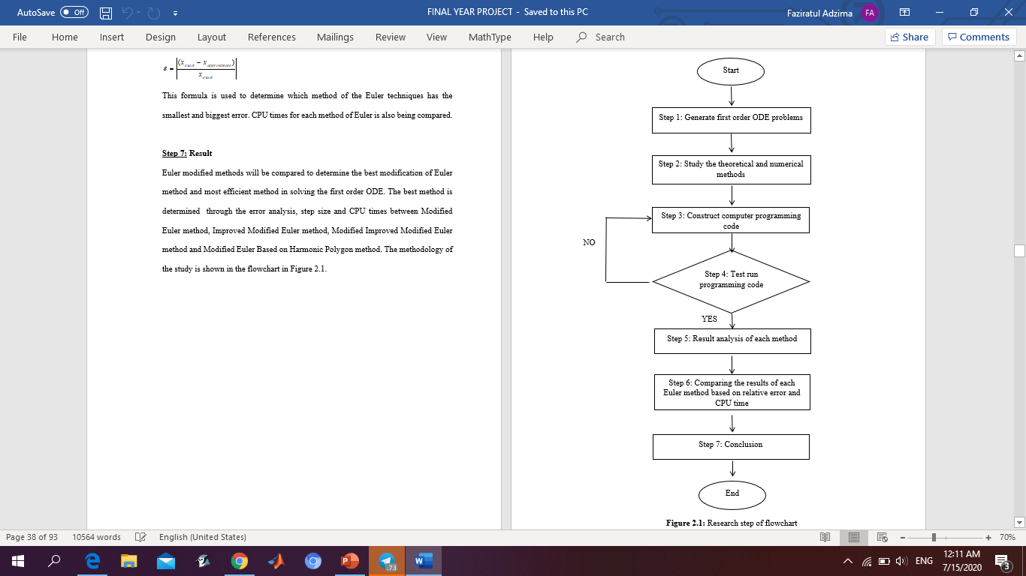
METHODOLOGY

Slide 6
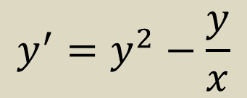


For this research, Linear ODE, Separable ODE and Bernoulli’s ODE are involved in solving first order ODE problems
EQUATIONS OF TEST FUNCTION
LINEAR ODE:
$$y^{′}(x)=x+xy$$
SEPARABLE ODE:
$$y^{′}(x)=6y^{2}x$$
BERNOULLI’S ODE:
$$y^{′}=y^{2}−\frac{y}{x}$$

Slide 7
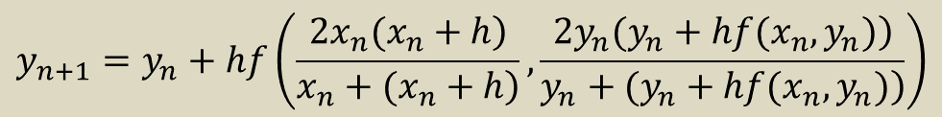
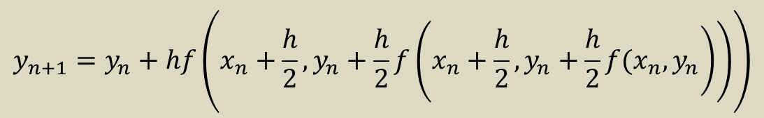
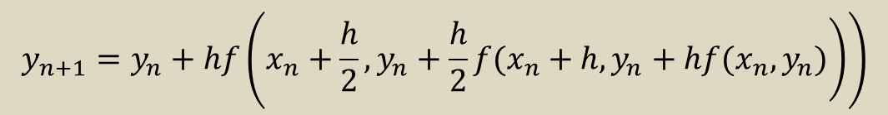
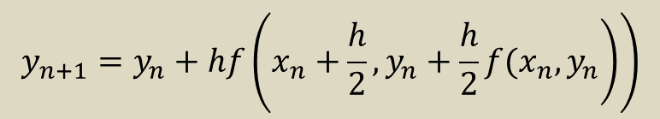
EQUATIONS OF NUMERICAL METHOD
$$y_{n+1}=y_{n}+hf\left(\left.x_{n}+\frac{h}{2},y_{n}+\frac{h}{2}f(x_{n},y_{n}\right)\right)$$
MODIFIED EULER:
IMPROVED MODIFIED EULER:
$$y_{n+1}=y_{n}+hf\left(\left.x_{n}+\frac{h}{2},y_{n}+\frac{h}{2}f(x_{n}+h,y_{n}+hf(x_{n},y_{n})\right)\right)$$
MODIFIED IMPROVED
MODIFIED EULER:
$$y_{n+1}=y_{n}+hf\left(x_{n}+\frac{h}{2},y_{n}+\frac{h}{2}f\left(\left.x_{n}+\frac{h}{2},y_{n}+\frac{h}{2}f(x_{n},y_{n}\right)\right)\right)$$
MODIFIED EULER BASED ON HARMONIC POLYGON:
$$y_{n+1}=y_{n}+hf\left(\frac{\left.2x_{n}(x_{n}+h\right)}{\left.x_{n}+(x_{n}+h\right)},\frac{\left.2y_{n}(y_{n}+hf(x_{n},y_{n})\right)}{\left.y_{n}+(y_{n}+hf(x_{n},y_{n})\right)}\right)$$

Slide 8
RESULT PROBLEM ONE:
LINEAR ODE
Table 4.4: Analytical and Numerical solutions of Linear ODE at
Based on Table 4.4, the comparison between analytical solution and numerical approximation based on relative error show that, the new Modified Euler Based on Harmonic Polygon(HP) method has the least accuracy for all step sizes.
HP method has the largest error compared to those of the existing methods.
While, Modified Improved Modified Euler (MIME) method has the better approximation as this method has the smallest error.
 | Analytical | ME | IME | MIME | HP
0.2 | 13.7781122 | 13.2489539 | 14.5650548 | 13.8678806 | 12.3218901
 | Iterations |  | 10
 | Error | 3.8406E-02 | 5.7115E-02 | 6.5153E-03 | 1.0569E-01
 | CPU time | 0.609375 | 0.984375 | 1.328125 | 1.734375
0.05 | 13.7781122 | 13.7376854 | 13.8405070 | 13.7884501 | 13.6487344
 | Iterations |  | 40
 | Error | 2.9341E-03 | 4.5285E-03 | 7.5031E-04 | 9.3901E-03
 | CPU time | 0.593750 | 1.000000 | 1.406250 | 1.859375
0.001 | 13.7781122 | 13.7780950 | 13.7781393 | 13.7781171 | 13.7780422
 | Iterations |  | 2000
 | Error | 1.2513E-06 | 1.9640E-06 | 3.5491E-07 | 5.0812E-06
 | CPU time | 0.906250 | 1.656250 | 2.515625 | 3.328125

Slide 9
Discussion of result:
Upon observation, MIME method is the best numerical method as this method has the better approximation for Linear ODE (Problem one) at x=2.0
MIME method gave the values that are more accurate with the step size, h=0.001 because it has the smallest error which is 3.5491E-07 followed by ME, IME and HP method.
Figure 4.3(b): Relative error of Linear ODE for

Slide 10
RESULT PROBLEM TWO:
SEPARABLE ODE
Table 4.8: Analytical and Numerical solutions of Separable ODE
at
Based on Table 4.8, the comparison between analytical solution and numerical approximation based on the relative error show that, the new Modified Euler Based on Harmonic Polygon(HP) method has the least accuracy for all step sizes.
HP method has the largest error compared to those of the existing methods.
While, Modified Improved Modified Euler (MIME) method has the better approximation as this method has the smallest error.
 | Analytical | ME | IME | MIME | HP
0.2 | 0.06250000 | 0.06211842 | 0.06300942 | 0.06253680 | 0.06186763
 | Iterations |  | 5
 | Error | 6.1053E-03 | 8.1507E-03 | 5.8878E-04 | 1.0118E-02
 | CPU time | 0.593750 | 0.968750 | 1.406250 | 1.875000
0.05 | 0.06250000 | 0.06247217 | 0.06253777 | 0.06250450 | 0.06245267
 | Iterations |  | 20
 | Error | 4.4530E-04 | 6.0438E-04 | 7.2017E-05 | 7.5734E-04
 | CPU time | 0.546875 | 0.968750 | 1.343750 | 1.703125
0.001 | 0.06250000 | 0.06249999 | 0.06250002 | 0.06250000 | 0.06249998
 | Iterations |  | 1000
 | Error | 1.9520E-07 | 2.5264E-07 | 3.8400E-08 | 3.1808E-07
 | CPU time | 0.718750 | 1.265625 | 1.828125 | 2.500000

Slide 11
Discussion of result:
For the Separable ODE (Problem Two), the best numerical method to approximate the solution at x=2.0 is MIME method with the step size, h=0.001
MIME method has the smallest error which is 3.84E-08 followed by ME, IME and HP method
Figure 4.7(b): Relative error of Separable ODE for

Slide 12
RESULT PROBLEM THREE:
BERNOULLI’S ODE
Table 4.12: Analytical and Numerical solutions of Bernoulli’s ODE
at
Based on Table 4.12, the comparison between analytical solution and numerical approximation based on the relative error show that, the new Modified Euler Based on Harmonic Polygon(HP) method is more accurate compared to the Improved Modified Euler(IME) method.
For this problem, IME method has the largest error compared to the new HP method and those of the existing methods.
While, Modified Improved Modified Euler (MIME) method has the better approximation as this method has the smallest error.
 | Analytical | ME | IME | MIME | HP
0.2 | 1.62944568 | 1.59519170 | 1.69492815 | 1.64255493 | 1.57715759
 | Iterations |  | 5
 | Error | 2.1022E-02 | 4.0187E-02 | 8.0452E-03 | 3.2089E-02
 | CPU time | 0.640625 | 1.046875 | 1.390625 | 1.765625
0.05 | 1.62944568 | 1.62669540 | 1.63479738 | 1.63071394 | 1.62502265
 | Iterations |  | 20
 | Error | 1.6879E-03 | 3.2844E-03 | 7.7834E-04 | 2.7144E-03
 | CPU time | 0.578125 | 0.937500 | 1.312500 | 1.718750
0.001 | 1.62944568 | 1.62944454 | 1.62944803 | 1.62944619 | 1.62944376
 | Iterations |  | 1000
 | Error | 7.0024E-07 | 1.4453E-06 | 3.1667E-07 | 1.1783E-06
 | CPU time | 0.734375 | 1.343750 | 1.937500 | 2.500000

Slide 13
Discussion of result:
For the Bernoulli’s ODE (Problem Three), the best numerical method to approximate the solution at x=2.0 is MIME method with the step size, h=0.001.
MIME method has provided a more accurate performance as this method gave the smallest error of 3.1667E-07 followed by ME, HP and IME method.
Figure 4.11(b): Relative error of Bernoulli’s ODE for

Slide 14
CONCLUSION
In this research, the best method in terms of accuracy is Modified Improved Modified Euler (MIME) method with step size of 0.001.
This method also is the best modification of Euler method for solving the first order ODE for Linear ODE, Separable ODE and Bernoulli’s ODE.
However, Modified Euler possesses good CPU time based on step size of 0.05.
Conclusion: If an accurate result is required, then the use of smaller step size such as 0.001 or smaller is needed. This smaller step size will generate higher number of iterations to find the final solution which in terms contribute to the higher CPU time.

Slide 15
CONCLUSION
AND RECOMMENDATION
Conclusion:
Recommendation:
All of the ODE problems had been solved with the theoretical method successfully.
All the coded problem has been run successfully. All the numerical result based on approximate solution and CPU time are recorded.
All the results of Euler modified (ME, IME, MIME and HP method) numerical methods has been analyzed based on its accuracy in terms of relative error.
Based on the results shown graphically, it showed that the best modification of Euler method in terms of accuracy is Modified Improved Modified Euler (MIME) method with a step size of 0.001.
In this research, four version of Euler modified methods (ME, IME, MIME and HP method) has been tested to solve first order ODE.
For the future research, consider another version of Euler modified method which is a third order Euler method
Could also be extended to solve second order ODE problems
The coded program using Maple 16 could also be coded in MATLAB or Mathematica to see the behavior of CPU time.

Slide 16
REFERENCES
Ochoche, A. (2008). Improving the improved modified Euler method for better performance on autonomous initial value problems. Leonardo Journal of Sciences, 12, 57-66.
Ma, A. (2010). On Improving Euler Methods for Initial Value Problems. Archives of Applied Science Research, 2(2), 369-379.
Yusop, N. M. M., Hasan, M. K., Wook, M., Amran, M. F. M., & Ahmad, S. R. (2017). Comparison New Algorithm Modified Euler Based on Harmonic-Polygon Approach for Solving Ordinary Differential Equation. Journal of Telecommunication, Electronic and Computer Engineering (JTEC), 9(2-11), 29-32.
Hasan, A. (2018). Numerical computation of initial value problem by various techniques. Journal of Science and Arts, 18(1), 19-32.

Slide 17
THANK YOU

