Slide 1
A STUDY OF E-COMMERCE BUSINESS ON CRITERIA THAT INFLUENCE THE COURIER SELECTION USING TOPSIS METHOD
TITLE:

Slide 2

BY: NAJIHAH BINTI ISMAIL
SUPERVISOR: PUAN ROHAYATI BINTI MAT RIPIN

Slide 3
1
2
3
4
5
TABLE OF CONTENTS
PROBLEM STATEMENT
INTRODUCTION
OBJECTIVE
SIGNIFICANCE OF RESEARCH
LITERATURE REVIEW
6
METHODOLOGY
7
EXPECTED RESULT
8
CONCLUSION
9
RECOMMENDATION

Slide 4
INTRODUCTION
1
A courier may be a company, a representative of that company or an individual who conveys a message, bundle or letter from one put or individual to another put or individual. Other than that, couriers are the people contracted by courier companies to convey, well, anything substantial, counting mail, packages and indeed beds of products.
Delivering, understanding and maintaining better service are the major concerns of every industry today. According to (M.L Tseng, 2009), service quality expectation has been used to explain the prediction of service, an ideal standard, an attribute importance, and customers’ evaluation of the service quality. Therefore, people need to choose the best courier services for their delivering and receiving the parcels to avoid getting the bad conditions or feedbacks
Therefore, in this project I will be using TOPSIS method to rank the most influenced factors for e-commerce business to choose couriers service wisely.

Slide 5


PROBLEM STATEMENT
2
Therefore, the purpose of this study is to employ TOPSIS method approach for the selection of courier services in Malaysia. This is because there are several important factors and sub factors that online sellers need to know before choosing the right couriers.
In recent years, Malaysia Courier services are parcel delivery firms that help in the delivery of packages and other important documents. The foremost vital viewpoint that isolates courier services from standard postal conveyances is he speed of conveyance and productivity of conveyance. In a perfect world, a company that bargains with the conveyance of bundles will set up an account in arrange to create exchange less demanding.

Slide 6


OBJECTIVES
FIRST
OBJECTIVE
SECOND OBJECTIVE
THIRD
OBJECTIVE
To identify the important factors and sub-factors which contribute to the selection in courier services
To evaluate factors and sub factors by using TOPSIS method.
To rank the most influence factor that contributes to courier service selection.

Slide 7

SIGNIFICANCE OF RESEARCH
The conducted study can come up with many significance or consequences to the people before deciding to choose a courier service. As has been discussed earlier in the problem statement above, the project aims to help customers or people to be able to make the best decisions when selecting the courier services
The findings of this study will be able to help online sellers to select the best one among all the courier services that have in Malaysia.
Other than that, this research study will also help to relate the Techniques for Order of Preference by Similarity to Ideal Solution (TOPSIS) in Multi-Criteria Decision Making (MCDM) concept.

Slide 8

LITERATURE REVIEW
AUTHOR | EXPLANATION
Thompsom, 1998 | The strategic element of negotiations by many researchers and negotiation practitioners that the element of negotiation influences the following process of exchanging offers and outcomes, is negotiation phase
Fatih, Serkan, and Mustafa, 2009 | That the supplier selection make the research becomes hard as multi criteria group decision-making problem involve in several conflicting criteria on which the knowledge of the decision maker's is usually imprecise
Diyar, 2009 | The TOPSIS method used in this study were combined with intuitionistic fuzzy set is used to select appropriate supplier in group choice making environment.

Slide 9

LITERATURE REVIEW
AUTHOR | EXPLANATION
Gui-Wu Wei, 2010 | Extension of TOPSIS method for 2-tuple linguistic multiple attribute group decision with inadequate weight data, with respect to etymological different trait gather choice making issues with inadequate weight data, a unused strategy is proposed
Luis, Rosa, and Francisco, 2015 | Linguistic modelling has been used in solving a decision-making problem among research field since 1980s.
Gui-Wu Wei, 2009 | That the optimal alternatives are determined by calculating the shortest distance from the 2-tuple linguistic positive ideal solution, and on the other side, the most distant remove of the 2-tuple linguistic negative perfect solution

Slide 10
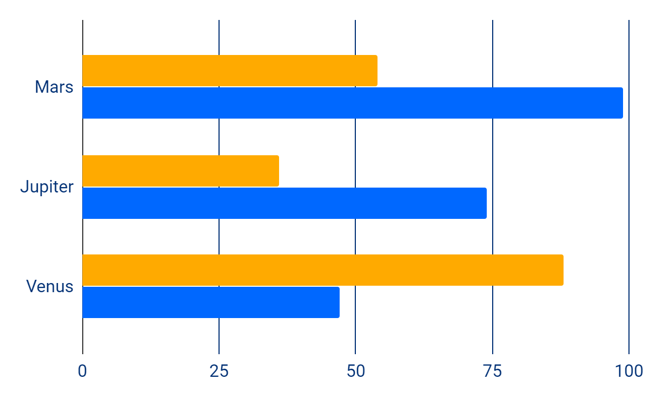
38%
METHODOLOGY
75%
6
Step 1: Topic and method is selected.
Step 2: Understand the concept and method
Step 3: Identify the formula that will be used in the calculation
Step 4: Data is collected
Step 5: Apply the formula.
Step 6: Analysis the data

Slide 11

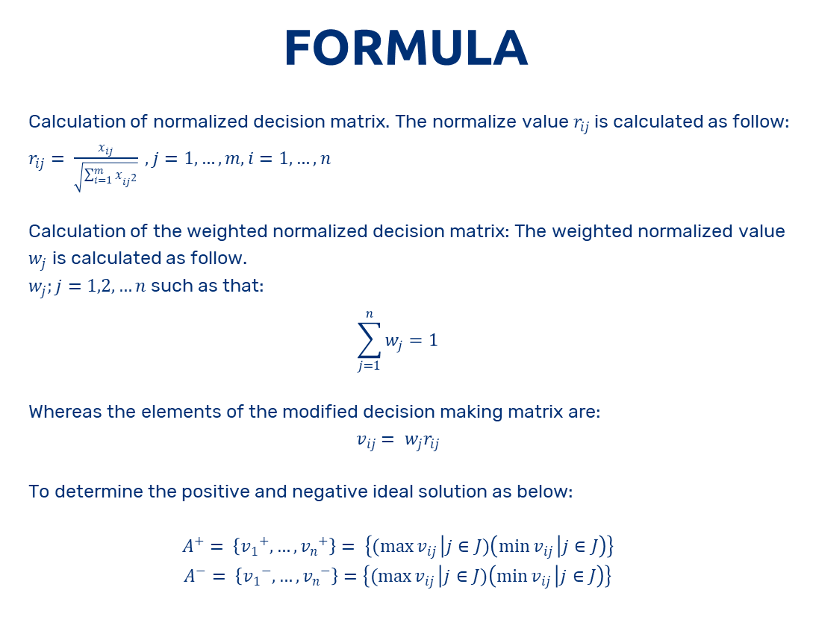
METHODOLOGY
FORMULA
Calculation of normalized decision matrix. The normalize value $r_{ij}$is calculated as follow:
$r_{ij}= \frac{x_{ij}}{\sqrt{\sum_{i=1}^{m}{x_{{ij}^{2}}}}} , j=1,…,m,i=1,…,n$
Calculation of the weighted normalized decision matrix: The weighted normalized value $w_{j}$ is calculated as follow.
$w_{j};j=1,2,…n$such as that:
$$\sum_{j=1}^{n}{w_{j}=1}$$
Whereas the elements of the modified decision making matrix are:
$$v_{ij}= w_{j}r_{ij}$$
To determine the positive and negative ideal solution as below:
$$A^{+}= \left\{{v_{1}}^{+},…,{v_{n}}^{+}\right\}= \left\{(\max{v_{ij}} | j∈J)\left(\min{v_{ij}} | j∈J\right)\right\}$$
$$A^{−}= \left\{{v_{1}}^{−},…, {v_{n}}^{−}\right\}=\left\{(\max{v_{ij}} | j∈J)\left(\min{v_{ij}} | j∈J\right)\right\}$$

Slide 12

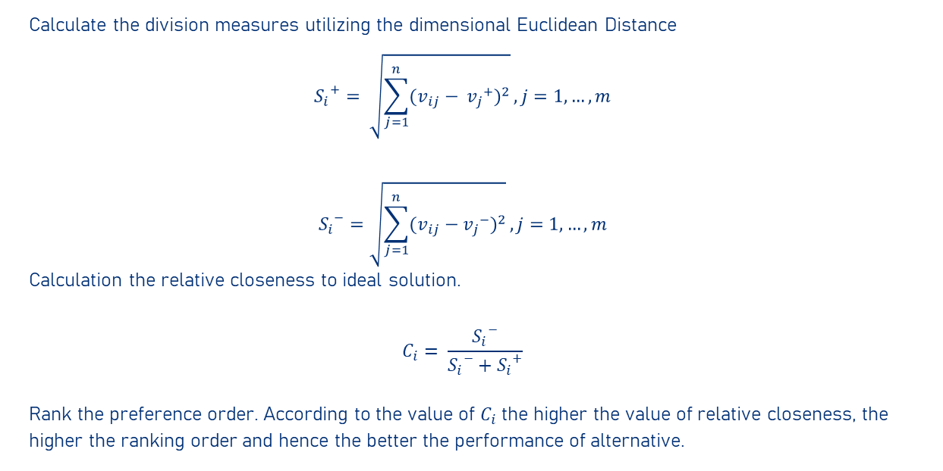
FORMULA
Calculate the division measures utilizing the dimensional Euclidean Distance
$${S_{i}}^{+}= \sqrt{\sum_{j=1}^{n}{{(v_{ij}− {v_{j}}^{+})}^{2}}}, j=1,…,m$$
$${S_{i}}^{−}=\sqrt{\sum_{j=1}^{n}{{(v_{ij}−{v_{j}}^{−})}^{2}}}, j=1,…,m$$
Calculation the relative closeness to ideal solution.
$$C_{i}= \frac{{S_{i}}^{−}}{{S_{i}}^{−}+{S_{i}}^{+}}$$
Rank the preference order. According to the value of $C_{i}$ the higher the value of relative closeness, the higher the ranking order and hence the better the performance of alternative.

Slide 13

EXPECTED RESULT
Price
COD Price
Insurance Price
Quality
Location Serve
Reverse Logistic Features
Reliability
Service
Communication
Reverse Logistic Price
Product Delivery
Management and Organization
Capital and Revenue
Product loss and coverage policy
Delivery Lead Time
Customization Capability

Slide 14
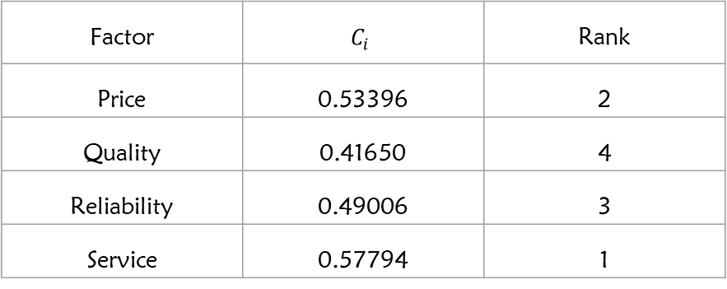
EXPECTED RESULT
7
Ranking of the factors that influenced the courier’s selection.
x
Factor | $$C_{i}$$ | Rank
Price | 0.53396 | 2
Quality | 0.41650 | 4
Reliability | 0.49006 | 3
Service | 0.57794 | 1
DELIVERY SERVICE

Slide 15


CONCLUSION
This project has succeed all of the objectives
One of the objective is to identify the important factors and sub factors which contribute to the selection in courier services.
The second objectives is successfully achieved because can evaluate factors and sub factors by using TOPSIS method
Last objective also succeed because the rank of the most influence factor that contributes to courier service selection can be shown by this method.

Slide 16


RECOMMENDATION
The methodology of TOPSIS method has been successfully applied to complete the objective of this research.
Other than TOPSIS method, the most suitable factor that influences the selection of the courier services also can be determined by using the Fuzzy Analytic Hierarchical Process (FAHP) as one of the Multi-Criteria Decision Making (MCDM) method. However, in many situations, especially involves a larger number of attributes or alternatives, the combination of TOPSIS method with other MCDM method such as FAHP is highly recommended.
This combination of method also can resulting to the selecting which factor that the most influential in order to choose the best courier services.

Slide 17


RECOMMENDATION
In order to prevent the original TOPSIS method from failed or disfunction, a new personalized recommendation technique based on the modified TOPSIS method is recommended.

Slide 18
THANK YOU

