Slide 1
Anggun Boutique Online Booking System (ABOBs)
By:
Hanis Hamizah Binti Harun (2017669158)
Supervisor : Miss Fazlin Marini binti Hussain

Slide 2
Background of Study
Case Study: Online booking system for Anggun Boutique customers’.
Area of Interest: E-commerce
Domain: Boutique
Theory: Jakob Nielsen’s 10 Heuristics of Usability
Problem Statement
All customers request service via Whatsapp only.
The list of booking are not organized.
Anggun Boutique have problem to keep track who customers that have paid the deposit payment.
Objectives
To identify the current process of manual booking problems and the requirements in managing the online booking system.
To design and develop an online booking system for Anggun Boutique.
To evaluate the functionality and usability of the proposed system.

Slide 3
Current Business Process
Anggun Boutique conducts its booking system manually. Customers view the Facebook and Instagram account to view the services offered by Anggun Boutique.
Once the customers interested in the services offered, they click on the link Whatsapp provided in the wall of Facebook and Instagram account.
Customers directly contact the owner and request service offered via Whatsapp. Then, Anggun Boutique gets the customers’ details like name, date, time, address and type of service.
Anggun Boutique check the date and time availability first. Once the date and time is available, Anggun Boutique inform the customers and wait for the deposit payment about 24 hours to confirm the booking. If there is no payment about 24 hours, Anggun Boutique will slot the date and time for another booking.
If there are more than one booking at the same date and time, Anggun Boutique will wait the early deposit payment. Once there is one customer have paid early, Anggun Boutique confirm the booking to the early customer and cancel the others. Anggun Boutique informs the other customers that the date and time are fully booked.

Slide 4
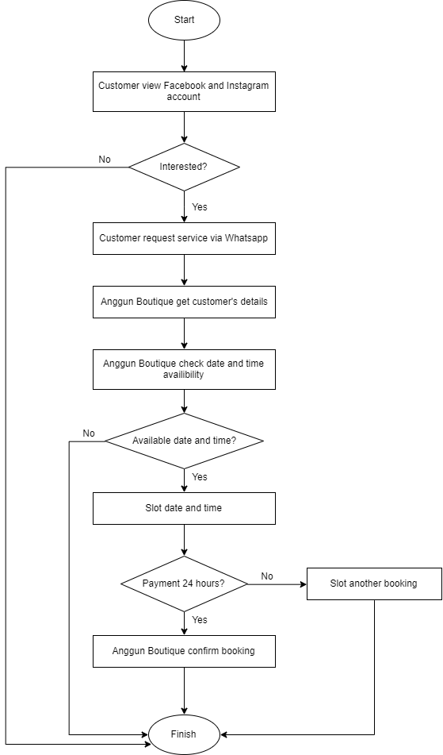
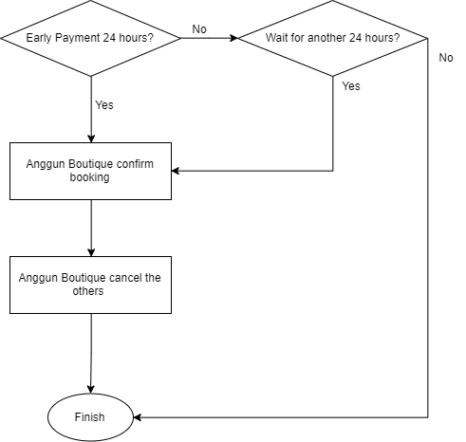
Flowchart of Current Booking Process of Anggun Boutique when there are more than one customer’s request.
Flowchart of Current Booking Process of Anggun Boutique

Slide 5
Proposed Solution
Problem Statement | Proposed System
All customers request service via Whatsapp only. Anggun Boutique (AB) just use Whatsapp to interact directly with customers. So, there is a long customer waiting list until the owner of AB missed some messages. | Develop Anggun Boutique online booking system that customers can select and book service offered online.
The list of booking are not organized. Anggun Boutique just use Whatsapp to save the time and date of customer booking. This will cause her to accept double booking, means book at same date and time. | Develop Anggun Boutique online booking system that the owner can view the list of booking systematically.
Anggun Boutique have problem to keep track who customers that have paid the deposit payment. Anggun Boutique need to scroll one by one to check the customers that have paid the deposit payment. AB need to check every time there is customer book at same date and time whether the previous customers have paid or not to confirm the booking. | Develop Anggun Boutique online booking system that the owner can keep track who customers that have paid the deposit payment so that she can confirm the booking.

Slide 6
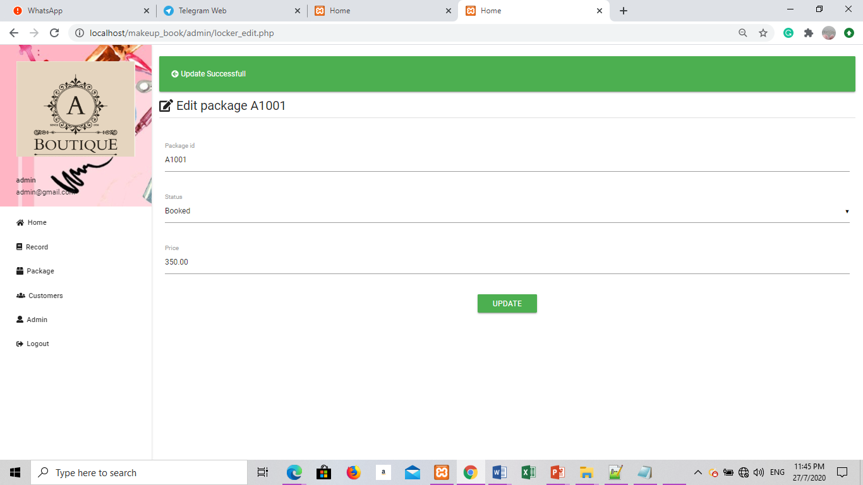
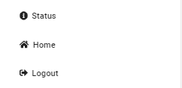
Theory : Jakob Nielsen’s 10 Heuristics of Usability
1. Visibility of system status
2. Match between system and the real world

Slide 7
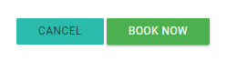
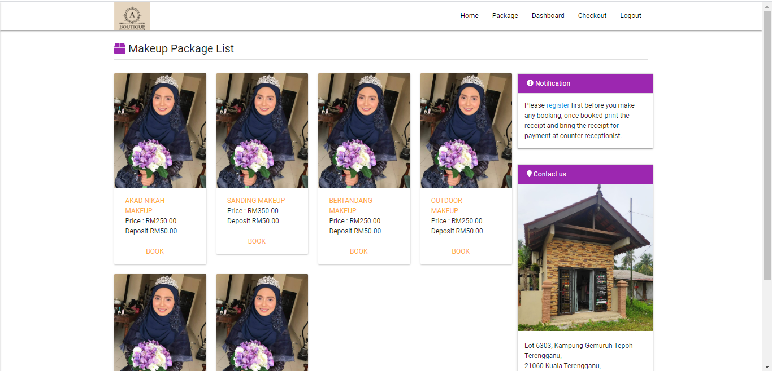
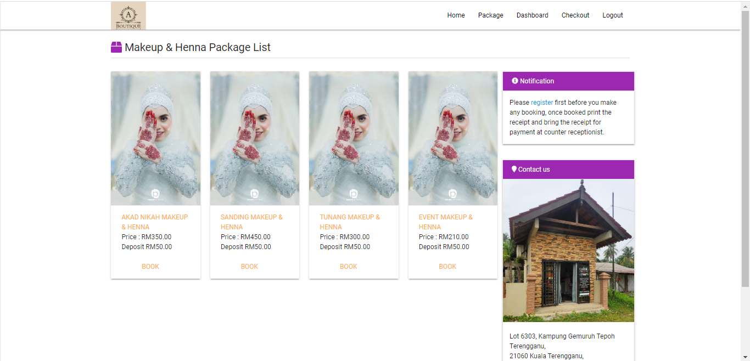
3. User control and freedom
4. Consistency and standards

Slide 8
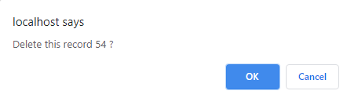
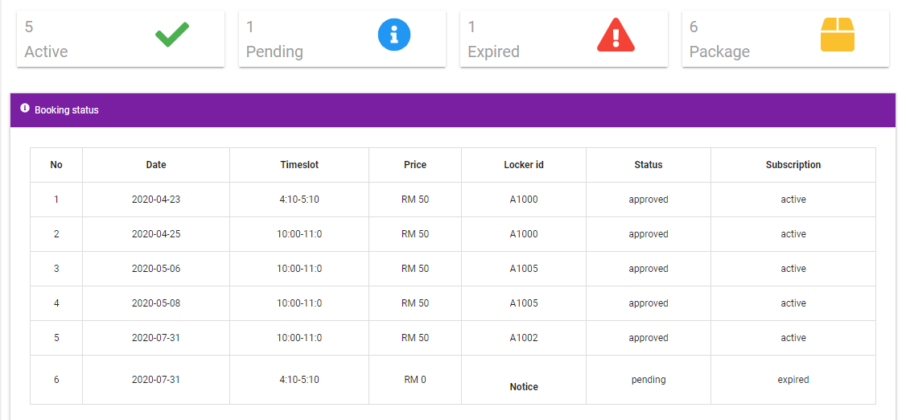
5. Error Prevention
6. Recognition rather than recall

Slide 9
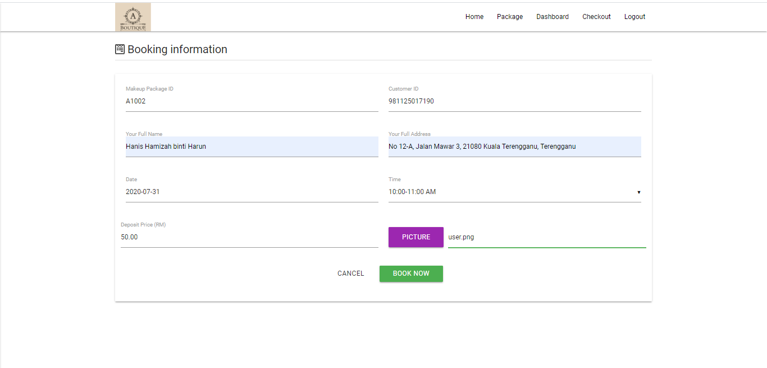
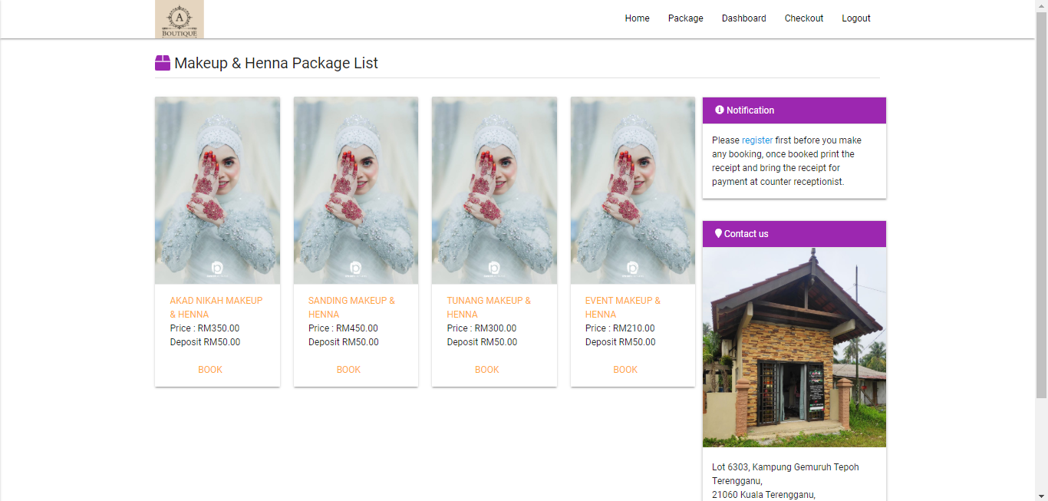
7. Flexibility and efficiency of use
8. Aesthetic and minimalist design

Slide 10
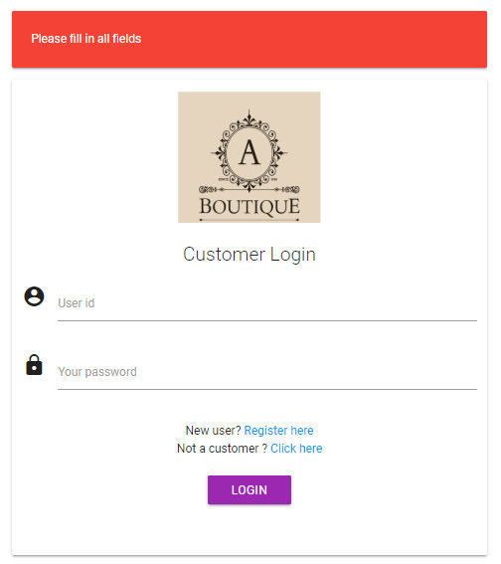
9. Help users recognize, diagnose, and recover from errors

