Slide 1

Noha Beauty Cosmetic E-Commerce System (NBCeS) Based On Online Shopping Behaviour
By:
NURSYAHIDATUL AKMAL BINTI HASSIM
(2017843978)
SUPERVISED BY MISS NOR HASNUL AZIRAH BINTI ABDUL HAMID

Slide 2
Background of Study
Objective
To identify the current business process and problem face by Noha Beauty Cosmetic.
To design and develop an E-Commerce system for Noha Beauty Cosmetic Shop.
To evaluate the functionality and usability of the NBCeS.
Case Study : Noha Beauty Cosmetic Shop at ,Seberang Marang, Terengganu.
AOI : E-Commerce(Online Ordering)
Domain : Cosmetic Industry
Theory : Online Shopping Behaviour Theory

Slide 3
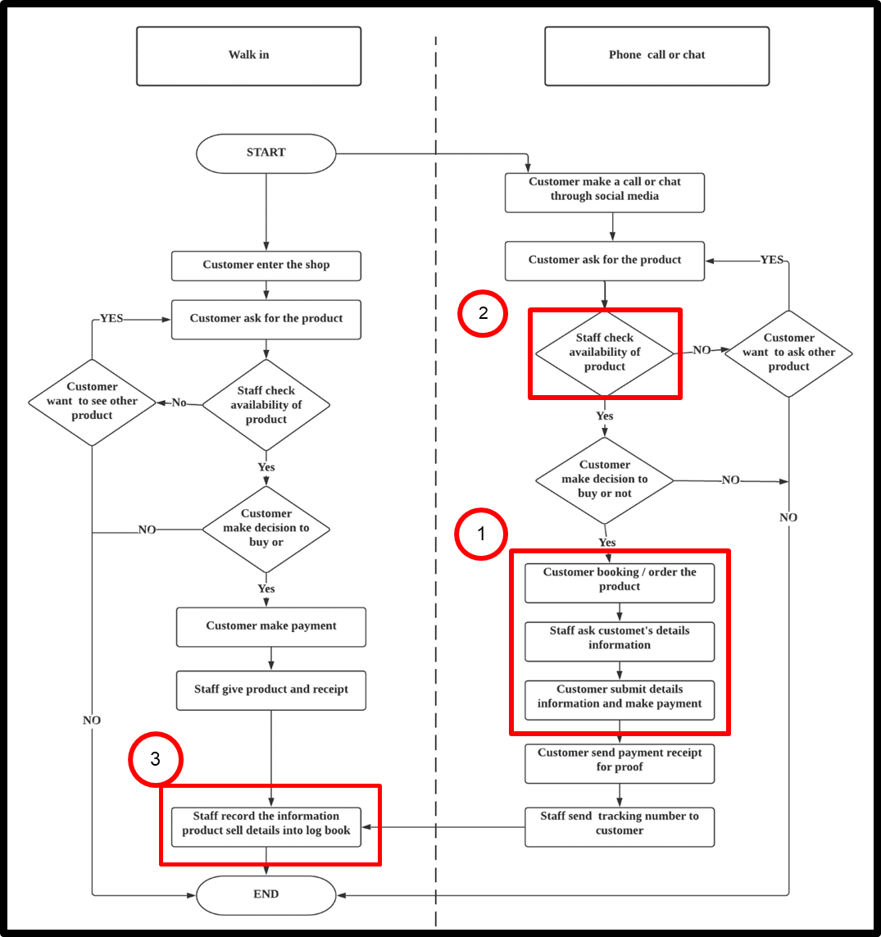
Current Business Process
Problem Statement
Misorder from the customer (manager might tend to lose the order details)
Mismanage and overlooked the data of product and customer (all the data save in a logbook)
Lack of security of the data submitted by the customer (The data was save in the logbook)

Slide 4
PROPOSED SOLUTION
Problem | Proposed Solution
Misorder from the customer (manager might tend to lose the order details) | Develop the NBCeS will help staff to manage the customer order more organized and systematic
Mismanage and overlooked the data of product and customer (all the data save in a logbook) | The system allow staff to retrieved the data of product and customer easily.
Lack of security of the data submitted by the customer (The data was save in the logbook) | The system can help the staff secure their customer details by providing the security policy in the system.

Slide 5
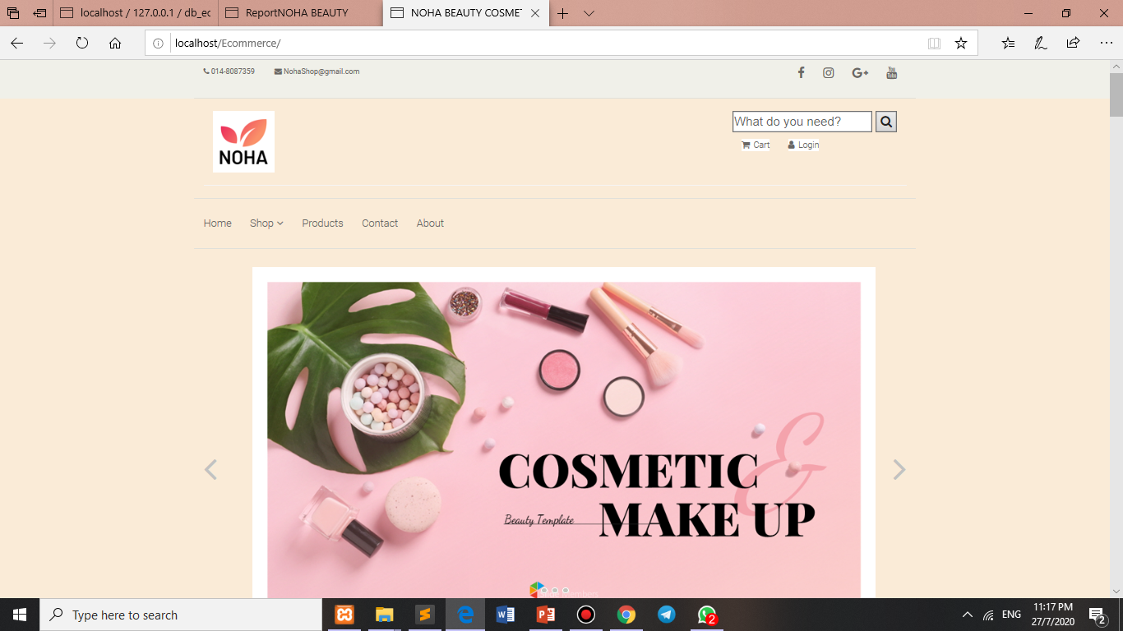
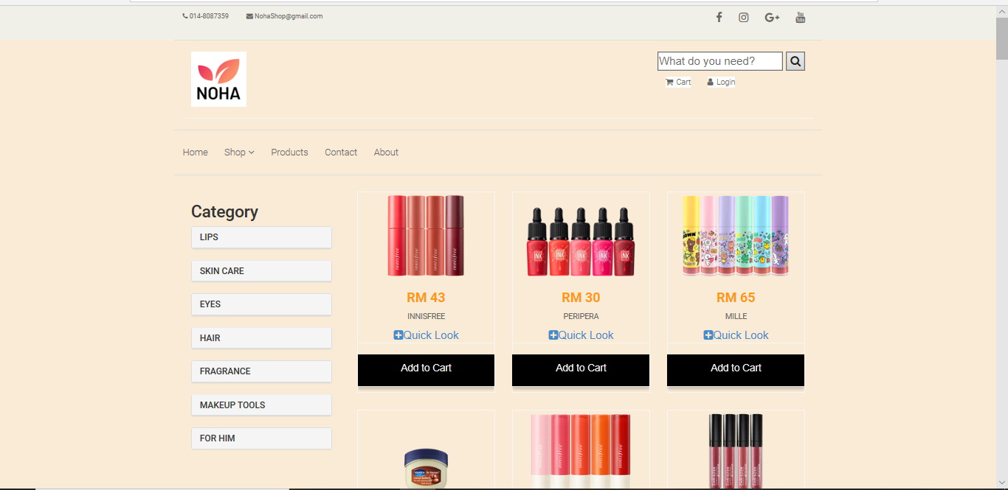
ONLINE SHOPPING BEHAVIOURE THEORY
How it is implemented in the system
Easy of navigation
Means user can easy to navigate and allows users to find the content they're looking for much faster.

Slide 6
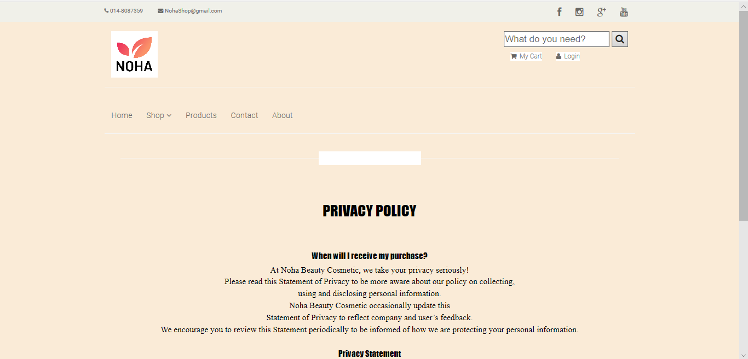
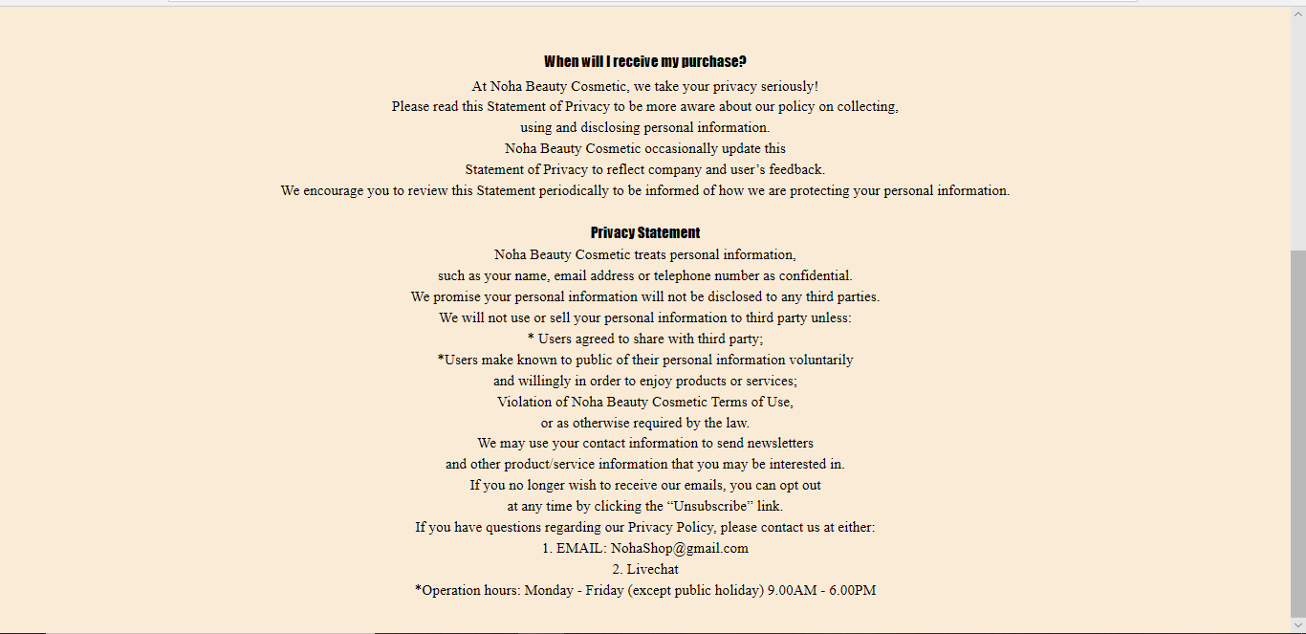
ONLINE SHOPPING BEHAVIOURE THEORY
How it is implemented in the system
2. Trust

Slide 7
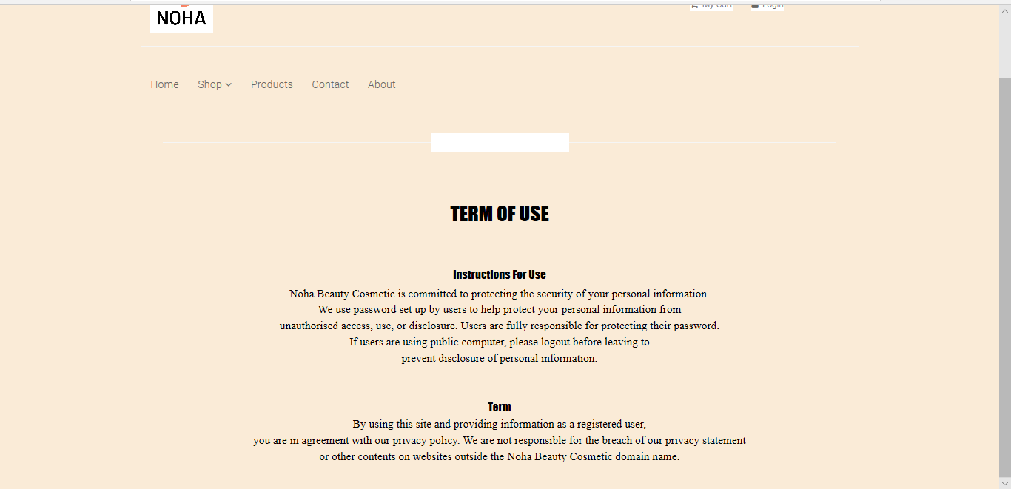
ONLINE SHOPPING BEHAVIOURE THEORY
How it is implemented in the system
3. Security

Slide 8
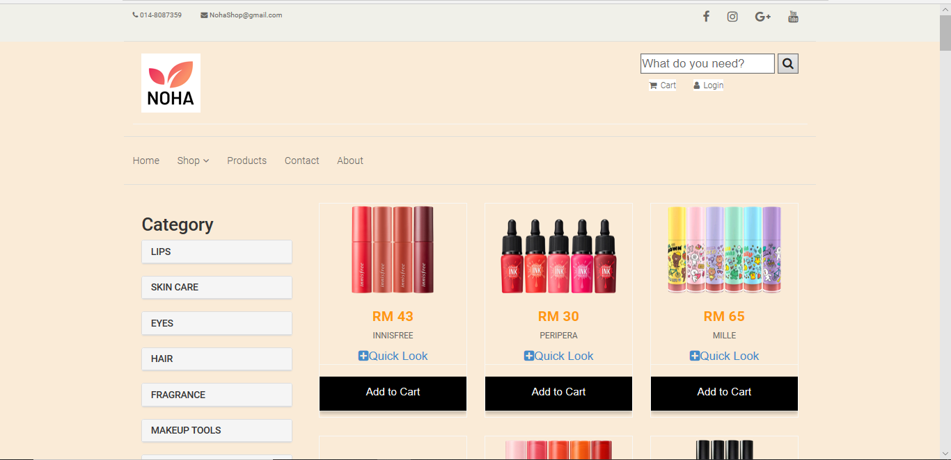
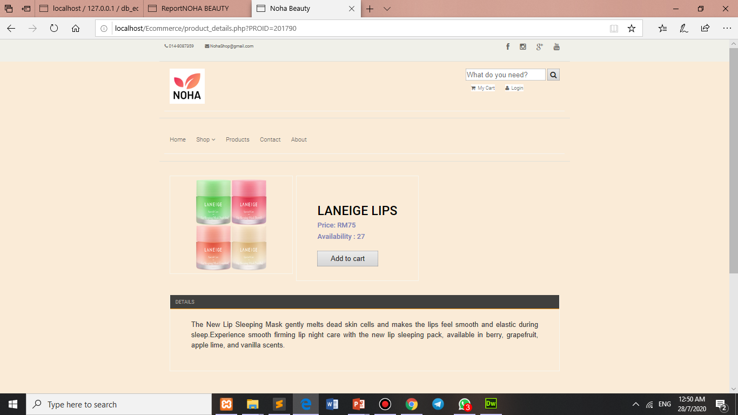
ONLINE SHOPPING BEHAVIOURE THEORY
How it is implemented in the system
4. Product features

Slide 9
THANK YOU

