Slide 1

STUDENT INFORMATION
MANAGEMENT SYSTEM (SIMS)
FOR PASTI AN - NUR
SUPERVISOR NAME : NOR HASNUL AZIRAH BT ABDUL HAMID
NAME : NURUL NAJIHAH BINTI MUSTOPA
STUDENT ID : 2017882492

Slide 2
Background Study
Area of Interest :Student Information
Management System
Domain: Preschool Education
Theory: Nielsen Heuristics Usability Theory
Problem Statement
The registration previously done by manual system such as filled in the form. (from interview)
Lack of formal procedure when keeping the information manually which resulting in redundant of student information data.
Problem regarding payment method when the parent have to go PASTI An Nur every month to make a payment fees. (from interview)
Objective
To identify the current process registration and problem related to the PASTI An-Nur.
To design and develop a Student Information Management System for PASTI An – Nur.
To evaluate the functionally and usability of the Student Information Management System.

Slide 3
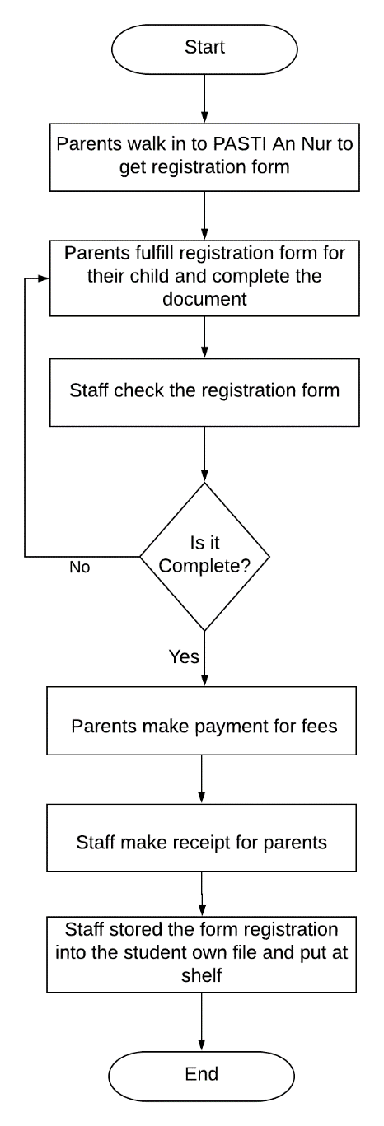
Proposed Solution
1
Problem Statement | Proposed Solution
1. The registration previously done by manual system such as filled in the form. (from interview) | Develop Student Information Management System (SIMS) for parents easy to register their child to PASTI An Nur.
2. Lack of formal procedure when keeping the information manually which resulting in redundant of student information data. | Develop Student Information Management System (SIMS) will be help staff to manage the information student is more organized and systematic.
3. Problem regarding payment method when the parent have to go PASTI An Nur every month to make a payment fees. (from interview) | Develop Student Information Management System (SIMS) easy for parents to make fees payments in monthly.
Current
Process
2
3

Slide 4
Heuristic Usability Theory
1. Visibility of system status
6. Recognition Rather than recall
2. Match between system and the real world
7. Flexibility and efficiency of use
3. User control and freedom
8. Aesthetic and Minimalist design
4. Consistency and standards
9. Help users recognize, diagnose and recover from errors
5. Error prevention
10. Help and Documentation

Slide 5
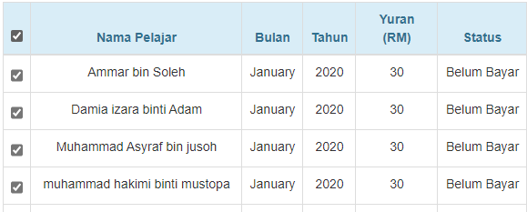
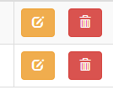
10 Heuristic Usability for User Interface Design
How it is implemented in the system
1. User control and freedom
2. Match between system and the real world

Slide 6
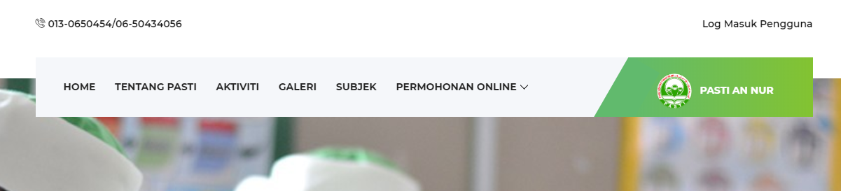
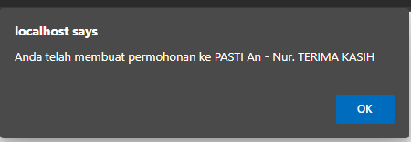
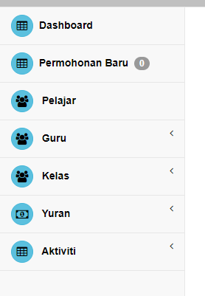
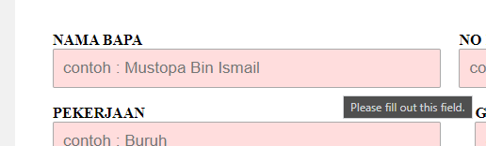
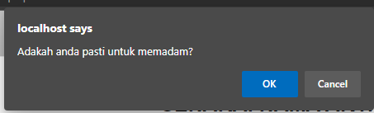
10 Heuristic Usability for User Interface Design
3. Consistency and standards
4. Error prevention

Slide 7
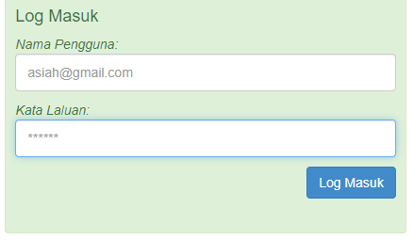
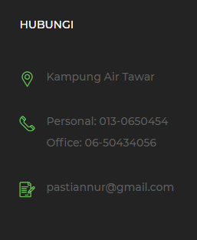
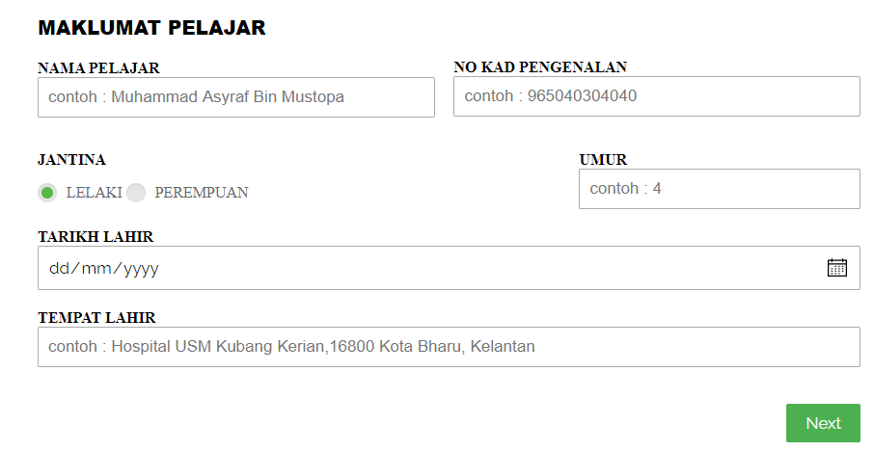
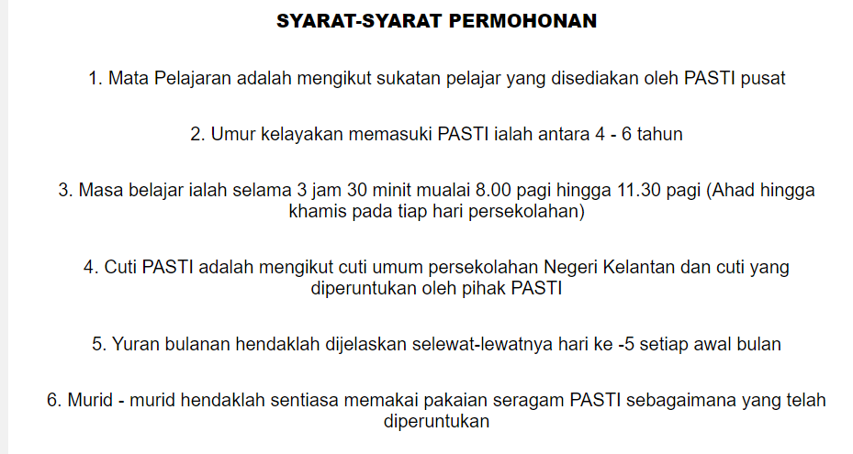
10 Heuristic Usability for User Interface Design
5. Help and Documentation
6. Aesthetic and Minimalist design

Slide 8
Proceed To System
Demonstration

