Slide 1
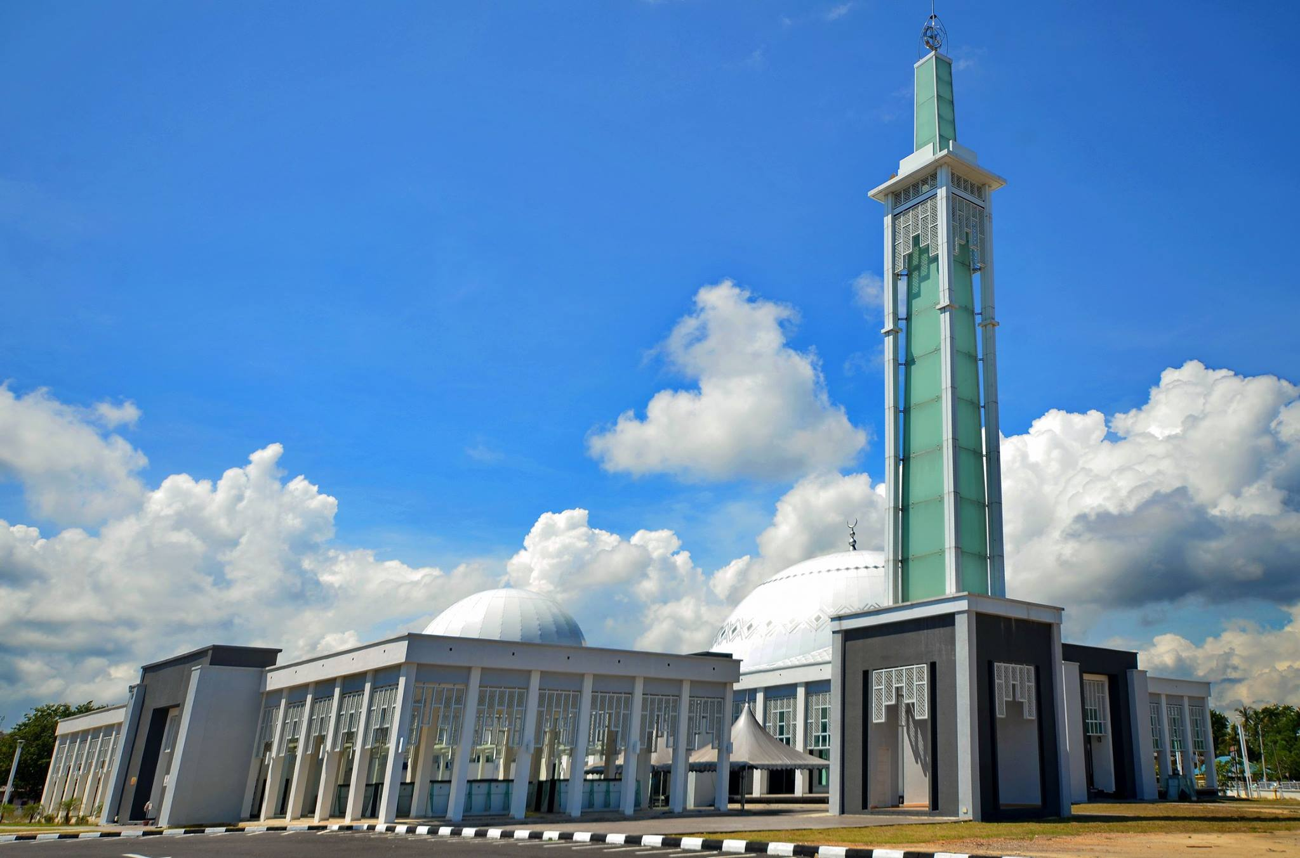
Mosque Event Management System (MEMS)
By:
Muhammad Azrilkhair Bin Zainol Abidin

Slide 2
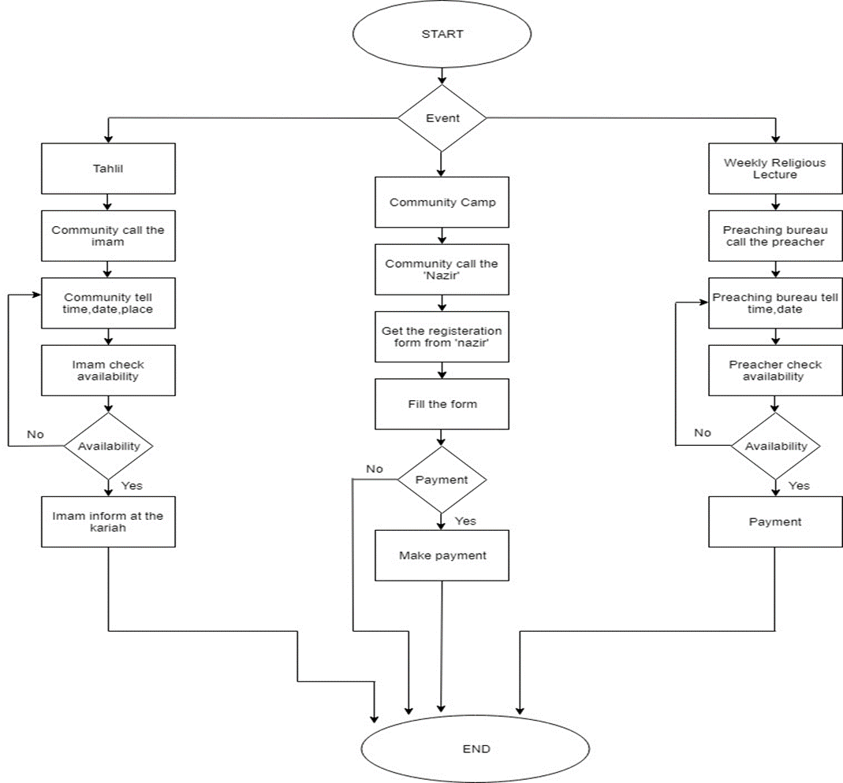
Background of Study
Case Study: Kampung Kubang Ikan Mosque
AOI: Mosque Event Management System (MEMS)
Domain: Organization
Theory: 10 Heuristic Principles – Jakob Nielsen’s
Current Booking Process
Problem Statement
1. Double Booking
2. Paper based system to record preacher’s details
3. Walk in registration for camps takes time
Objectives
To identify current event management process and the problem arises from the process
To design and develop Mosque Management System to manage events for Kampung Kubang Ikan Mosque.
To evaluate the functionality and usability of Mosque Event Management System.

Slide 3
Proposed Solution
Problem | Proposed Solution
1. Double booking Tahlil request | Develop a Tahlil booking system for community and the mosque.
2. Paper based system to record preachers’ details | Develop a database for the mosque to store the preacher’s details.
3. Walk in registration for camps takes time | Develop an online camp registration system for the mosque

Slide 4
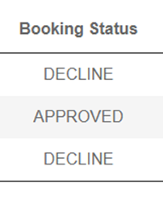

Theory: Jakob Nielsen 10 Usability Heuristic
Visibility of system status
2. Match between system and real world

Slide 5
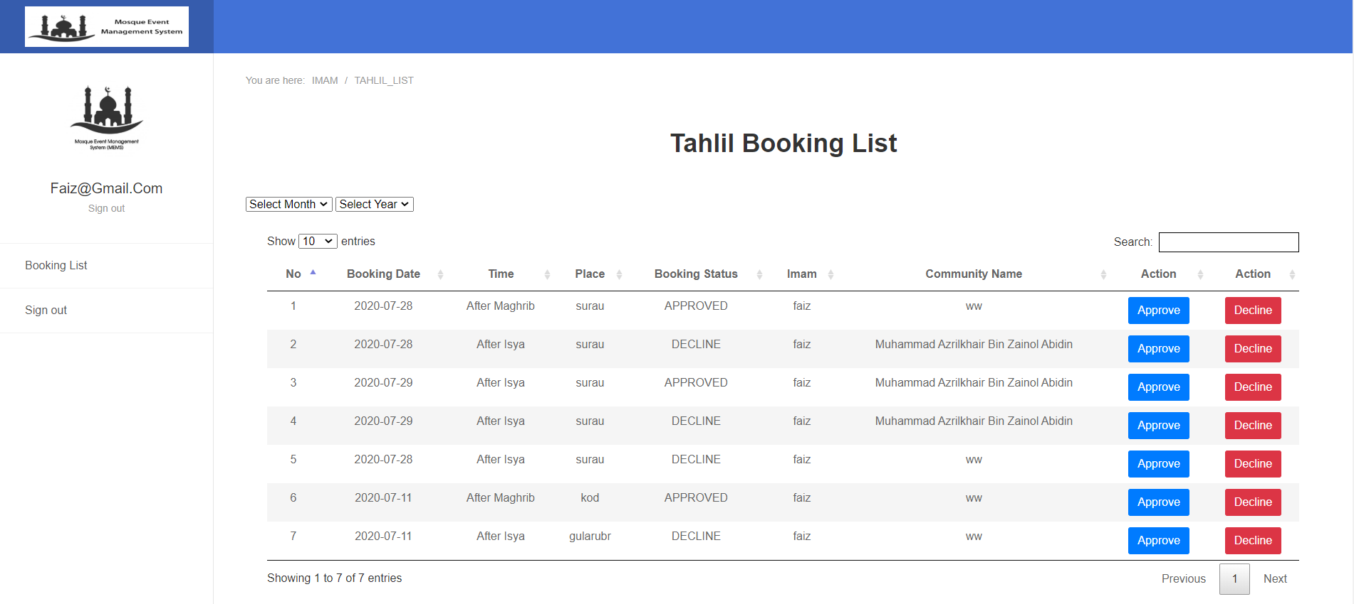
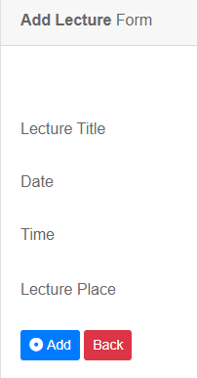
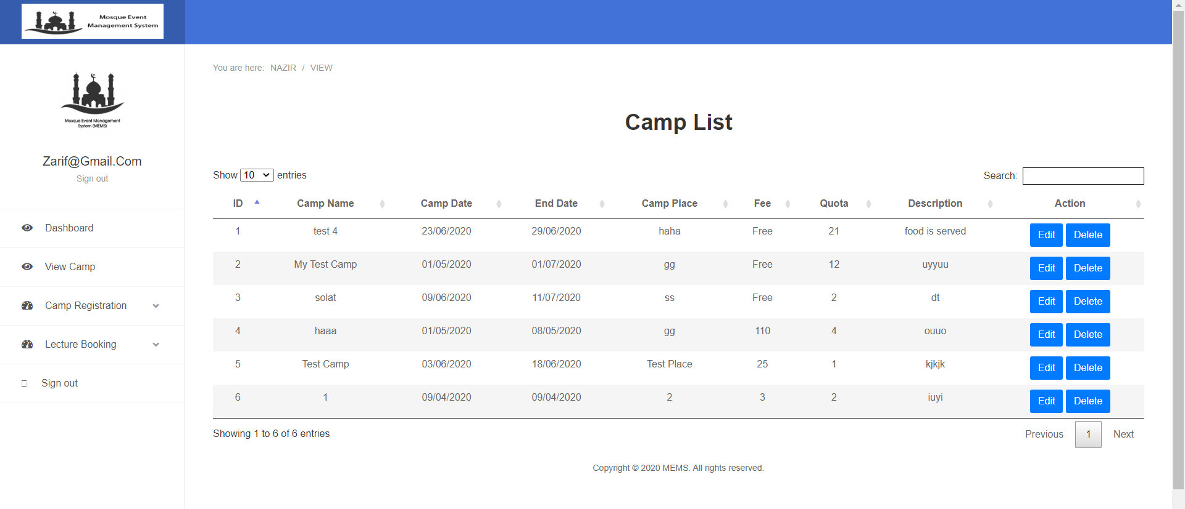
3. User Control and Freedom
4. Consistency and Standard

Slide 6
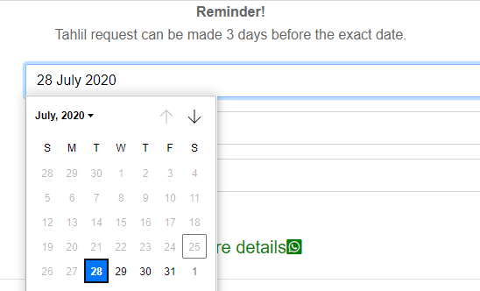
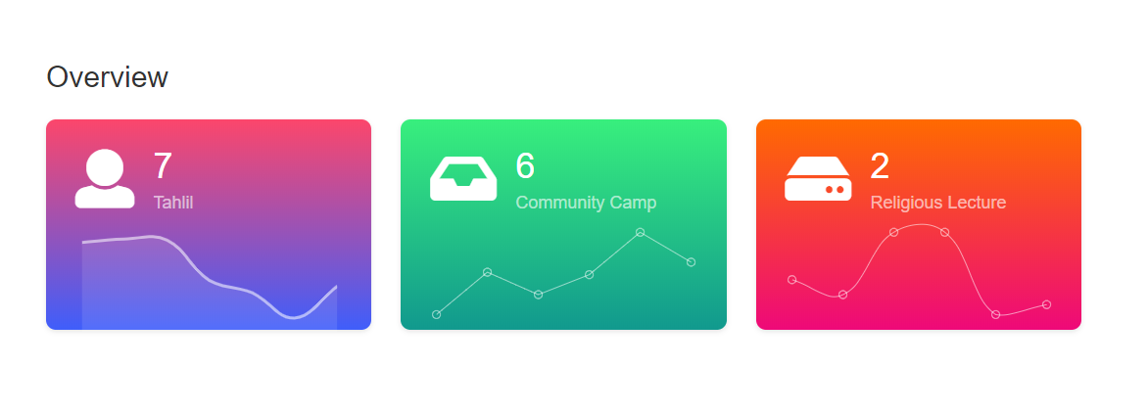
5. Error Prevention
6. Recognition rather than recall

Slide 7
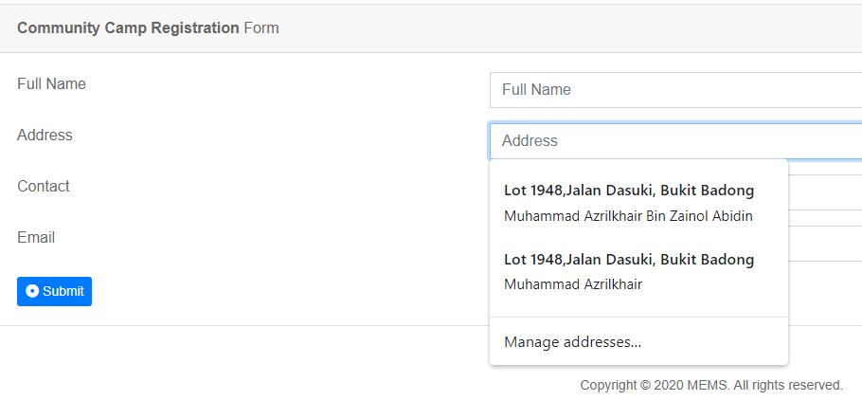
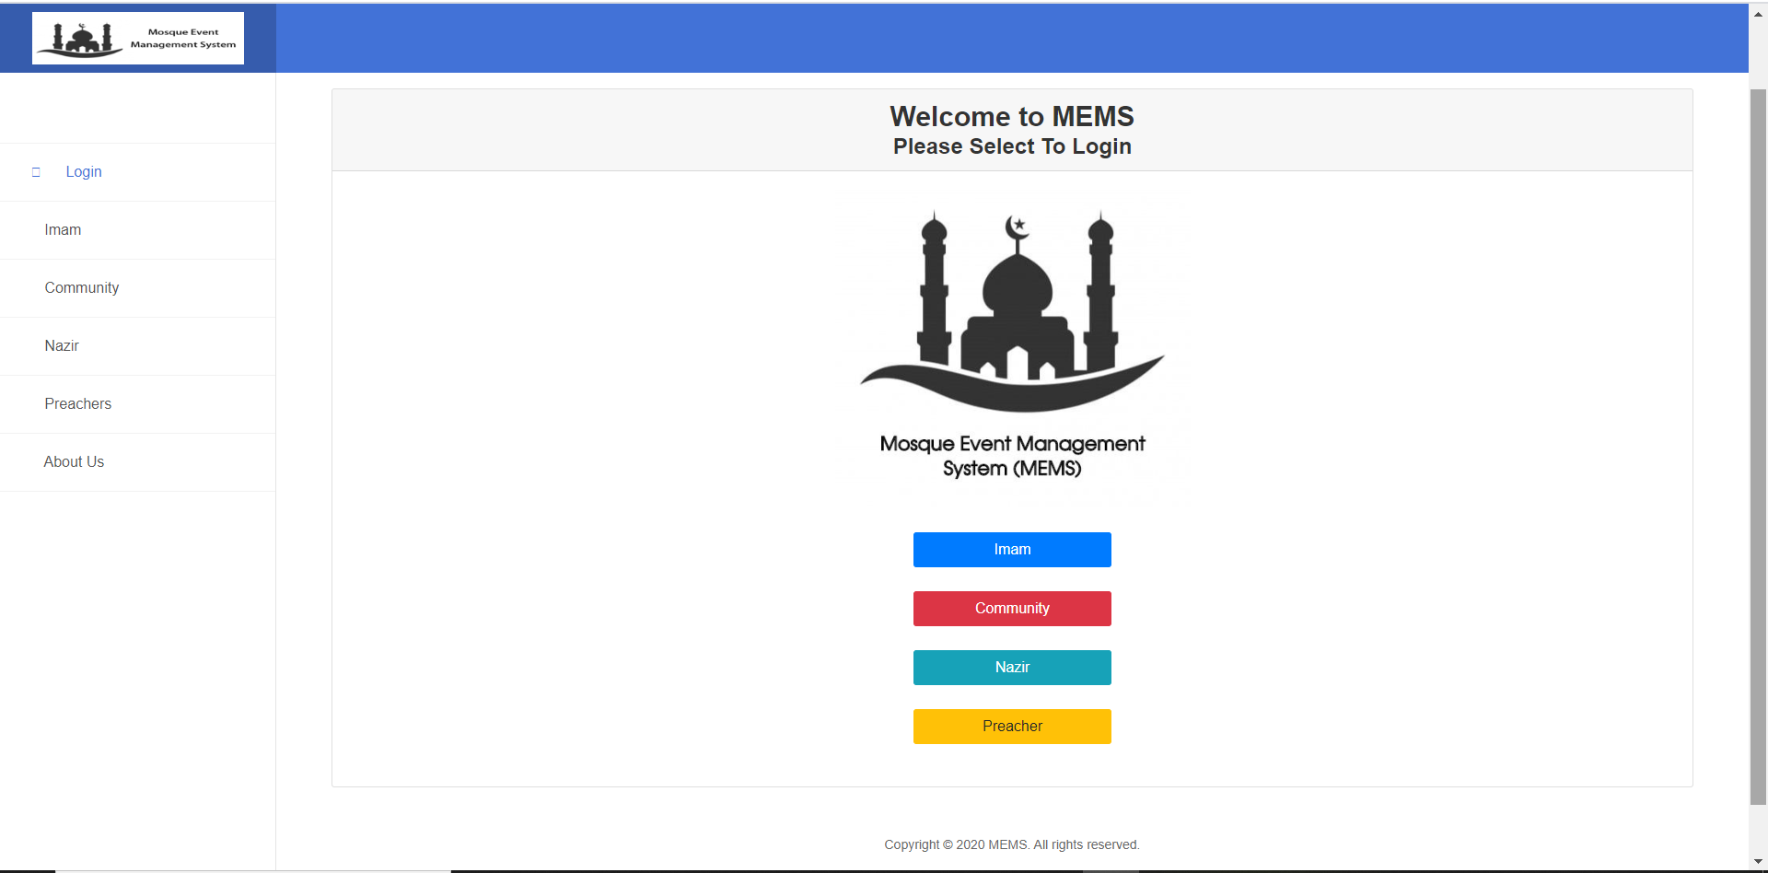
7. Flexibility and efficiency of use
8. Aesthetic and minimalist design

Slide 8
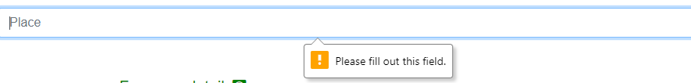

9. Help user recognize and recover from error
10. Help and documentation

