Slide 1
English Reading Courseware using Persuasive Design Strategy for Kindergarten
By:
NURULFATHIAH BINTI KAMARUDIN

Slide 2
Background of Study
Case Study: Kindergarten
AOI: Interactive multimedia courseware
Domain: Educational institute
Theory: Persuasive design strategy
Objectives
To identify and understand the appropriate principles of persuasive design strategy to apply in English courseware for children.
To design and develop English courseware using persuasive design strategy for children
To evaluate the functionality and usability of English courseware using persuasive design principles in educational learning.
Problem Statement
Traditional teaching method
The capability of students to maintain their focus in learning
The limited time-teaching and learning in the class
Current Process
The children current practice in learning English is by using a textbook and at the beginners level, kindergarteners learn about beginning consonant, and vowel a, e and o.
The teachers tend to play the YouTube videos to make a better explanation about the vowels sound.
For English learning, current practice use a traditional methods in teaching such as textbooks, flash cards ands story books.

Slide 3
Proposed Solution
Problem Statement | Proposed Solution
Traditional teaching method | Design and develop an CD-ROM based English reading courseware.
The capability of students to maintain their focus in learning | To provide a courseware that linked to the principles of persuasive design.
The limited time-teaching and learning in the class | Implement the persuasive design strategy in order to develop an efficient educational courseware

Slide 4
Theory of Persuasive Design Strategy and How it is implemented in the English Reading Courseware

Slide 5
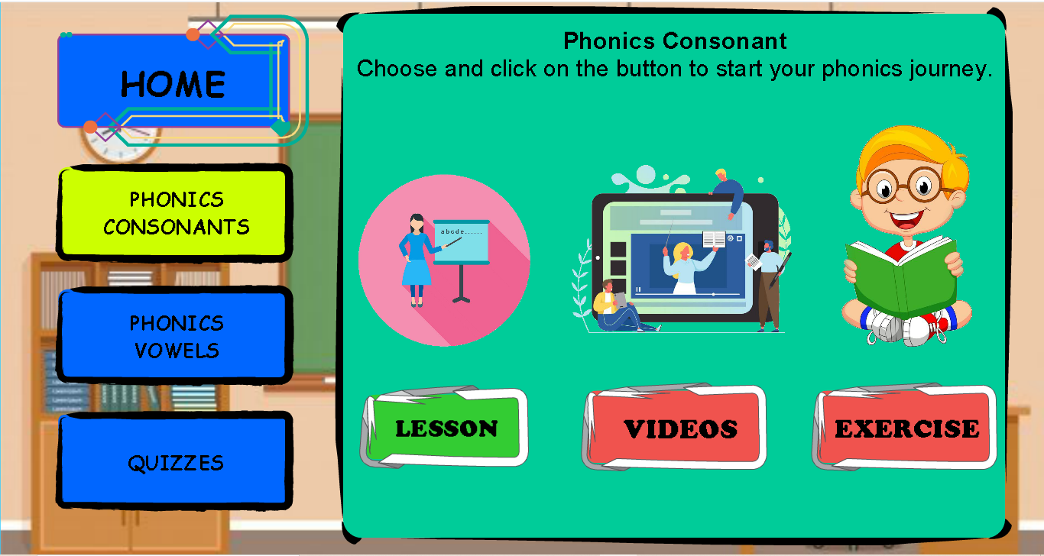

Reduction - Making complex task become simple to avoid the user to jump through several hoops in to get to their course.
The user have to click on the “Home” button to go back to the homepage, and exit.
The user will exit using “Exit” button that only provided in the homepage.

Slide 6
Tailoring – We provides an options and user are more likely to complete the task that they choose.
Navigational options that will helps the user to change the direction of main menu.
Navigational option for the content activities.

Slide 7
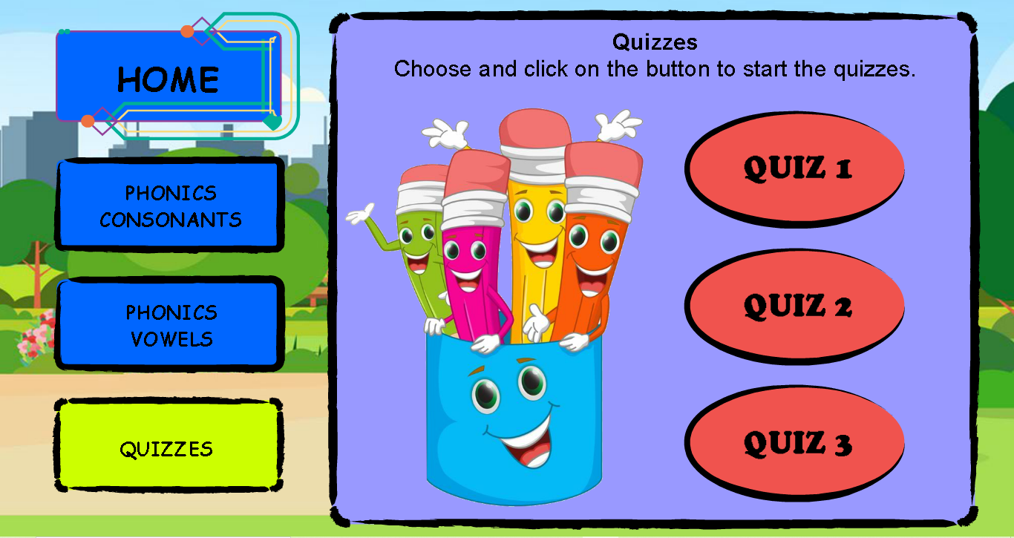
Suggestion – We place a trigger in the path to persuade the user behavior and keep the engaged.
The quiz menu is one of the trigger to keep the user engaged in learning English.

Slide 8
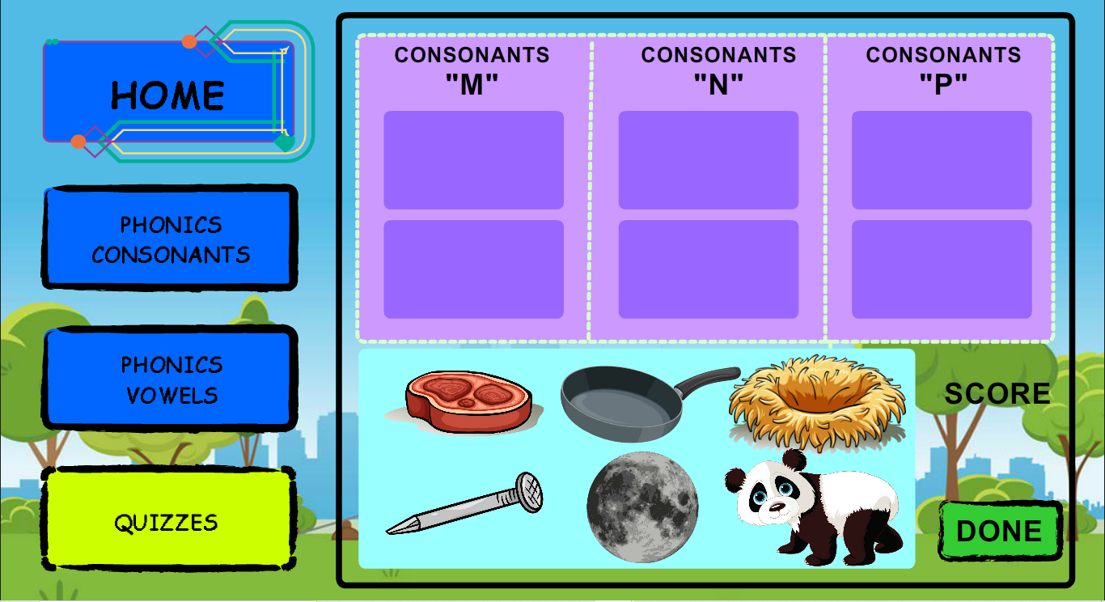
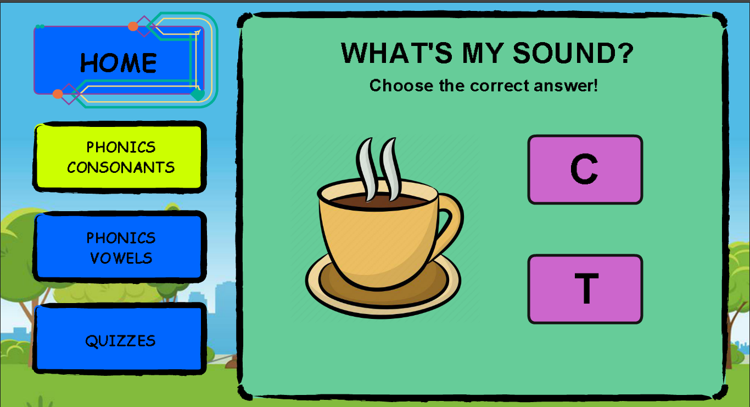
Self-monitoring – The teacher or parents can check the understanding and depth of knowledge of user through assessment.
Examples of quiz and exercise provided in English Reading courseware.

Slide 9
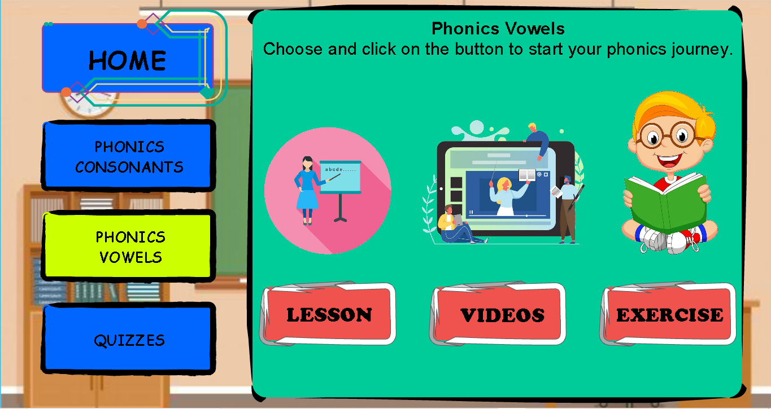
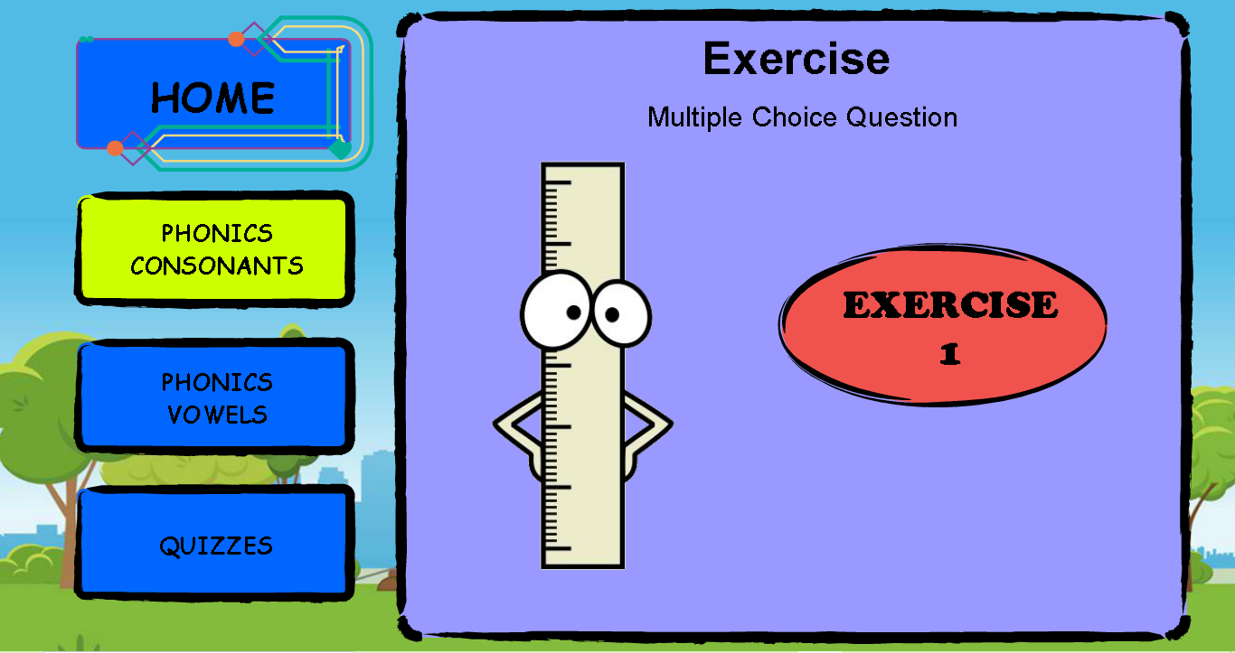
Conditioning – The theory help to create a good habit by reinforcing the targeted user behaviors.
“Exercise” session is provided in phonics consonants and vowels.

Slide 10
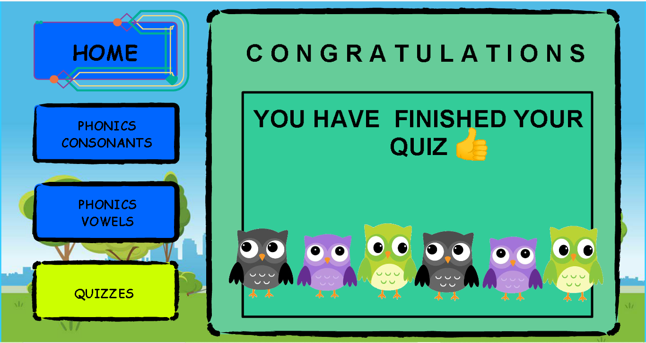
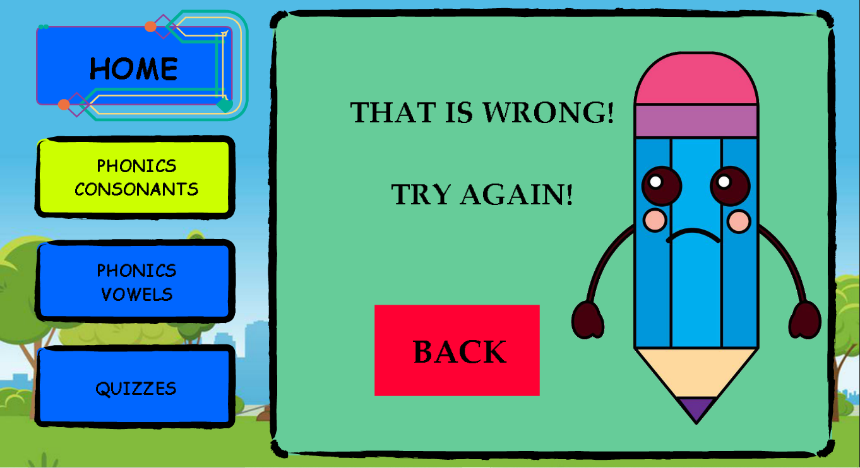
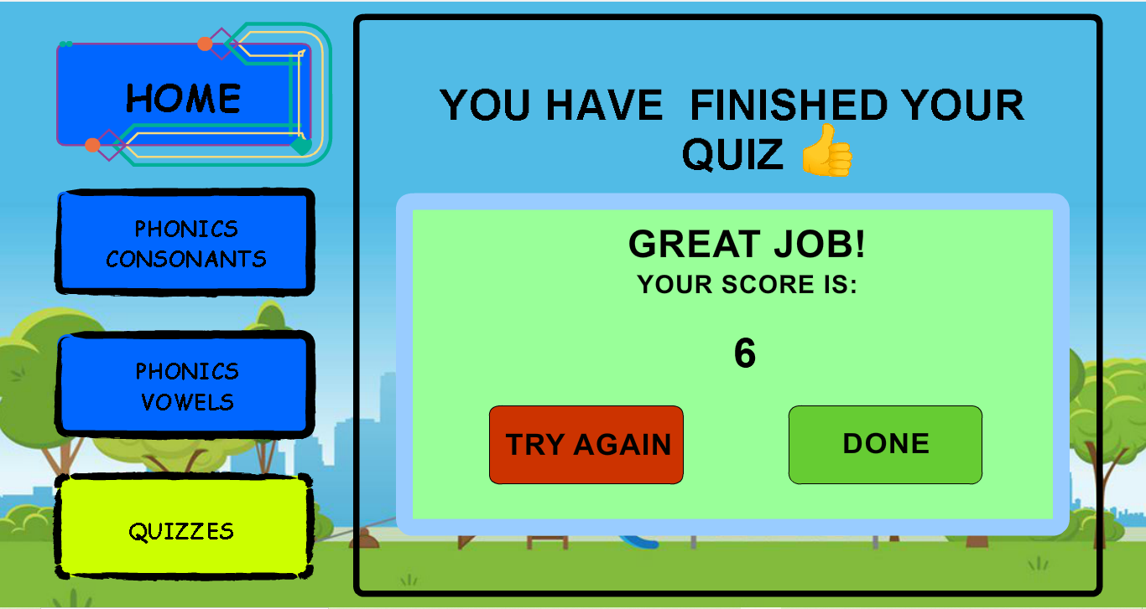
Surveillance – We provides an indicator and praise or total of marks after the user finished answering the exercises and quizzes.
Indicator will appeared when the user choose a correct answer.
Indicator will appeared when the user choose a wrong answer.

Slide 11
THANK YOU.

