Slide 1


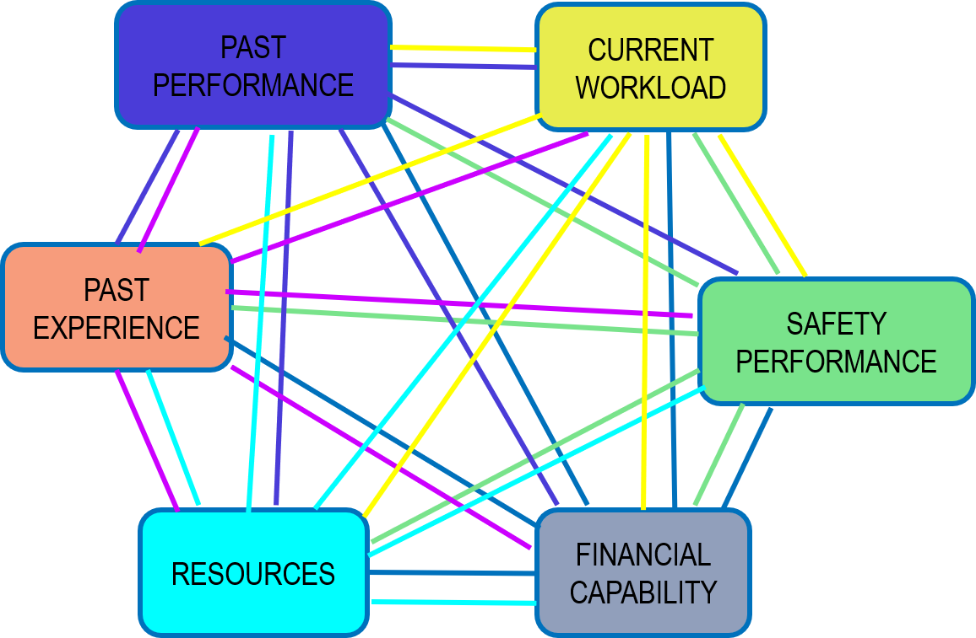
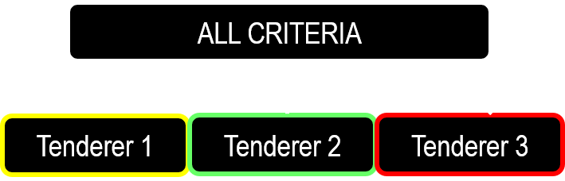



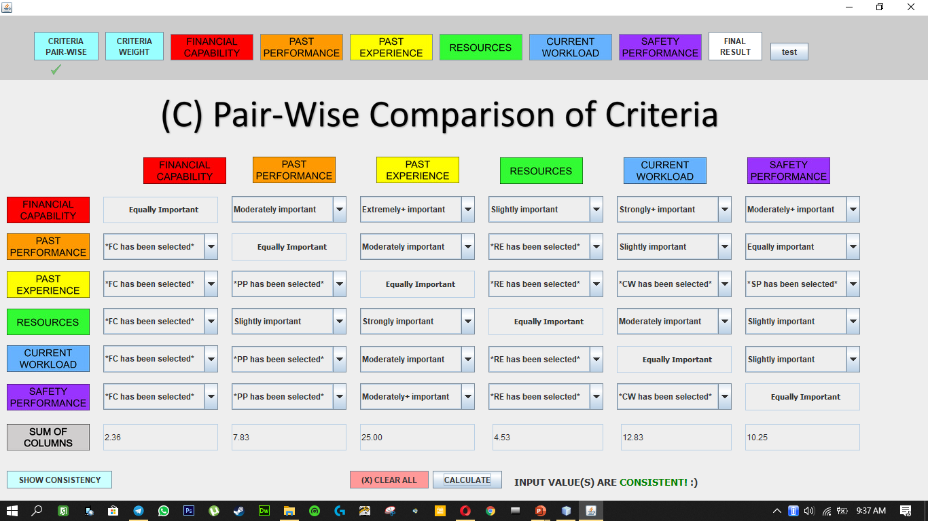
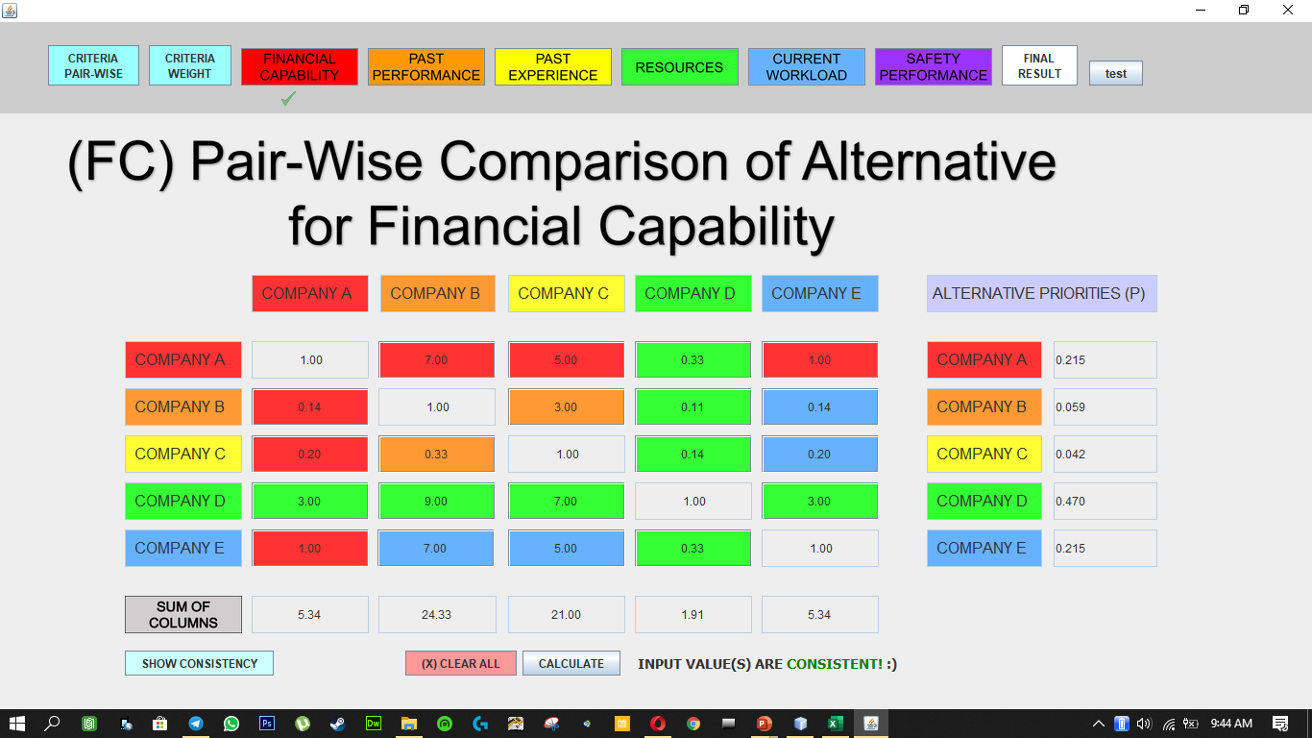
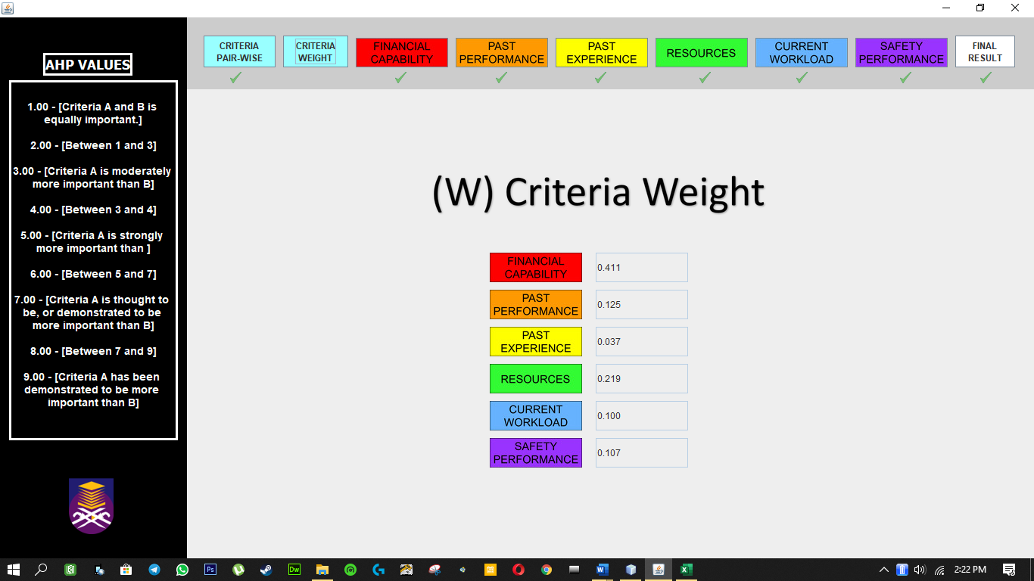
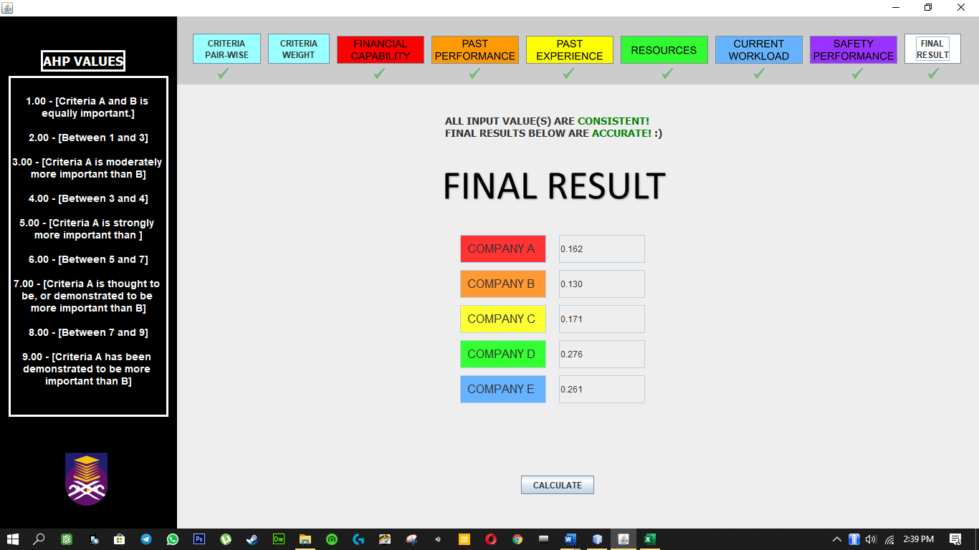
DECISION SUPPORT SYSTEM OF
CONSTRUCTION TENDERING USING
ANALYTICAL HIERARCHY PROCESS (AHP).
AHMAD NUZUL ASRAR BIN ABD RAHIM
SHARIFAH NURULHIKMAH SYED YASIN
INTRODUCTION
Decision Support System (DSS) of Construction Tendering Using Analytical Hierarchy Process (AHP) helps the decision maker to find the best tenderer for a construction project. There are multiple tenderer alternatives and every alternative has multiple criteria to be evaluated. AHP algorithm implemented into the system compares every criterion and every alternative to one another to find the best tenderer alternative.
OBJECTIVES
EXPERIMENT SETUP
1- To identify requirements in evaluating and analyzing the tender.
2- To develop a prototype system with complete rules, criteria and algorithm.
1 – Compare Criteria
2 – Compare Alternatives for every Criteria
3 – Get Results
3- To evaluate the functions of the system by expert accuracy test and user testing.
PRELIMINARY STUDY
DATA COLLECTION
METHODOLOGY
IMPLEMENTATION
Interviews
Jabatan Kerja Raya journals
Tendering Process online journals
SYSTEM DESIGN
Code AHP algorithm into the system’s engine
Java programming language
TESTING & EVALUATION
Contractor Selection
List of Criteria
Multi-Criteria Decision Making algorithms
AHP
- Java GUI
Data Comparison
Result Analysis
OUTCOME
-Problems statement
-Objectives
-Scxope
-Literature Review
-Methods and algorithms
-Evaluation
-Criteria
-Most suitable algorithm
System prototype
Complete System with core and additional functions
- Tenderer ranking
Result analysis
OBJECTIVE 1
OBJECTIVE 2
OBJECTIVE 3
CONCEPTUAL FRAMEWORK
MAKE
DECISION
Pair-Wise Comparison of Criteria
AHP
Pair-Wise Comparison of Alternatives for each Criterion
Criteria Weight
USES SYSTEM
INTERFACE
Multiply Criteria Weight with combined Alternative Priorities from every criterion
Goal
Alternative Priorities for each Criterion
GAINED
OUTPUT
RESULT
RESULTS ANALYSIS
SCREENSHOTS
Ranking | Expert 1 Choice | Expert 2 Choice | Criteria Choice Ranking from Literature Review and Researches | Experts’ Choice Similarity with The Project Proposal
1- | Financial Capability | Financial Capability | Financial Capability | 2/2
2- | Resources | Resources | Resources | 2/2
3- | Current Workload | Current Workload | Past Performance | 0/2
4- | Past Performance | Past Performance | Current Workload | 0/2
5- | Safety Performance / Past Experience | Safety Performance / Past Experience | Safety Performance | 2/2
6 | Safety Performance / Past Experience | Safety Performance / Past Experience | Past Experience | 2/2
Expert 1 Choice | Expert 2 Choice | AHP Ranking No. | AHP Suggestion | AHP Score
Tenderer E | Tenderer E | 1- | Tenderer D | 0.276
 |  | 2- | Tenderer E | 0.261
 |  | 3- | Tenderer A | 0.167
 |  | 4- | Tenderer C | 0.166
 |  | 5- | Tenderer B | 0.131
 |  | TOTAL |  | 1.00
CONCLUSION
Type | Advantage | Disadvantage
Human | Ability to know the information of tenderer when applied into real life based on knowledge and experience that only humans are capable of. | Humans may have uncertainty and prone to make even the slightest mistake when dealing with large number of alternatives (eg: 12 tenderers to be evaluated) and have a tendency to make decisions based on feelings that might be slightly unfair.
AHP Algorithm | Rank the selection of alternatives based on human input without bias throughout the steps of comparing the alternatives. | An algorithm only shows the actual data and fact that sometimes only human would know how to interpret on what is best or not for a particular construction project.
AHMAD NUZUL ASRAR BIN ABD RAHIM
FACULTY OF COMPUTER AND MATHEMATICAL SCIENCES
UNIVERSITI TEKNOLOGI MARA (TERENGGANU)
SHARIFAH NURULHIKMAH SYED YASIN
FACULTY OF COMPUTER AND MATHEMATICAL SCIENCES
UNIVERSITI TEKNOLOGI MARA (TERENGGANU)

