Slide 1



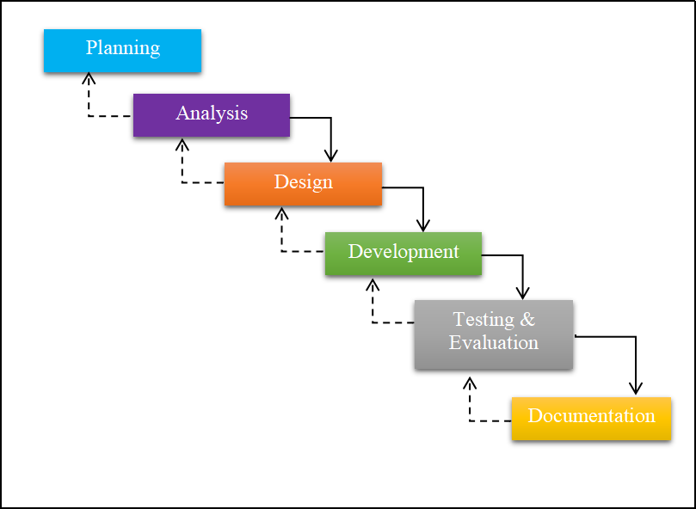

V-LAB ONLINE INVENTORY SYSTEM
MUHAMMAD KHAIRUL ZAMIR BIN MOHAMAD RAFI
UMMU FATIHAH BINTI MOHD BAHRIN
Faculty of Computer and Mathematics Science
Universiti Teknologi MARA Terengganu Branch Kuala Terengganu Campus, 21080 Kuala Terengganu, Terengganu, Malaysia
ABSTRACT
An inventory system is the combination of technology (hardware and software) and processes and procedures that oversee the monitoring and maintenance of stocked products. An inventory management system enables a company to maintain a centralized record of every asset and item in the control of the organization. The issue arises when the staff did not know how many the stocks are left and what item should buy, the staff need more books for data stock and staff did not know how many suppliers queue order. This system uses User Interface Design for V-Lab Printing and Service shop to manage inventory effectively and efficiency. The purpose of this project is to develop and reduce the problems and increase the speed of the process. This project implemented the System Development Life Cycle (SDLC) methodology using the Adapted Waterfall Model contains Planning, Analysis, Design, Development, Testing and Documentation. It is implemented and VOIS is developed to deal with the inventory process. VOIS is tested in terms of functionality only.
PROBLEM STATEMENT
OBJECTIVE
the staff did not know how many stocks are left and what items should they buy.
the staff needs more books for data stocks
the staff did not know how many supplier’s queues order
To identify the current business process and problems requirement an inventory for V-Lab.
To design and develop an inventory system for V-Lab Online Inventory System (VOIS).
To design and develop an inventory system for V-Lab Online Inventory System (VOIS).
METHODOLOGLY
FINDINGS & RESULT
Waterfall Model
Adapted Waterfall Model
The Graph of Satisfaction
Most of the user satisfied that they want this website work as they wants.
several consecutive phases that must be completed one after the other and moving to the next phase only when its preceding phase is completely done.
BENEFITS
NOVELTY
Helping staff to manage inventory stock and place order.
Staff, supplier and manager can manage order well
It will create new experiences for supplier in using the system.
VOIS is an alternative that provided for V-Lab Printing and Service Kuala Terengganu to manage stock product.
Fastest way to help staff make order the product and help supplier to receive the order.
This system is developed by implementing User Interface to make user friendly for the users that using the system.
COMMERCIALIZATION
CONCLUSION
This system intended to help the staff manage the inventory stock of the products V-Lab using the VOIS.
This system also help the staff to manage order easily and effectiveness.
This system used the test case as the functionality and using expert and user evaluation form as usability for the system.
This system gives significance to the target user which are staff, supplier and manager.

