Slide 1


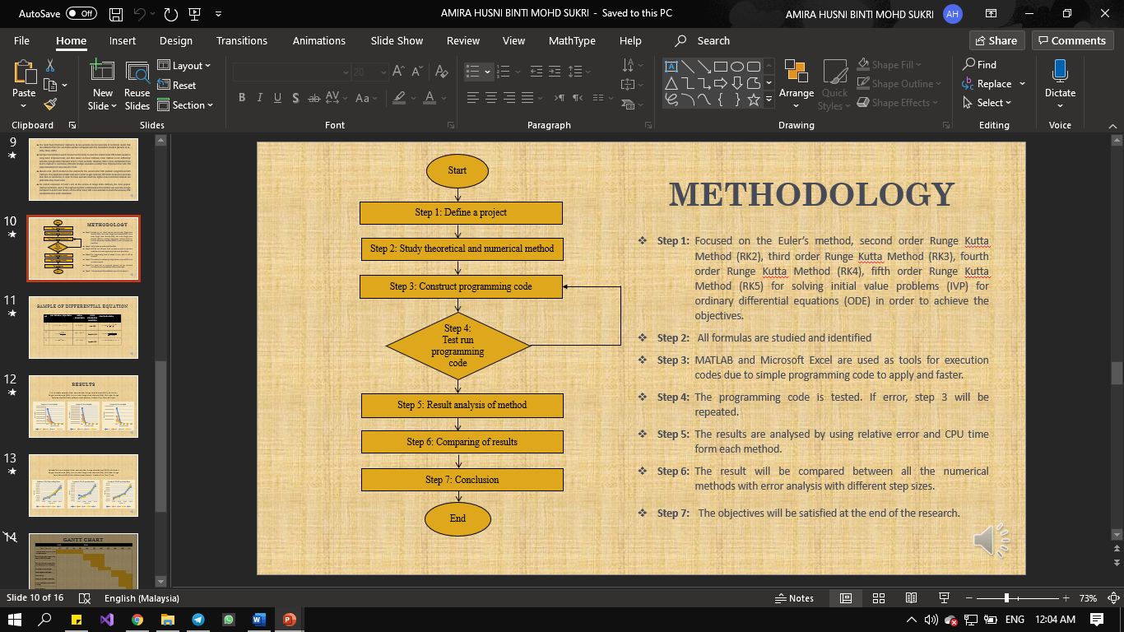
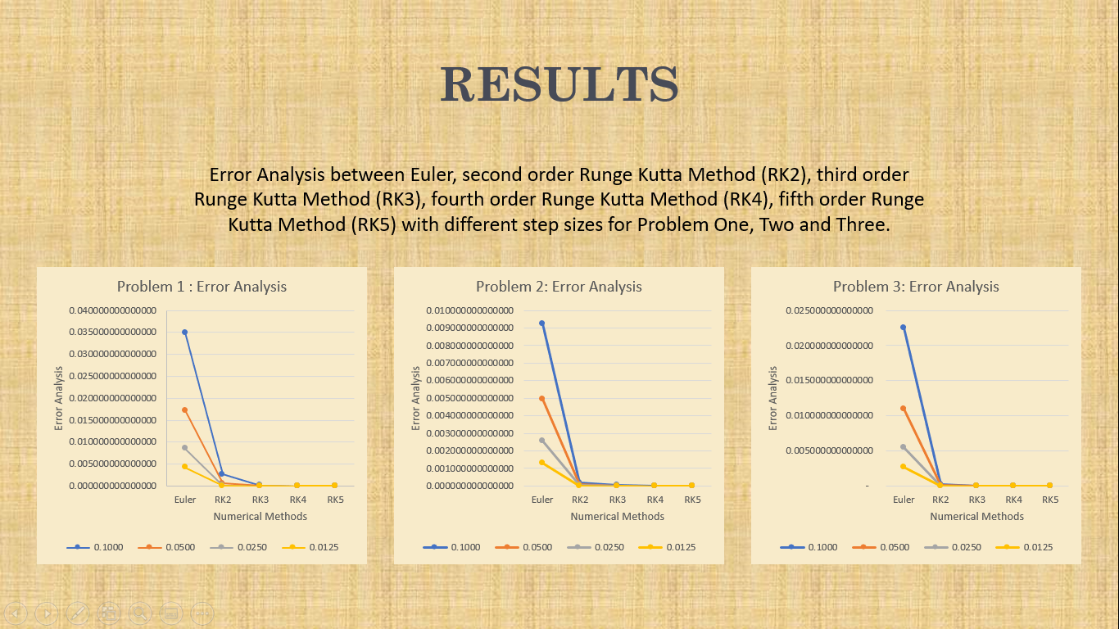
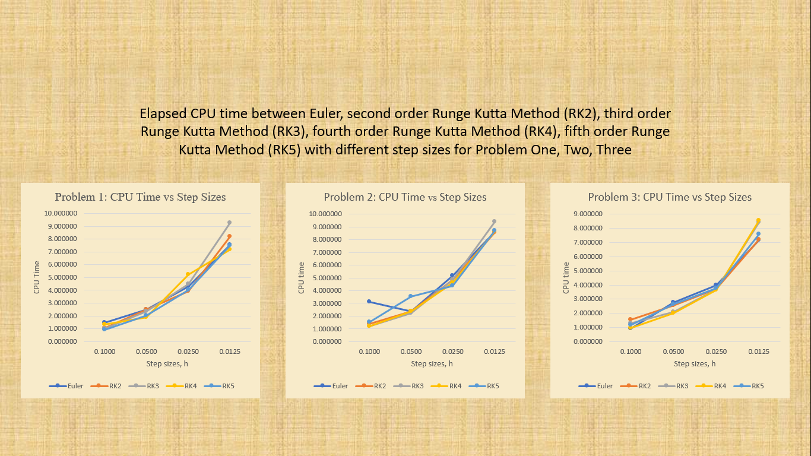

A COMPARATIVE STUDY ON NUMERICAL SOLUTIONS OF INITIAL VALUE PROBLEM (IVP)
FOR ORDINARY DIFFERENTIAL EQUATIONS (ODE) WITH EULER AND VARIOUS ORDERS OF RUNGE KUTTA METHODS
AMIRA HUSNI BINTI MOHD SUKRI
UNIVERSITI TEKNOLOGI MARA (UiTM)
ABSTRACT
This project mainly presents Euler method, second order Runge Kutta Method (RK2), third order Runge Kutta Method (RK3), fourth order Runge Kutta Method (RK4), fifth order Runge Kutta Method (RK5) for solving initial value problems (IVP) for ordinary differential equations (ODE). The proposed methods are precise efficient and practically well suited for solving these problems. In order to verify the accuracy, compared numerical solutions with the error analysis. The numerical solutions are in good condition with the exact solutions. Comparison between CPU time and step sizes has been presented. The step size needs to be very small in order to achieve higher accuracy in the solution. From this comparison, the best that can identify is Fifth Order of Runge Kutta method than other method. Finally, to investigate the best numerical for solving ODE problem.
PROBLEM STATEMENT
OBJECTIVE
Higher order ODE problem is difficult to solve because it required further calculation and complexity to develop a proper program. Some problems in ODEs are too complicated and difficult to solve and numerical methods or (approximate) is preferable as an alternative method to solve ODE. Numerical solutions that attempted by some researchers to solve initial value problems (IVP) to obtain high accuracy rapidly by using numerous methods, such as Euler’s method, Runge Kutta method, and some other methods. However, the proposed method required further calculation due to its higher evaluation function per-step. This made researchers difficult to choose which the best method on its less computation time or its accuracy.
To solve initial value problem (IVP) for ordinary differential equations (ODE) by using Euler’s and various versions of Runge Kutta methods.
To compare the numerical solutions with error analysis and CPU Time with different step sizes between Euler’s and various versions of Runge Kutta methods.
To investigate the best numerical methods between Euler’s and various version of Runge Kutta methods for solving ODE problem.
METHODOLOGY
FINDINGS & RESULT
FINDINGS & RESULT
BENEFITS
BENEFITS
COMMERCIALIZATIO
CONCLUSION
BENEFITS
This project compares the numerical method of Euler and various version of Runge Kutta method to solve initial value problem (IVP) for ordinary differential equations (ODE). The best method will be determined by their performance. Through this experiment, it can be decided which method is better for future research. Based on the result, it helps to gives a conclusion which method is good to apply in the other area of research. It also useful for the researcher since the solution used less computation time where the result can be obtained immediately.
This study is mainly focused to compare the error analysis and step sizes for accuracy verification, compare the performance and computational effort between Euler method and Runge Kutta version methods in term of CPU time and accuracy. Some ODE problems have been solved using the theoretical method. These theoretical methods have different type of ODE problem such as linear, separable and Bernoulli’s. These types of ODE are combination of polynomial, trigonometric and exponential function. All these had been solved successfully. On programming code, Euler’s and various version of Runge Kutta methods is coded using MATLAB software. The programming code is used to find the solution for all the ODE problem numerically. All the numerical result based on the approximate solution, exact solution, error analysis and CPU time were recorded. All the result of Euler’s method, second order Runge Kutta Method (RK2), third order Runge Kutta Method (RK3), fourth order Runge Kutta Method (RK4) and fifth order Runge Kutta Method (RK5) numerical method has been analysed based on its accuracy compared in the theoretical method in term of relative error. The recorded CPU time is also analysed to determine the fastest method to obtain the approximate solution. Analysis based on error and CPU time has been successfully plotted.Based on analysis, it showed that the best method in term of accuracy is fifth order of Runge Kutta method with step size 0.0125. For fastest CPU time is step size 0.1. As for the conclusion, all the objective has been successfully fulfilled.

